Slide 1
Accessibility2030
Inclusive Cities
– How does your city impact your daily life?

Slide 2
Accessibility2030
is a consortium led by the Global Disability Innovation Hub with partners the UK AID funded AT2030 programme, the Global Disability Fund, UNHabitat and World Blind Union with the shared goal of making inclusive cities that are welcoming and accessible for everyone.

Slide 3
The Global Disability Innovation Hub
(GDIHub) is a legacy organization that accelerates ideas into impact for a more just world
- for disabled people, for all people.

Slide 5
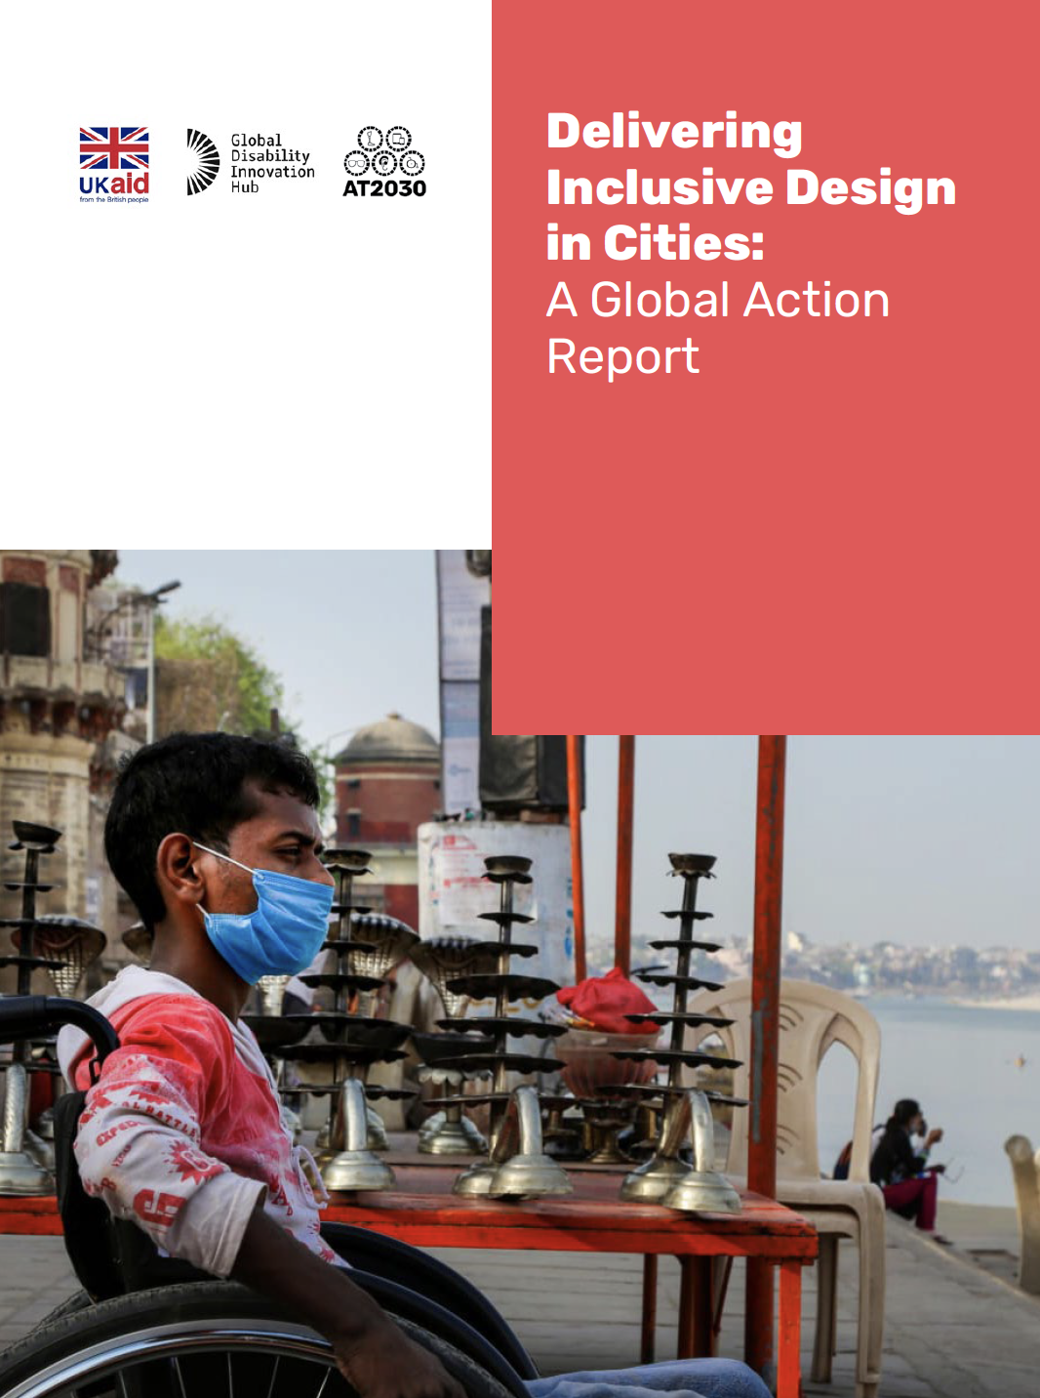
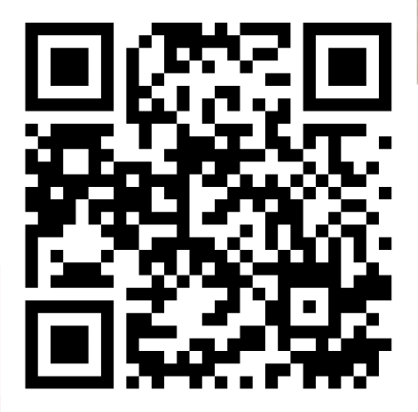
Check out our
Global Action Report
And let’s make your city more inclusive!

Slide 6
Global Disability Fund is a unique partnership that brings together UN entities, governments, OPDs and broader civil society to advance the rights of persons with disabilities around the world.

Slide 7
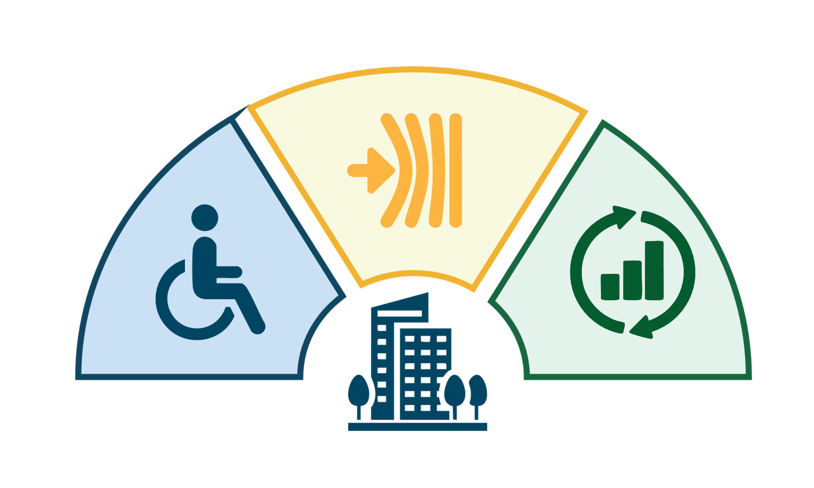
Resilient And Inclusive Cities Hub (RICH)
The Global Disability Fund has been selected to host this transformative initiative, seed-funded by the German Government to drive resilient and inclusive urban development through stakeholder engagement, collaborative learning, and innovative solutions.
Resilience
Accessibility
Sustainability
Together, we can create urban spaces where no one is left behind!

Slide 8
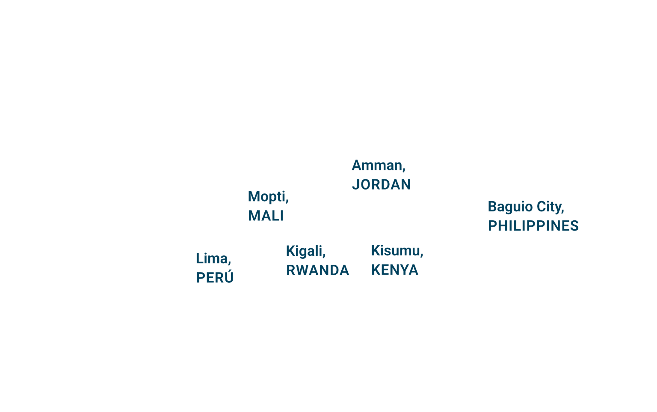
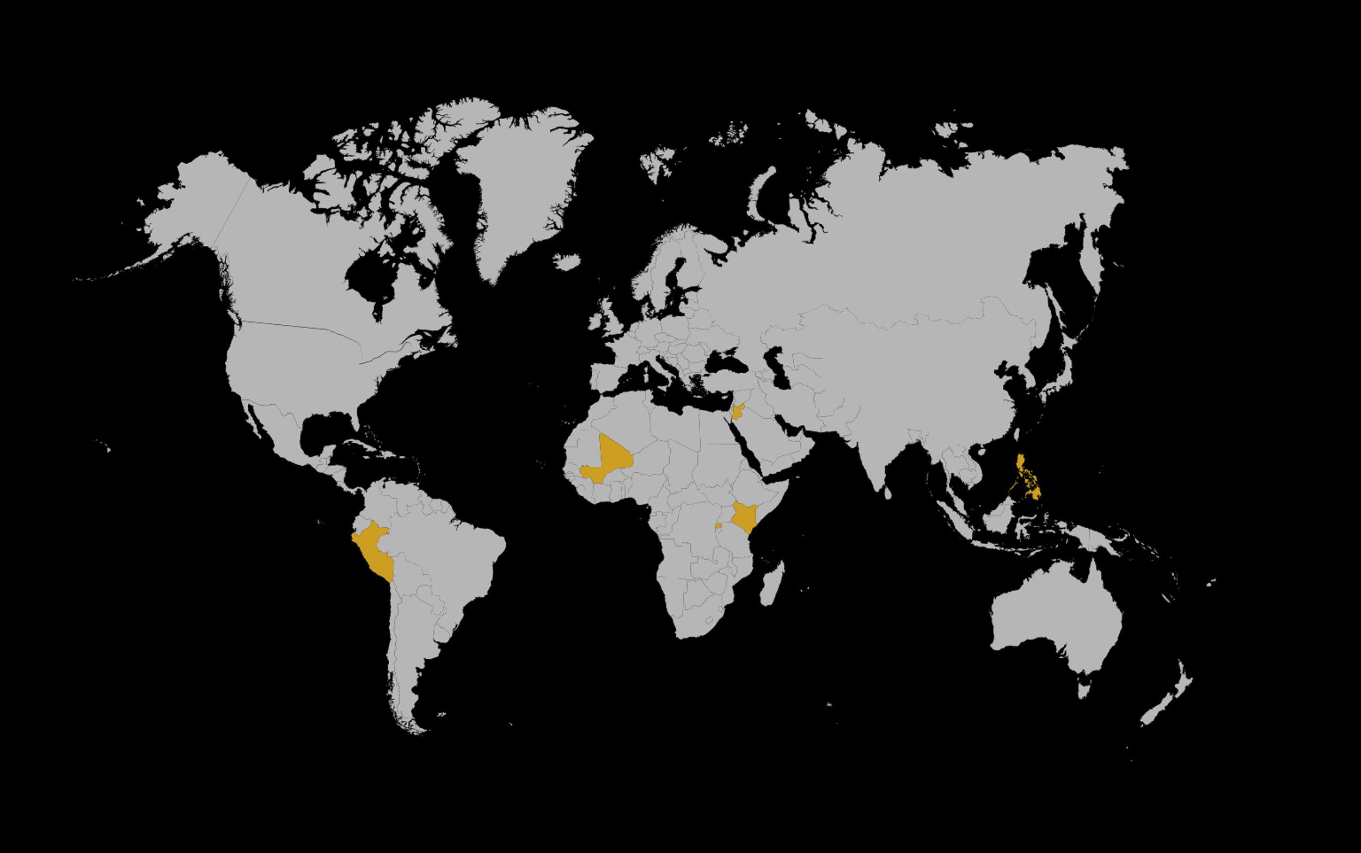
Resilient And Inclusive Cities Hub (RICH)
We are launching six pilot projects to test innovative approaches, build a global knowledge-sharing platform, and provide technical support and capacity-building resources to local governments and Organizations of Persons with Disabilities.
Together, we can create urban spaces where no one is left behind!

Slide 9
The World Blind Union (WBU) is a global organization bringing together international organizations of and for blind persons and those organizations providing services to people with low vision to work on the issues affecting the quality of their life.

Slide 10
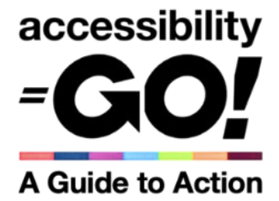
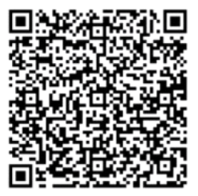
Accessibility GO! A Guide to Action is a guide to provide practical support on how to deliver a whole-of-organization approach towards accessibility. It describes how to progressively achieve 7 core accessibility commitments across built environments, information and communications, procurement of goods and services, training and capacity development, programmes, meetings and events, recruitment and human resource (HR) management.

Slide 11
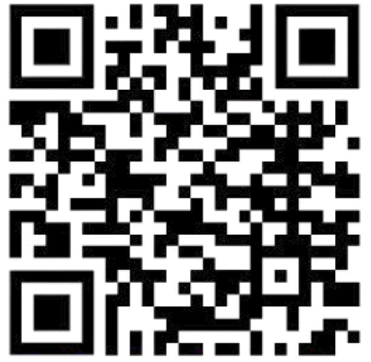
Global Voice Podcast
New Podcast Launching April 1st !
First Mini-Series:
Unpacking Accessibility Go!
Learn more about this essential WBU and CBM Global resource through a compelling audio series that breaks down the key commitments and ideas behind Accessibility Go!
New episodes released every two weeks
Follow us on your favourite podcast platform!

Slide 12
UNHabitat (United Nations Human Settlements Programme) is the United Nations entity responsible for developing urban policies and translating them into action to create sustainable cities and communities.

Slide 13
Accessibility2030
For more information, visit

