Slide 1
2030
Accessibility
This programming is brought to you by a collaboration of dedicated partners, listed below, who are passionate about driving disability inclusion and accessibility for a fairer world.
Accessibility
Starts
Together..
PERSONS WITH DISABILITIES AND OLDER PERSONS CONSTITUENCY GROUP

Slide 2
2030
Accessibility
Partner Profile
The WBU is a non-political, non-religious, non-governmental and non-profit-making organization. WBU members are organizations of and for the blind in about 190 countries and international organizations working in the field of vision impairment. The WBU conducts its work through six regions. These are: Africa, Asia, Asia-Pacific, Europe, Latin America, and North America and the Caribbean. The World Blind Union is governed by an Officers Board composed of six internationally elected Officers and the six regional presidents, as well as an executive committee. The WBU has its administrative office located in Toronto, Canada, and currently has three staff members. In order to raise funds for their work, the World Blind Union has registered as a charity under the Canada Revenue Agency.

Slide 3
CLOSING THE
ACCESSIBILITY GAP.
A Report from the World Blind Union
#Accessibility2030

Slide 4
The World Blind Union
is
the leading global voice
for
persons who are blind or partially sighted
253 million persons worldwide
over 250 organisations in more than 190 countries
#Accessibility2030

Slide 5
The Global State of Accessibility: a crisis on the horizon
It is not only relevant but also extremely urgent. I need that to be done today. African governments and local municipalities have never thought about the accessibility of cities for blind people. People have become accustomed to assisting blind people, but they do not consider our right to live independently and be included in the community. Transport is not affordable; streets are not accessible. From home to work, I face daily challenges. If I am not with a visual guide, I cannot live independently.
Abraham Mateta, AFUB.
#Accessibility2030

Slide 6
The Global State of Accessibility: a crisis on the horizon
2020
Today, more than half of all persons with disabilities and older persons live in cities with:
• Inaccessible transportation and public spaces
• Inaccessible digital infrastructure
• A lack of access to adequate housing, employment, health and education (UNDESA-2019)
2050
• 70% of the world’s population will live in cities while 60% of urban settlements remain to be built (UN Habitat)
• Over 2 billion persons with disabilities and older persons will be living in urban communities by 2050 (UCLG)

Slide 7
The Global State of Accessibility: a crisis on the horizon
It is more difficult to get on or off a taxi, and sometimes to pay for the journey if the terminal used is not accessible and the driver does not agree to help us. Danger of catching the virus in public transport. Difficulty respecting the rule of physical distance in public transport. To walk, difficulties caused by new types of urban space development that are developing rapidly in cities. Difficulty obtaining help to cross a more dangerous intersection because the other pedestrians do not wish to guide us.
Anonymous testimony, WBU Covid-19 Survey.

Slide 8
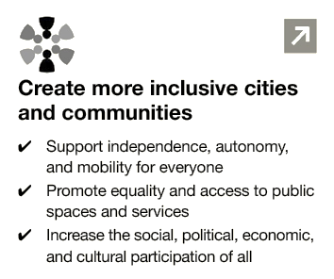
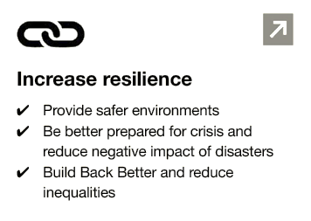
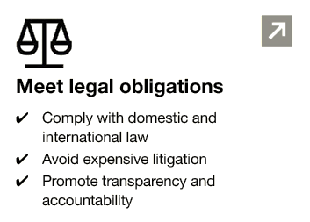
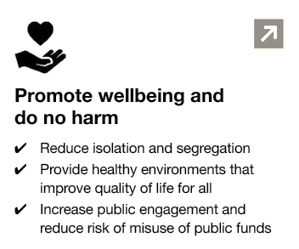
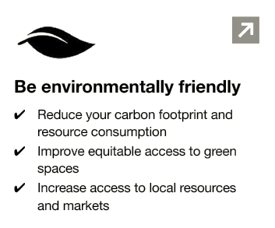
Why accessibility is so critical?

Slide 9
Our work to close the accessibility gap
Partnering for change
Amplifying voices
Tools for action

Slide 10
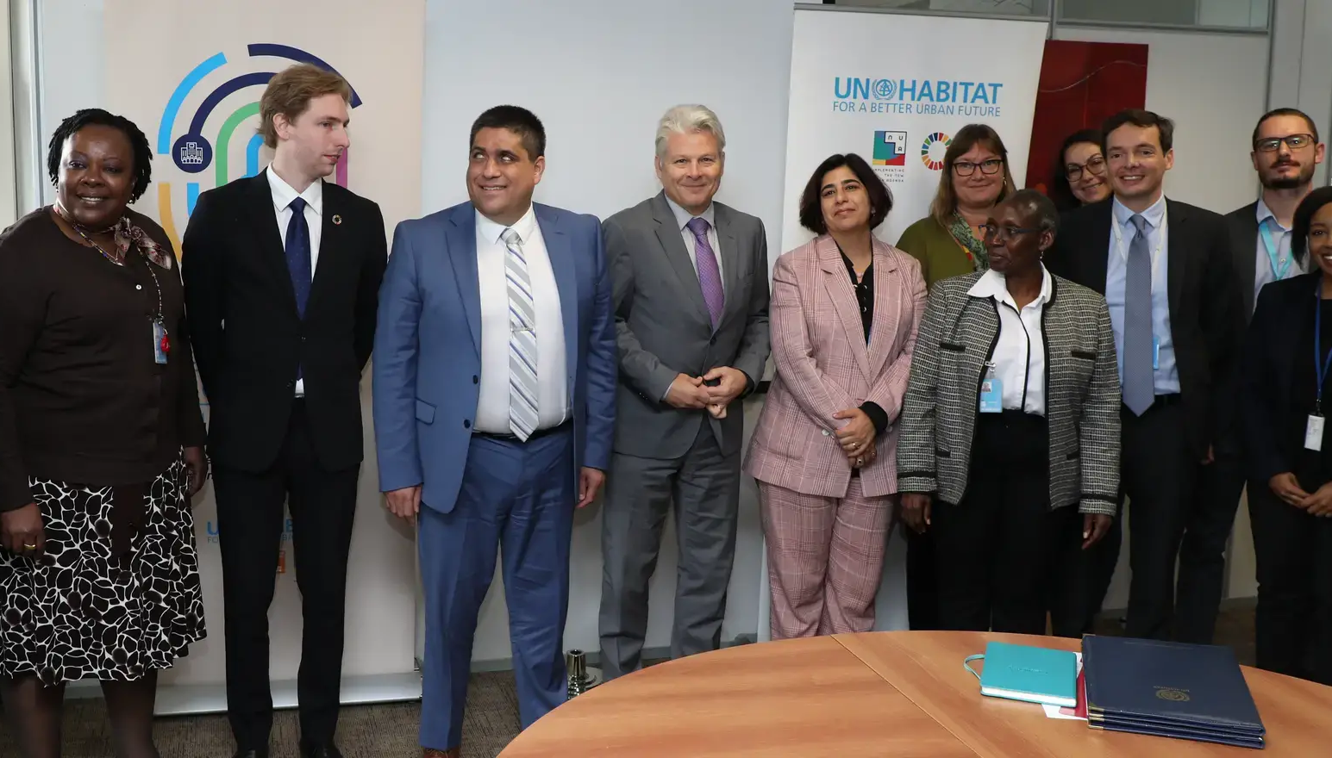
World Blind Union signed a milestone agreements with UN Habitat and United Cities and Local Governments to work together to make cities accessible for all

Slide 11
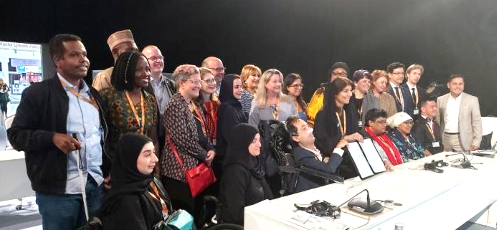
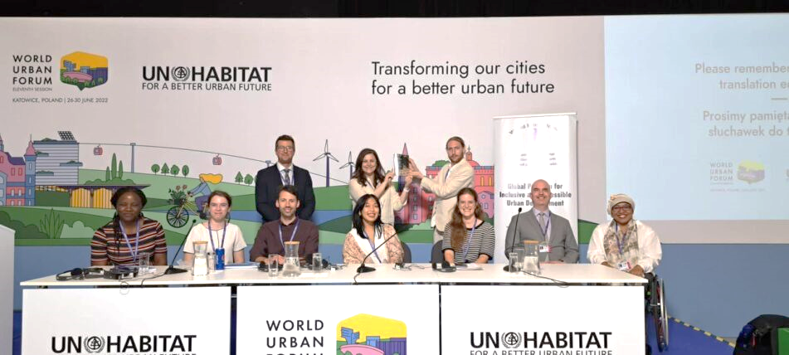
World Blind Union co-led global advocacy efforts to influence decisions and transform cities for a better urban future.
#WUF10 #WUF11
#Cities4All

Slide 12
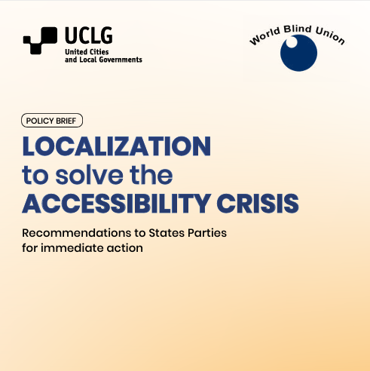
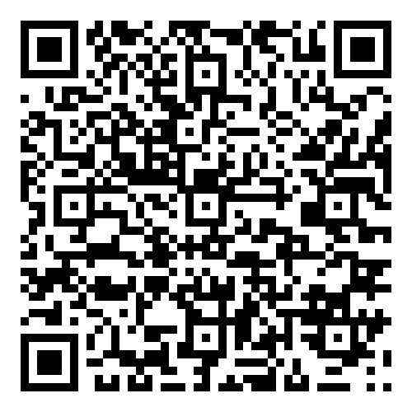
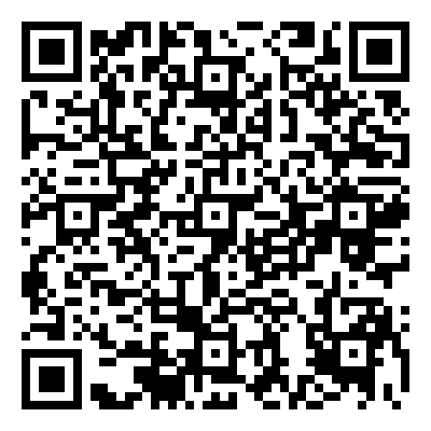
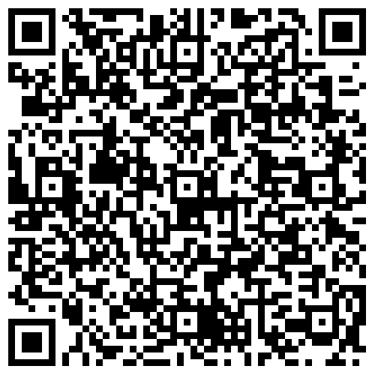
WBU and UCLG developed the ‘Policy Brief on Localization to Solve the Accessibility Crisis: Recommendations to States Parties for Immediate Action’
WBU worked with UCLG to successfully launch a Global Survey on Accessibility and Engagement of Persons with Disabilities which is a tool to map how local and regional governments are addressing accessibility and engaging with persons with disabilities.
English
Français
Español

Slide 13
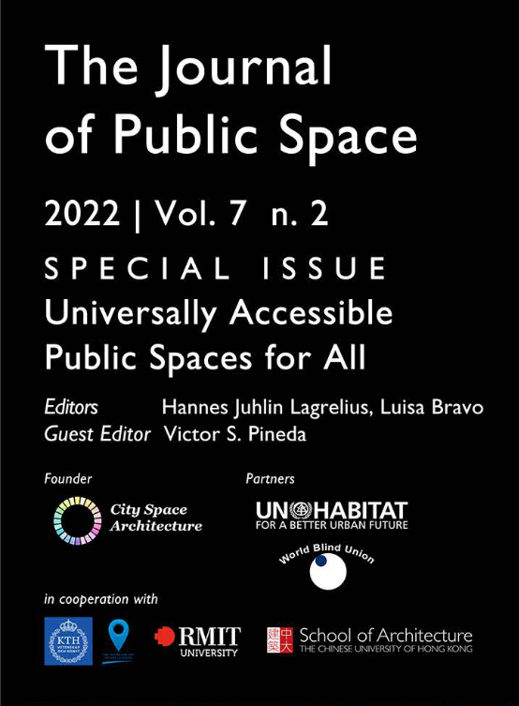
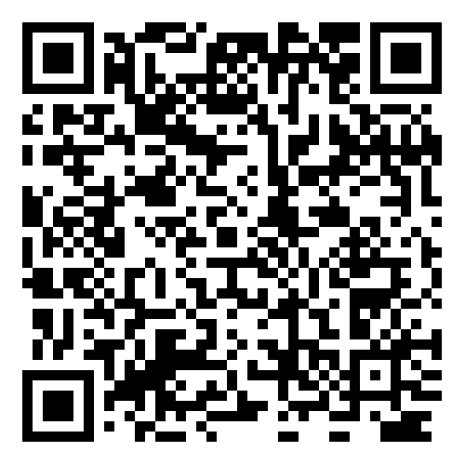
WBU & City Space Architecture co-developed a special issue of The Journal of Public Space on
Universally Public Spaces for All.
The publication, launched at WUF 11, has reached 16 900 readers. It includes 8 academic articles, 7 non-academic articles and case studies, and 2 viewpoints from various cities, universities, organisations, and experts, showcasing methods and learnings from implementing accessibility.
Scan to read

Slide 14
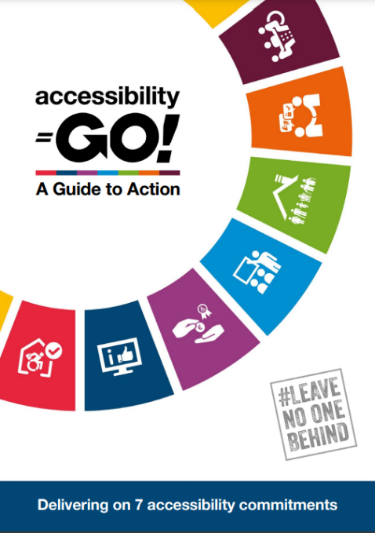
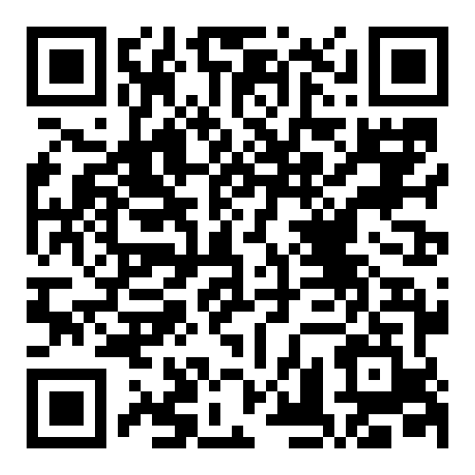
Accessibility GO! A Guide to Action is a flagship resource co-developed by WBU and CBM Global.
It serves as a comprehensive guide for implementing a whole-of-organisation approach to accessibility and inclusion, aligning with CRPD principles and the core commitment of leaving no one behind

Slide 15
Given the context of urbanisation, engaging with an OPD is key to UN-Habitat and the partnership with WBU makes us walk the talk and being intentional about the engagement. Angela Mwai, UN-Habitat.
New Urban Agenda
This has led to a lasting change for our policy priorities, with the understanding of the importance of accessibility as a critical pillar to truly build cities and territories for all. This progress would not have been possible without the engagement of the WBU. Federico Batista Poitier, UCLG.
Global Agendas
CRPD
The intersection of ageing and disability and urbanisation is absolutely critical and relevant and there was no connection before we entered in partnership. Without this collaboration, we would have been living in siloes. Ageing would not be on the agenda without the support from WBU. Katherine Kline, Co-Chair Older Persons, Partner Constituency Group, General Assembly of Partners.
Notes:
Our work has significantly increased global commitments towards inclusion and accessibility. We’ve strengthened WBU’s leadership in urban development by working together with cities, UN agencies, and key stakeholders to prioritize accessibility. This effort has helped advance our mission on a global scale.
We've made history by becoming the first global OPD to partner with UN-Habitat and UCLG, giving us the opportunity to engage over 240,000 local and regional governments. This partnership allows us to put disability inclusion at the forefront of urban development.
WBU has also been leading Disability Caucuses at the World Urban Forums. We signed the Global Compact on Inclusive Cities, a major milestone in advocating for universal accessibility. Our influence even extended to shaping UN-Habitat resolutions that emphasize the importance of accessibility in urban planning.
We’ve earned influential roles in advisory bodies such as UN-Habitat’s Stakeholder Advisory Group Enterprise (SAGE), and we co-chair key disability advocacy groups. Through these roles, we’ve directly influenced global urban policies and ensured that the needs of persons with disabilities are addressed.
Another highlight is the co-development of Accessibility GO! with CBM Global, a valuable resource supporting UN agencies and other partners in crafting accessibility policies and strategies. Additionally, we published a special issue on universal public spaces focusing on important issues raised by WBU community, reaching over 16,900 readers worldwide. This is part of our broader mission to ensure that knowledge on accessibility reaches as many stakeholders as possible

Slide 16
Be Part of the Solution.
Access
our full report
Learn from our work
worldblindunion.org

Slide 17
2030
Accessibility
Partner Profile
Tell us about your organization here. Who you are? what is your main focus of work? When did you start? Where can we find you in person and online? Any social media handles?

Slide 18
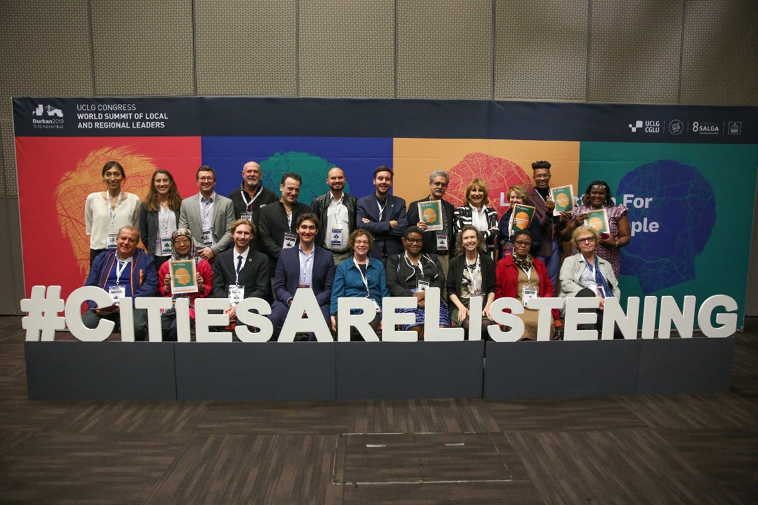
Cities & Territories for All
United Cities and Local Governments Community of Practice on Inclusive & Accessible Cities

Slide 19
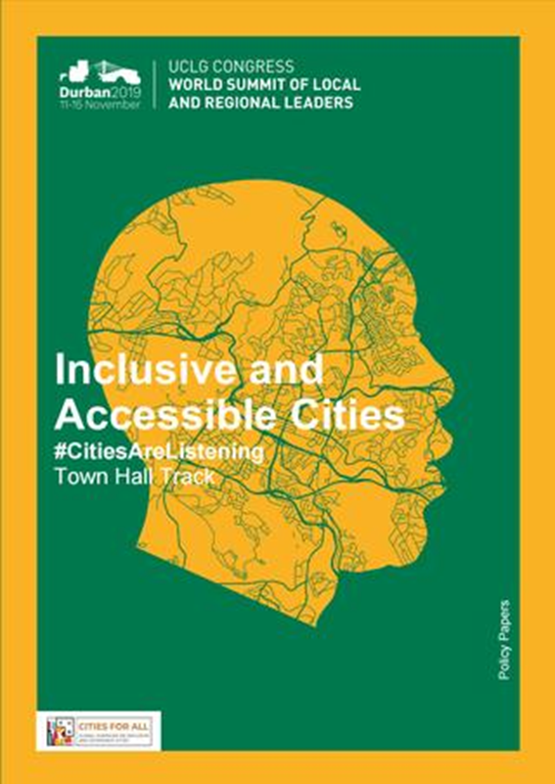
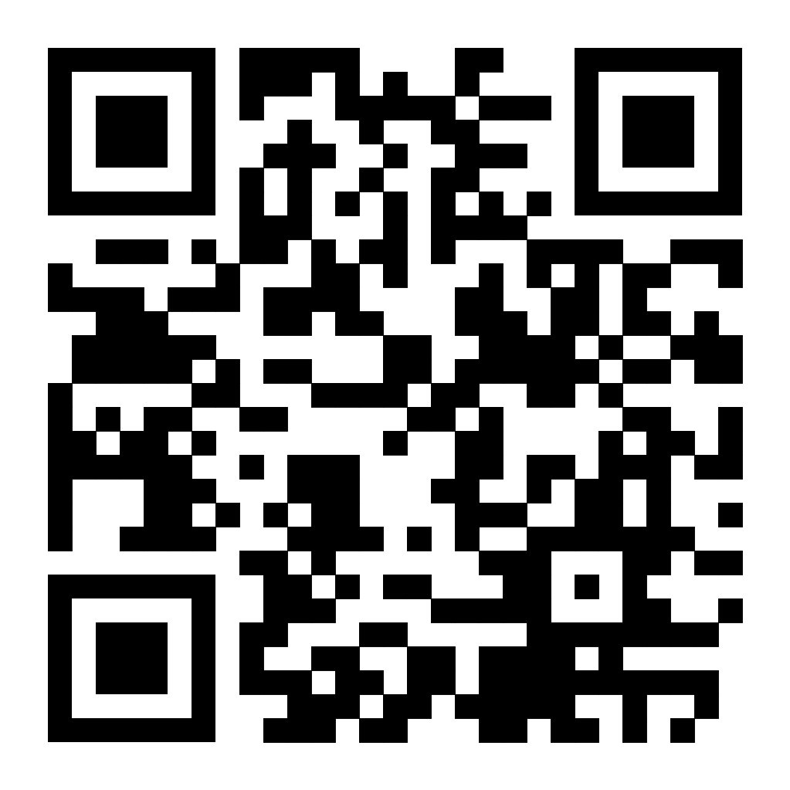
How UCLG work on Accessibility started
Policy Paper
Policy priorities on on Accessibility developed from our strategic partners representing civil society organizations, organizations of persons with disabilities and older persons
Key recommendations for Local and Regional Governments
Adopting explicit commitment to universal design & accessibility through localization
Engage in multi-stakeholder partnerships with persons with disabilities and older persons
Establish of a Community of Practice on Accessible Cities for peer-learning on universal design policies.

Slide 20
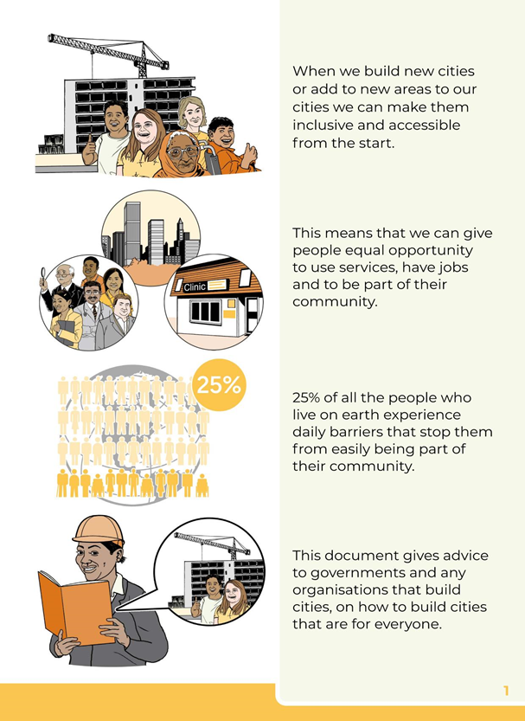
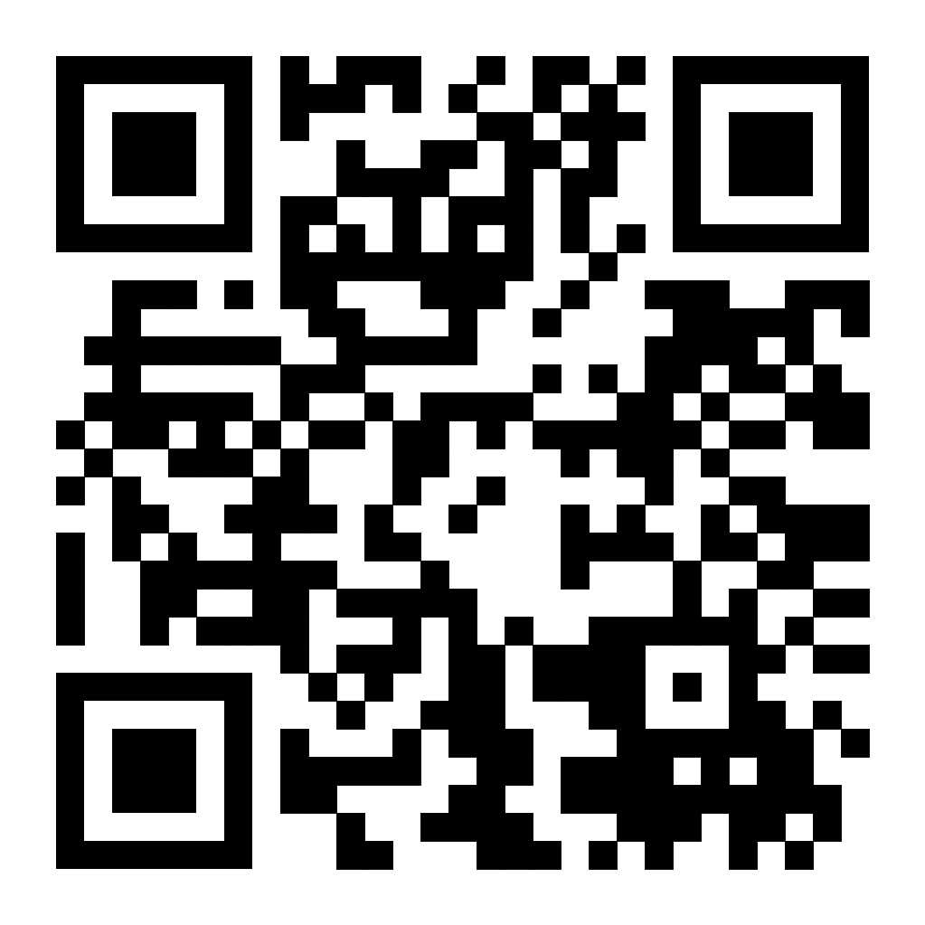
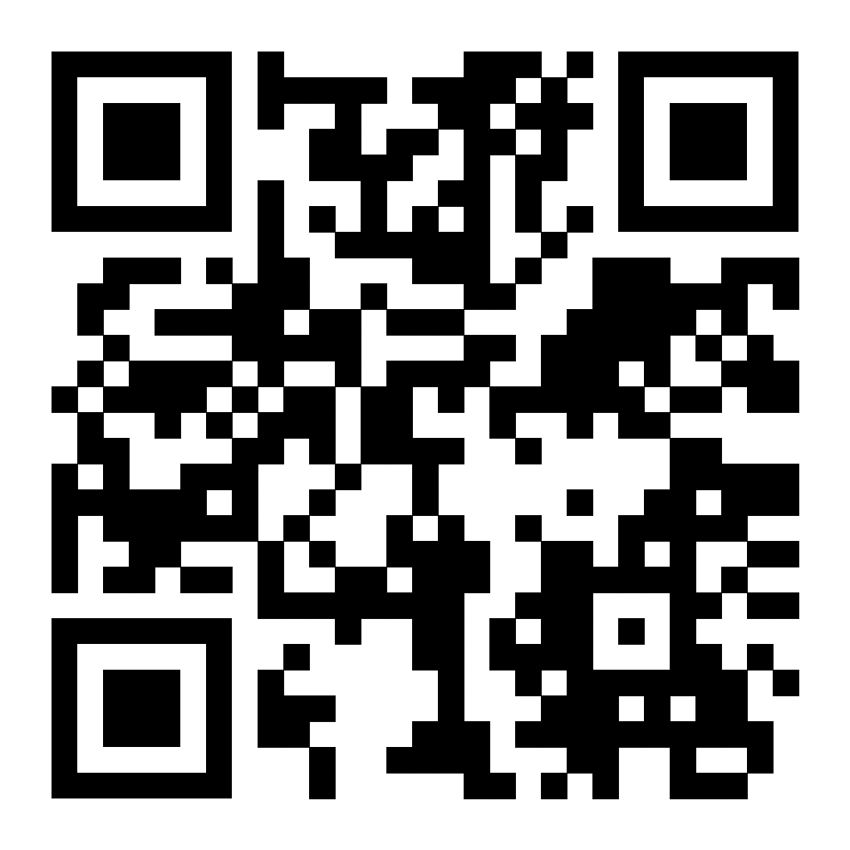
Policy Priorities in Accessible Formats
•Audio formats available in English, Spanish and French
•Easy to Read format available in English

Slide 21
Our core values on the localization of accessibility connected to the Cities4All
Global Compact
Aligning Global Commitments
At the core of the Cities4All Campaign lies:
The Global Compact on
Inclusive and Accessible Cities
A declaration that aligns key commitments to accessibility, universal design and inclusion within International frameworks and conventions
UN Sustainable Development Goals
WHO Age Friendly Cities
UN New Urban Agenda
UN Convention on the Rights of Persons with Disabilities

Slide 22
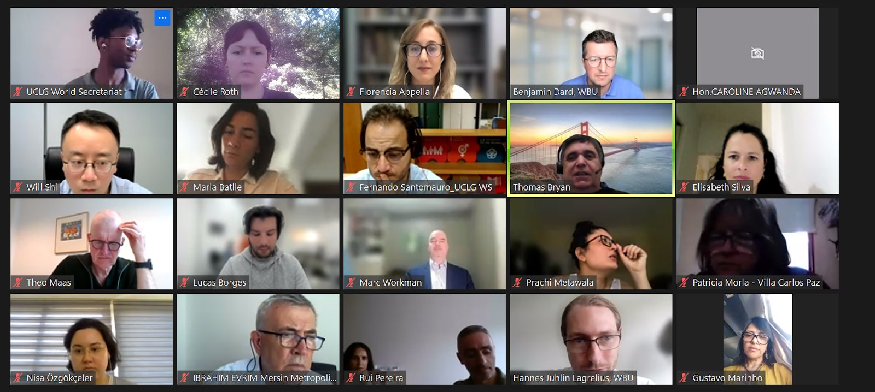
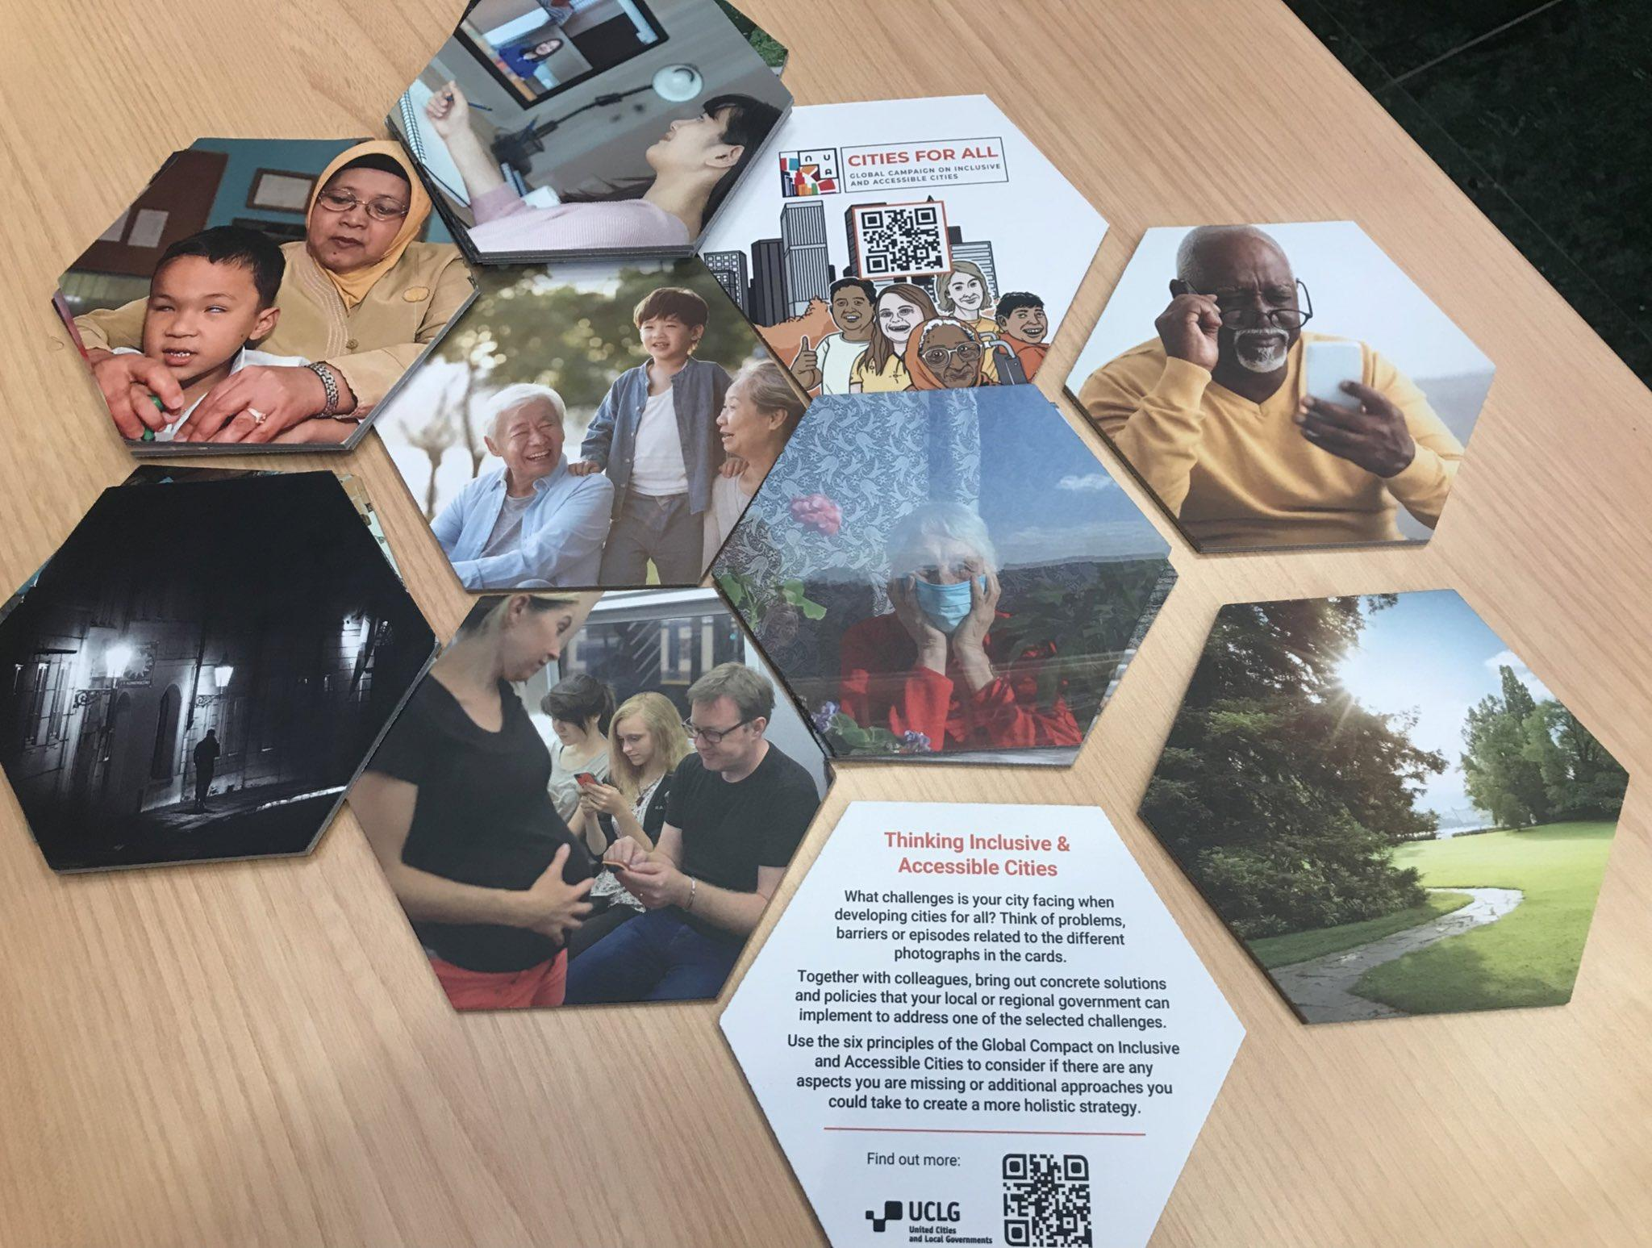
Strengthening Localization of Convention on the Rights of Persons with Disabilities (CRPD)
Through Peer to Peer Exchanges & Training with Local Governments

Slide 23
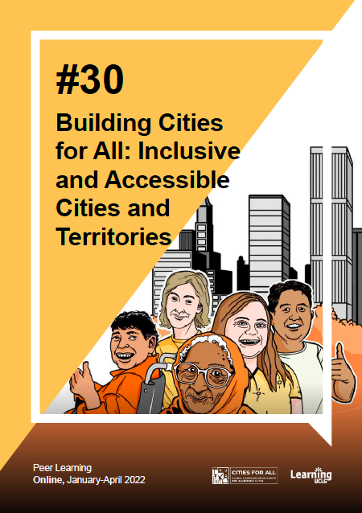
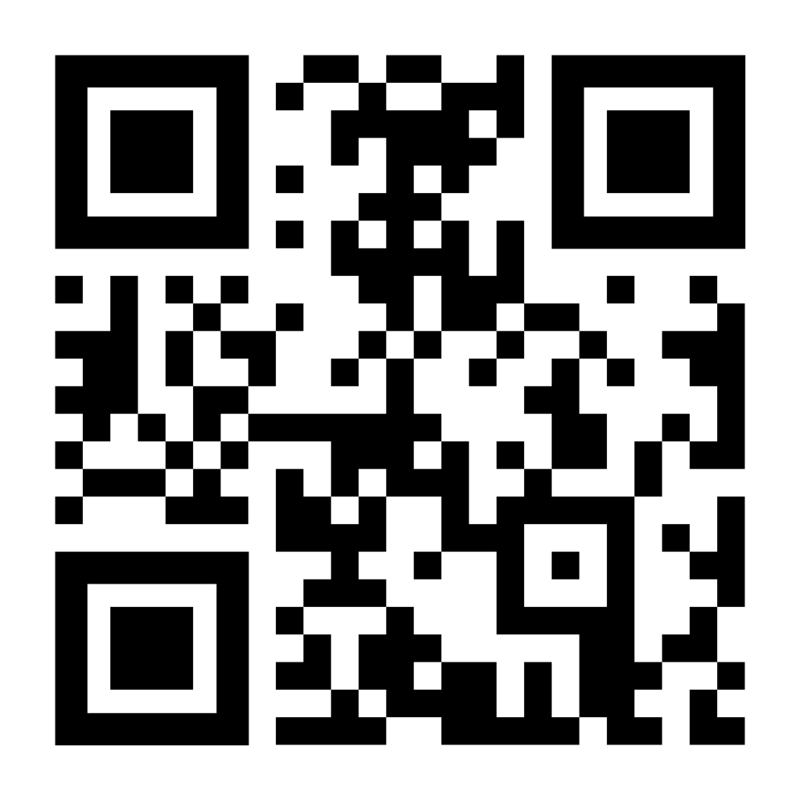
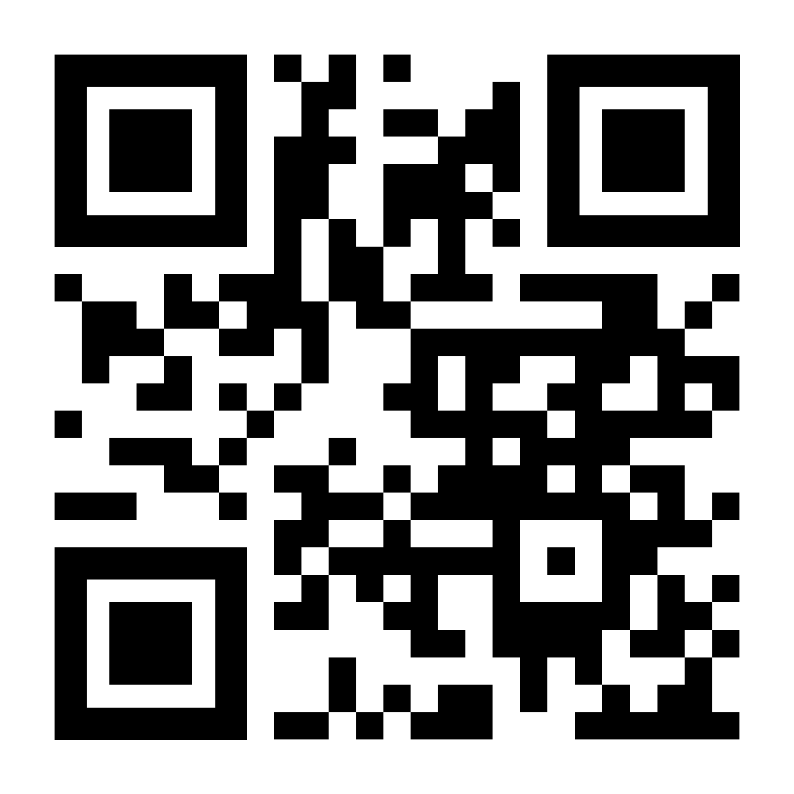
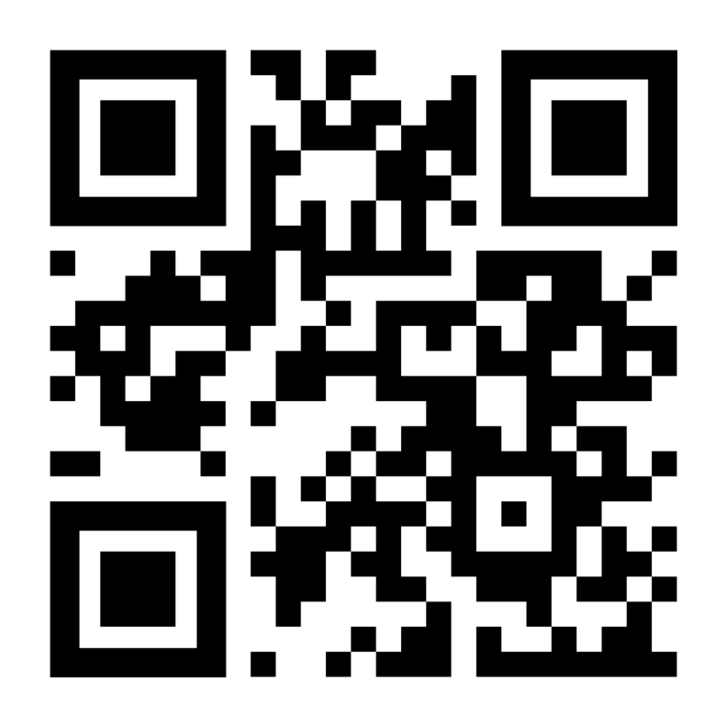
Strengthening Localization of the CRPD (continued)
2. Evidence Based Research

Slide 24
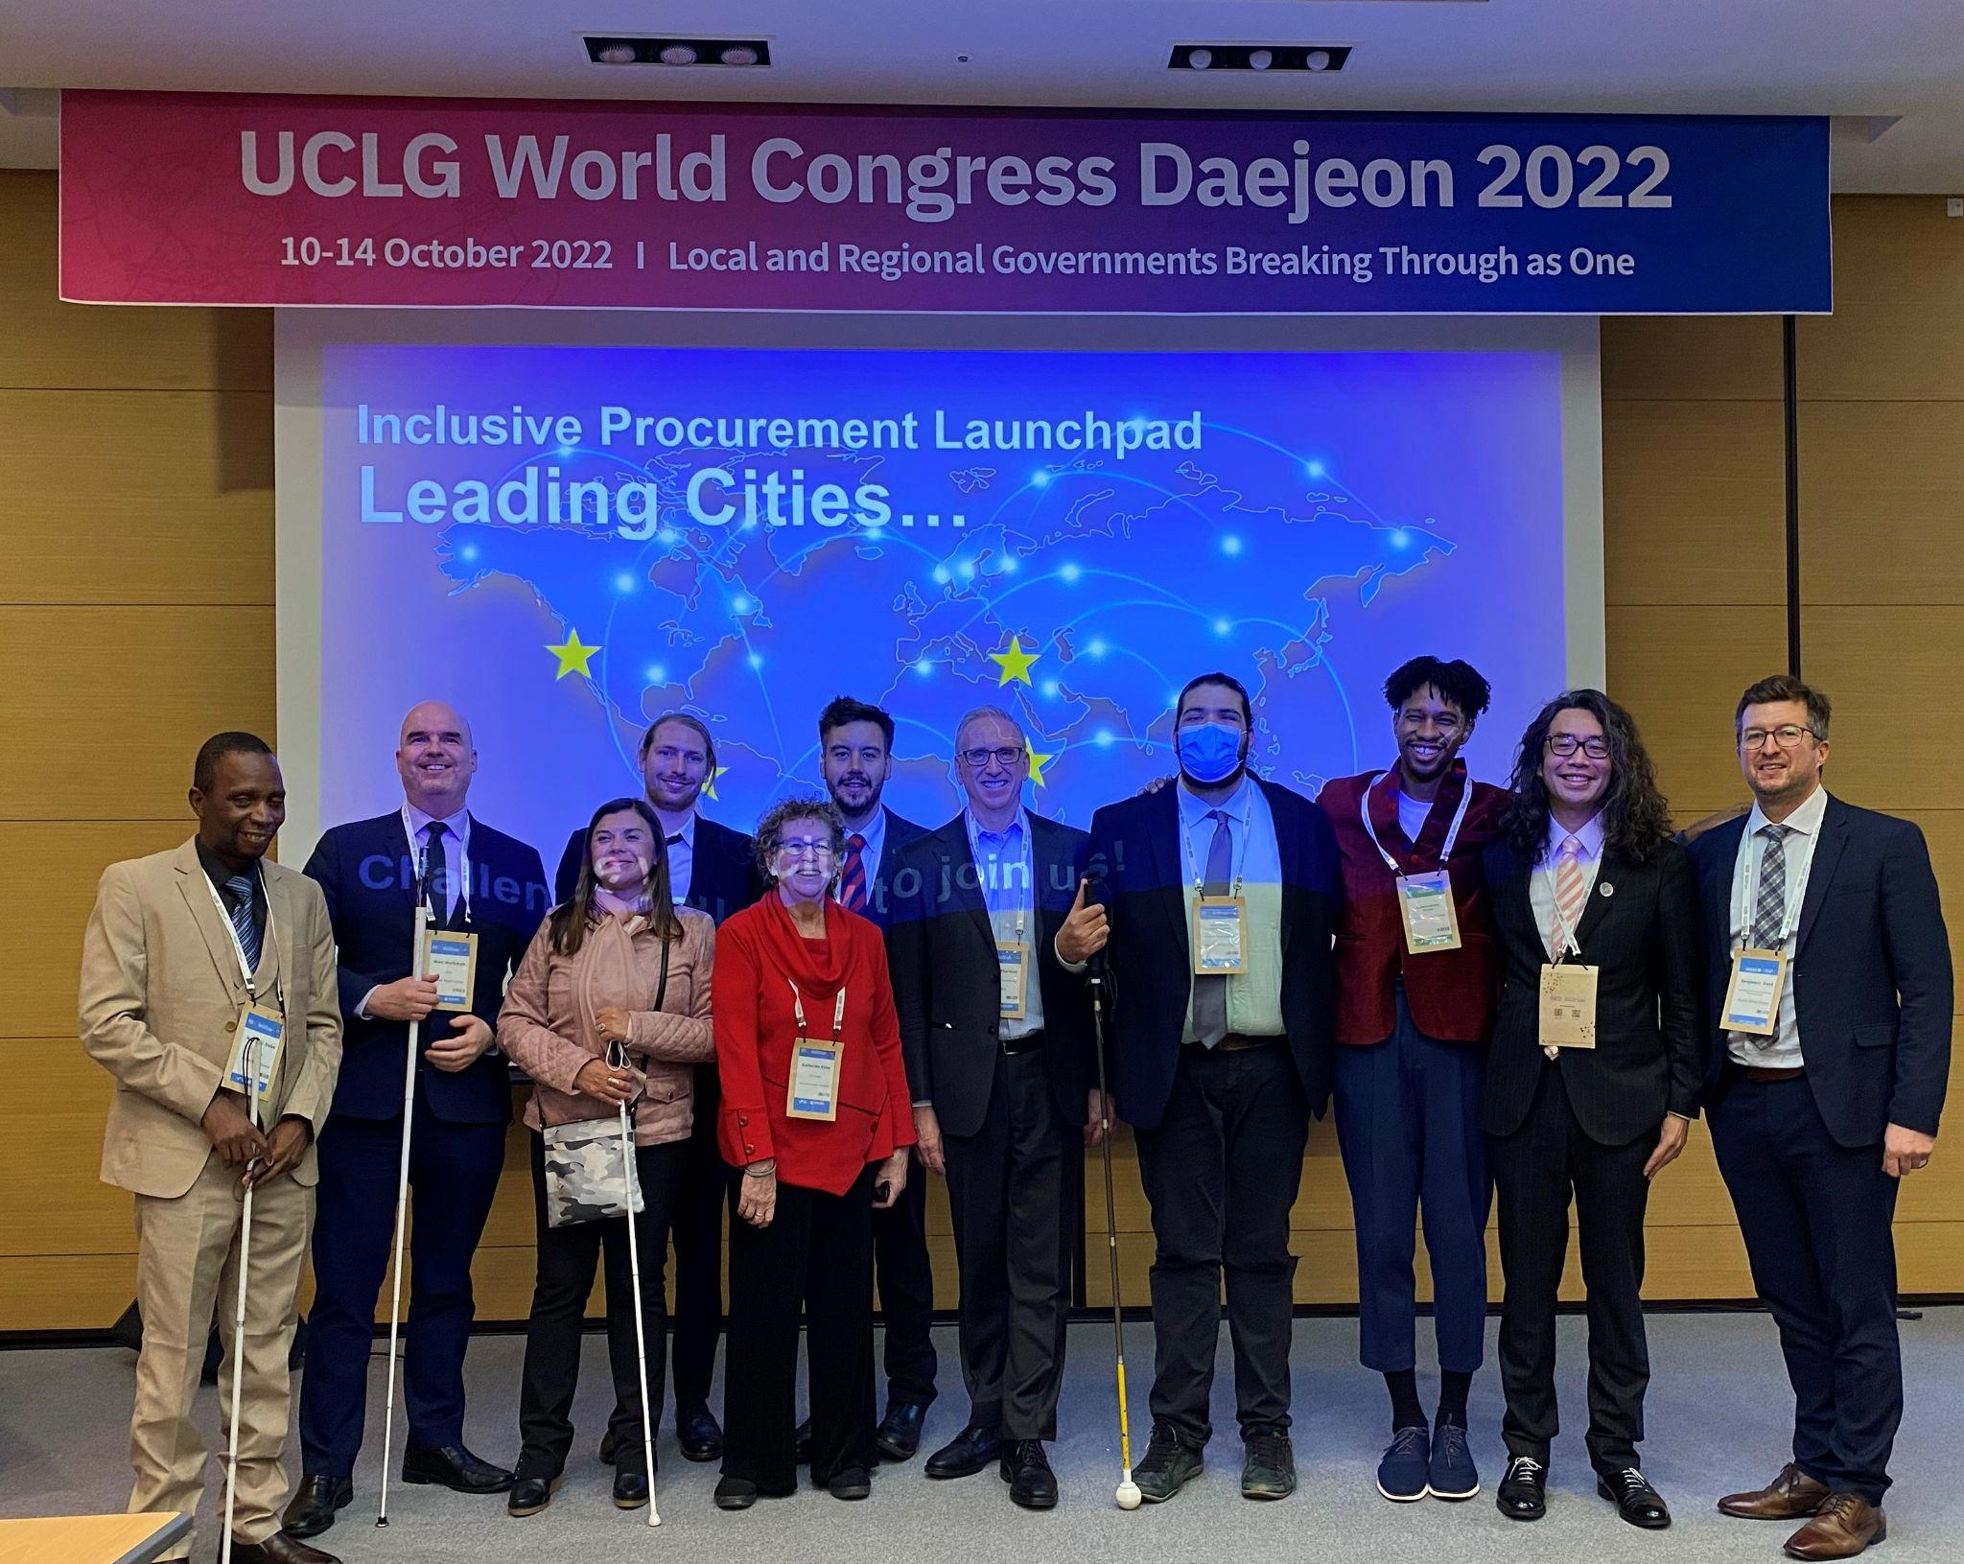
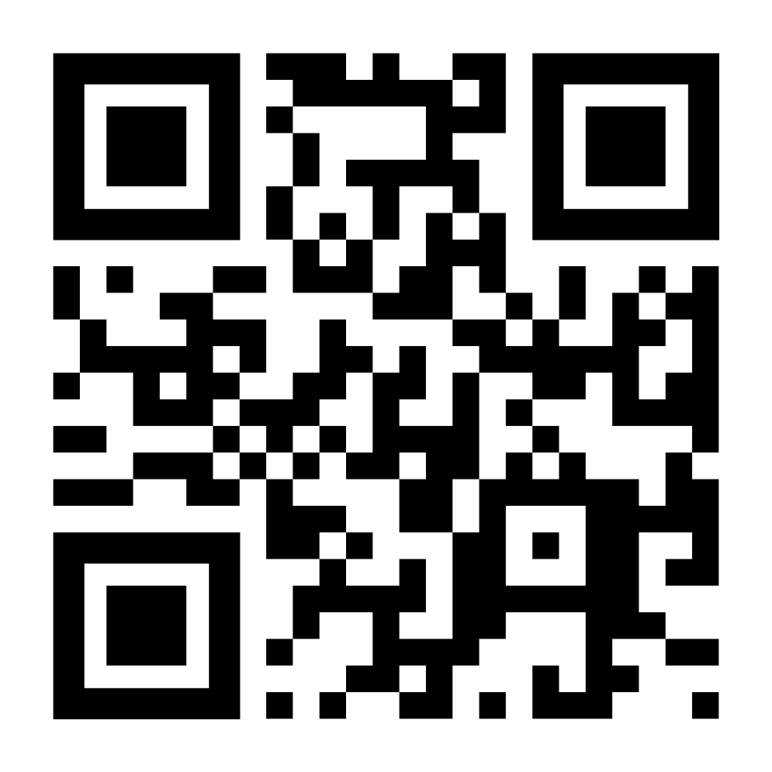
Strengthening Localization of the CRPD (continued)
3. Pilot projects

Slide 25
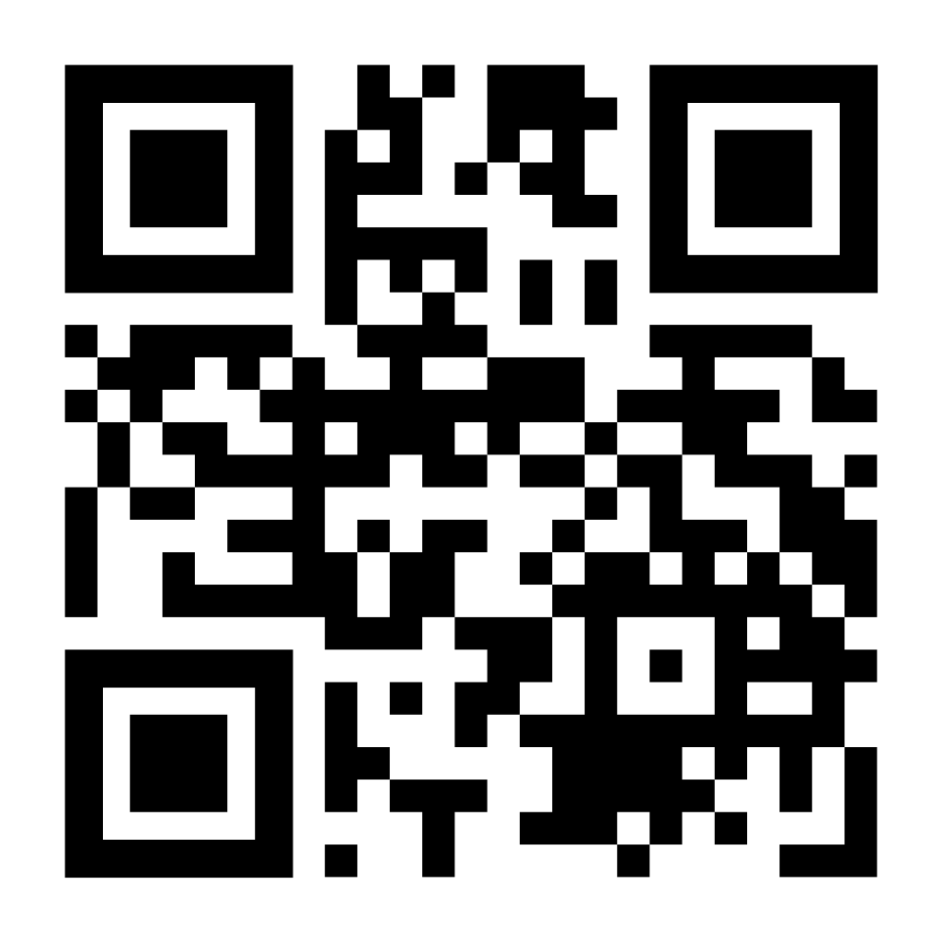
Strengthening Localization of the CRPD (continued)
4. Data collection
First results of Survey to be shared on at the WUF “Localisation to Close the Accessibility Gap Event” on November 6th 13:00-14:00h!

Slide 26
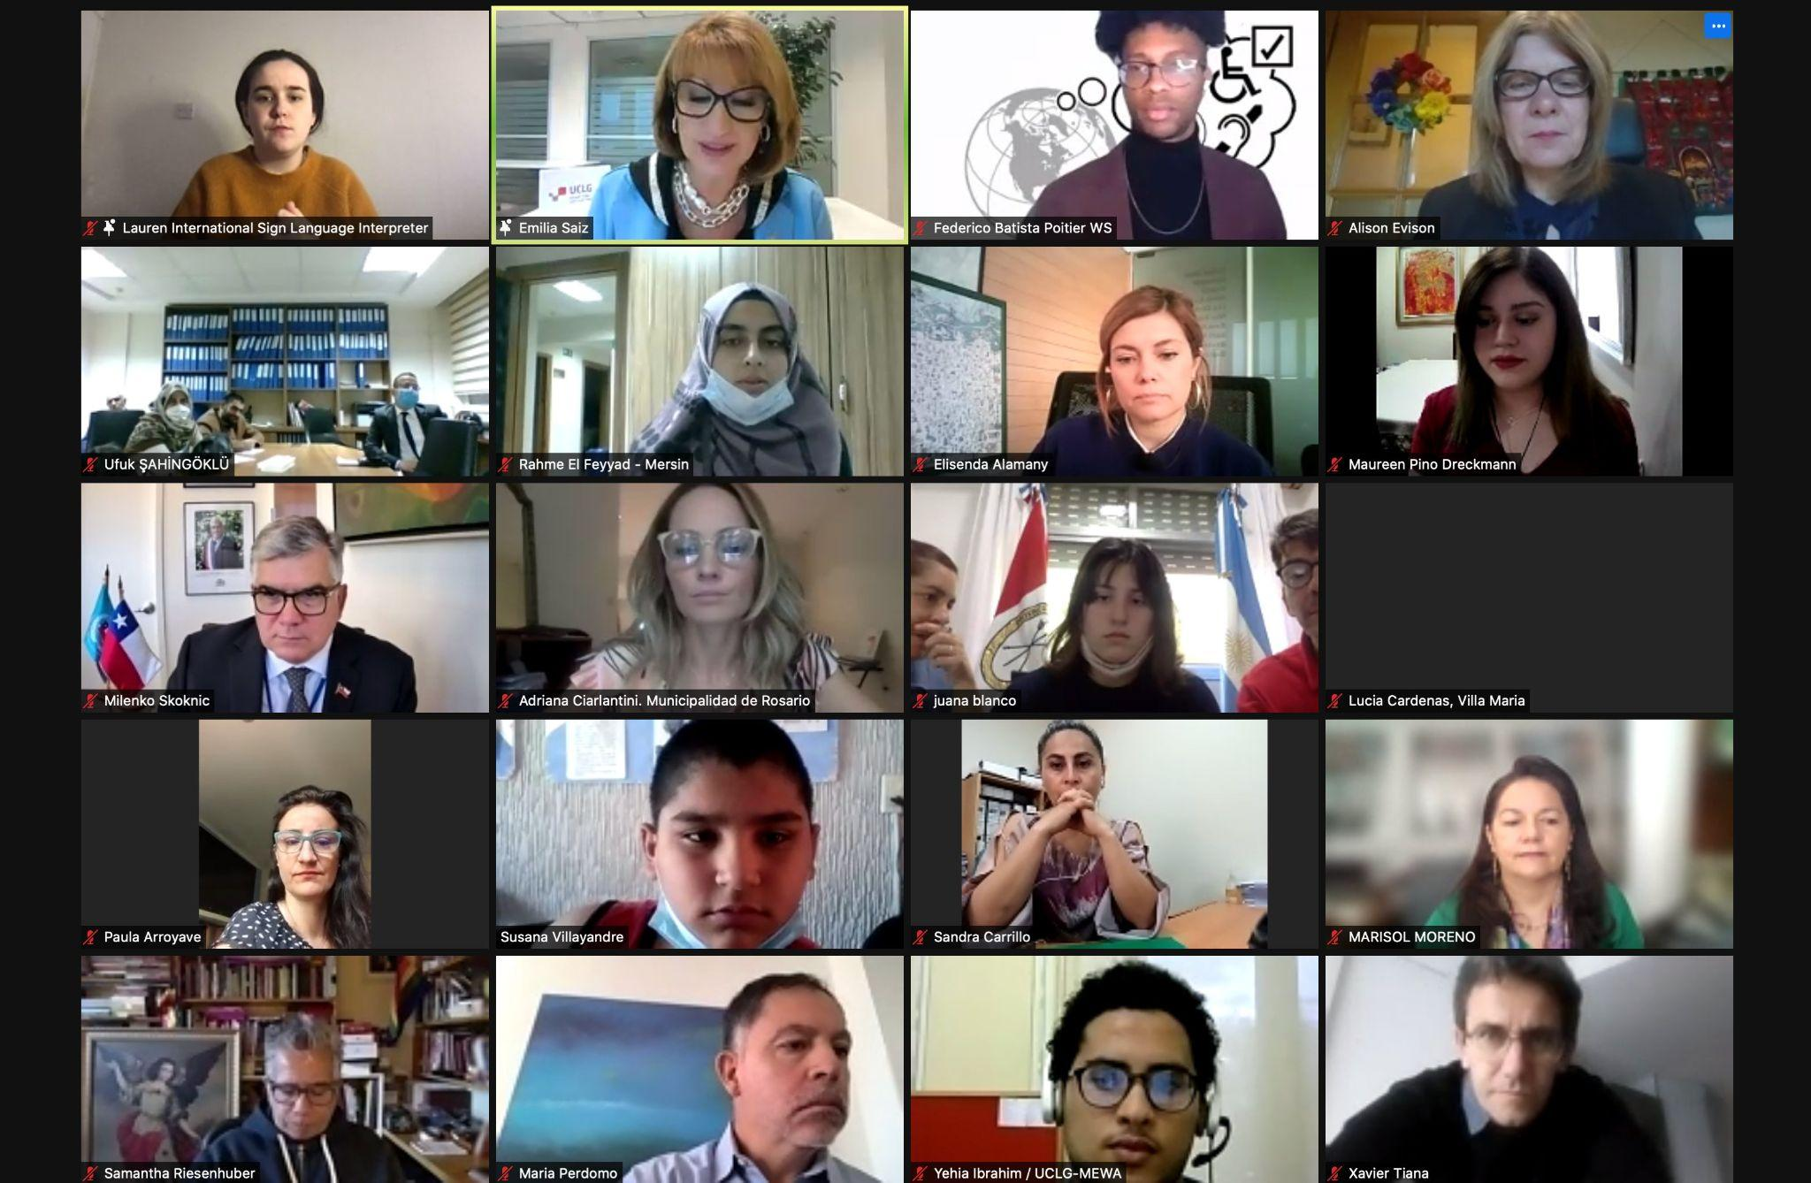
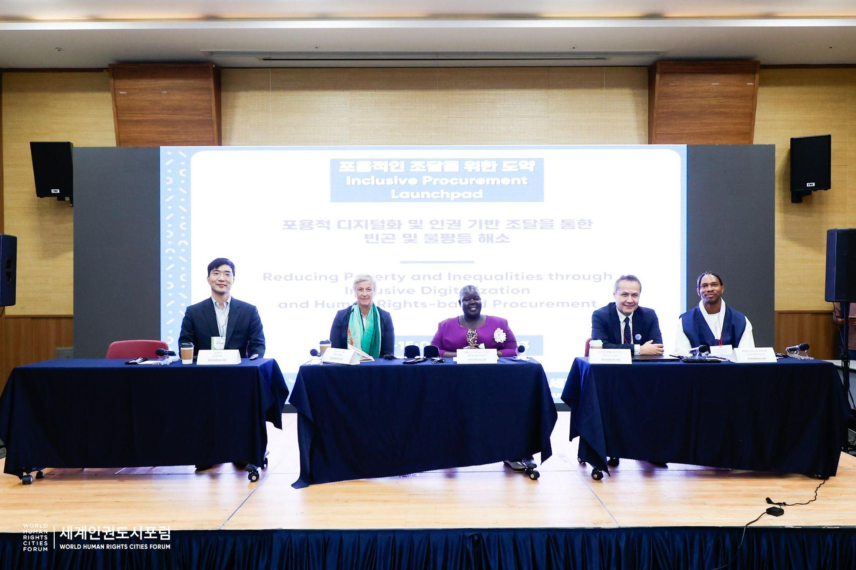
Strengthening Localization of the CRPD (continued)
5. Sharing commitments & progress on localization with the global community

Slide 27
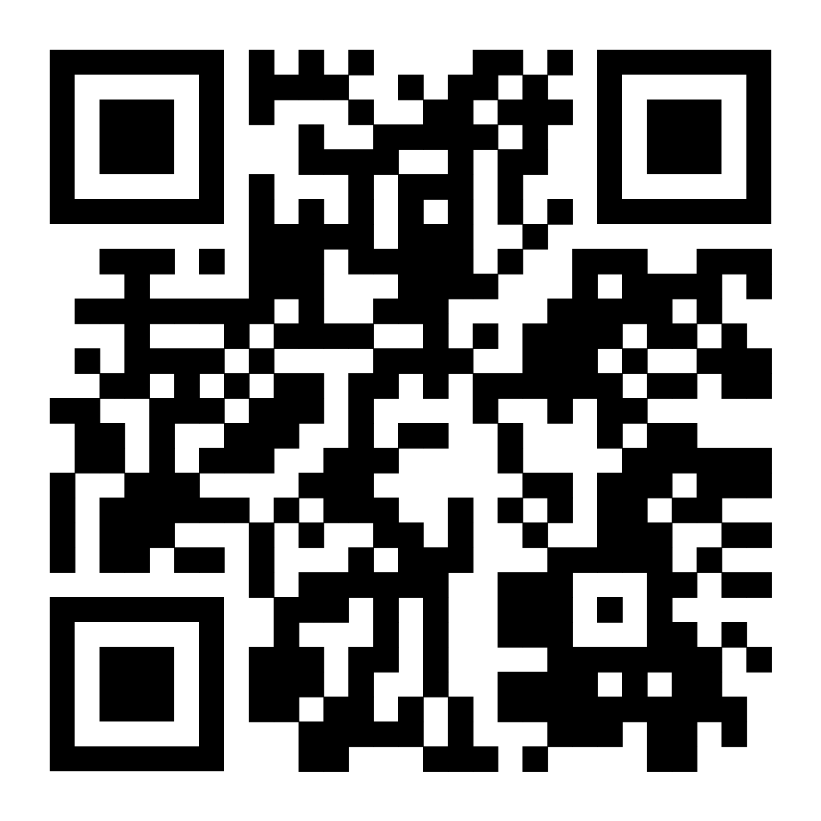
Check out our online MOOC!

Slide 28
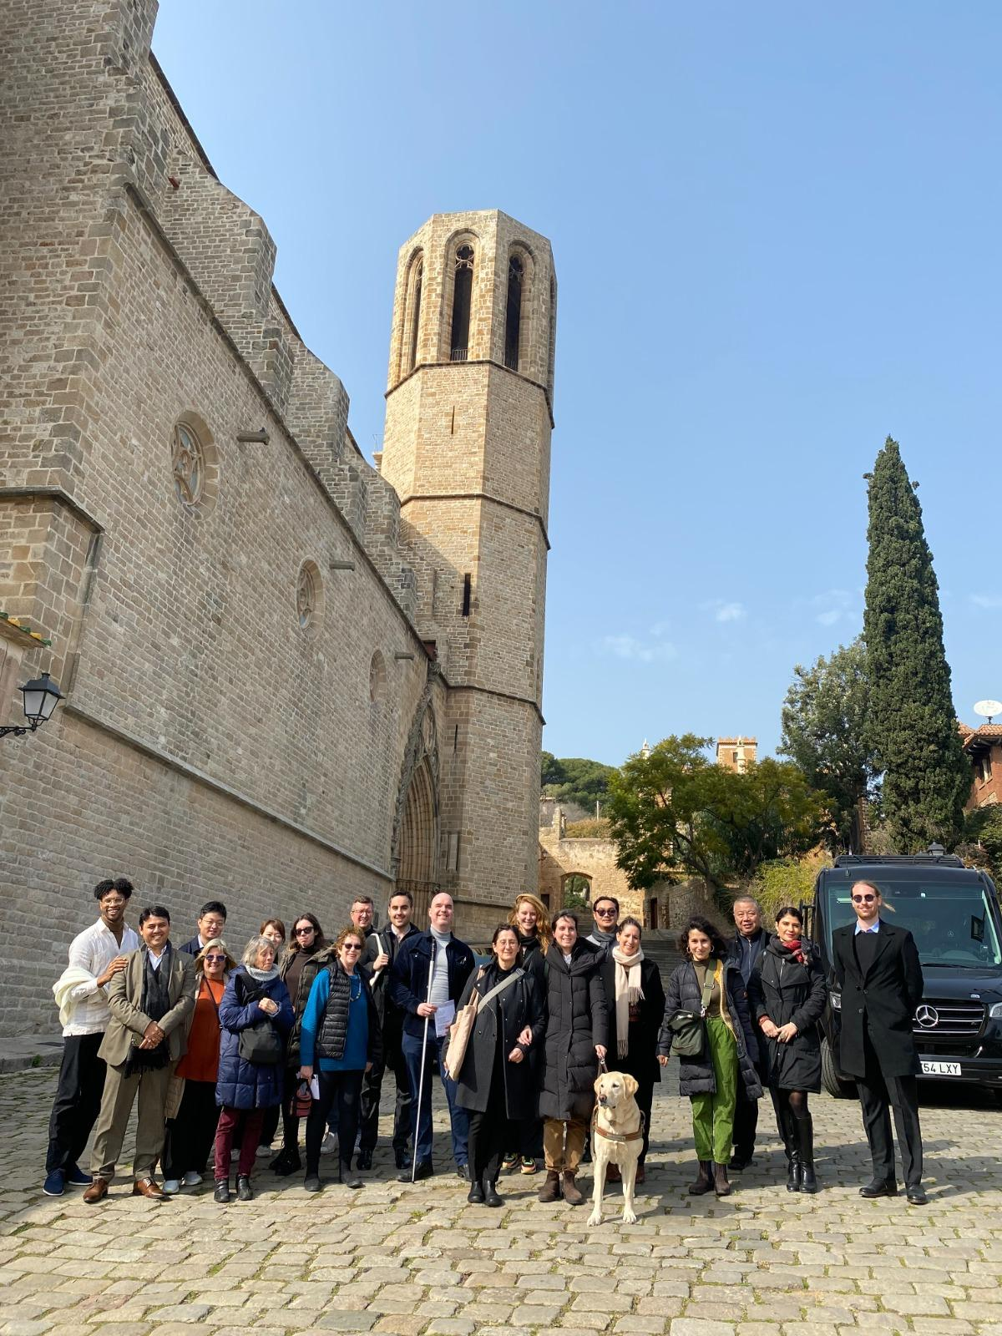
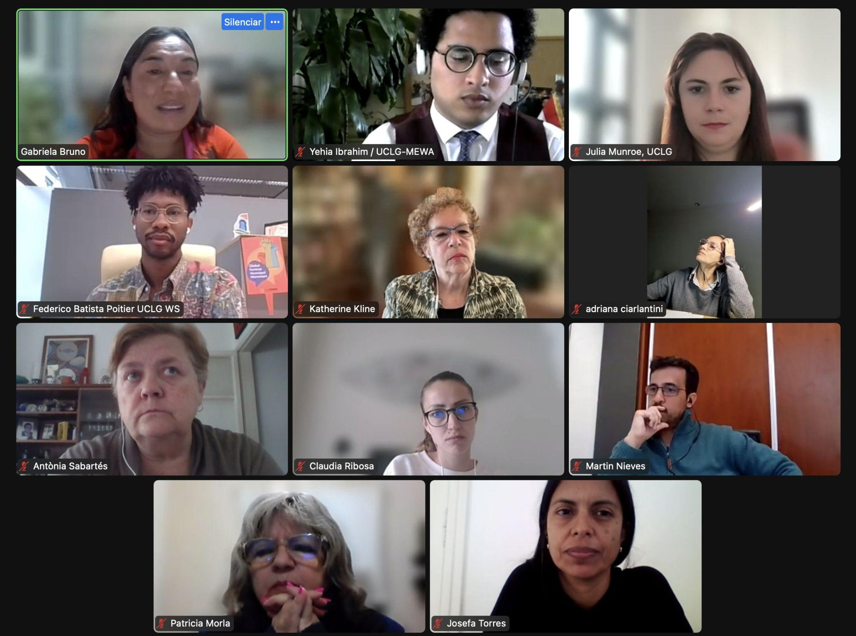
Join our growing community towards Cities for All!

Slide 29
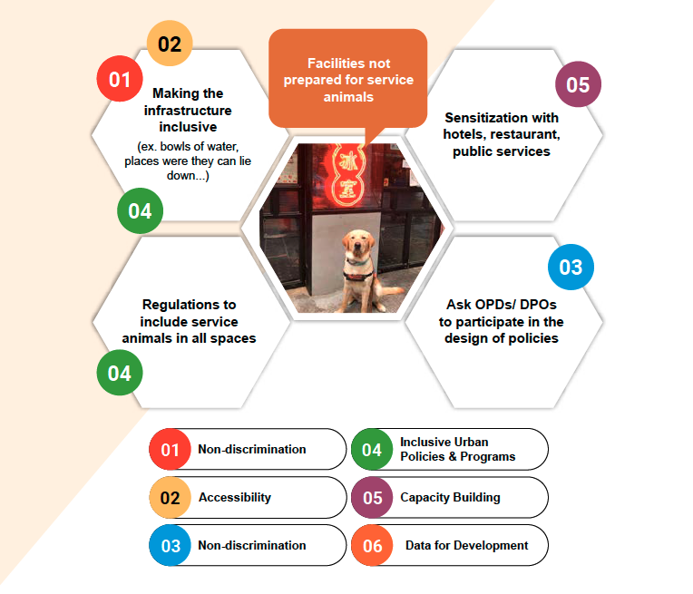
For more information on how to be involved contact f.poitier@uclg.org

Slide 30
2030
Accessibility
Partner Profile
The WHO Global Network for Age-friendly Cities and Communities (GNAFCC) was established in 2010 to connect cities, communities and organizations worldwide with the common vision of making their community a great place to grow older.
GNAFCC currently counts over 1700 cities and communities in 53 countries in its membership, covering over 330 million people worldwide.
Website: agefriendlyworld.org
Email: gnafcc@who.int

Slide 31
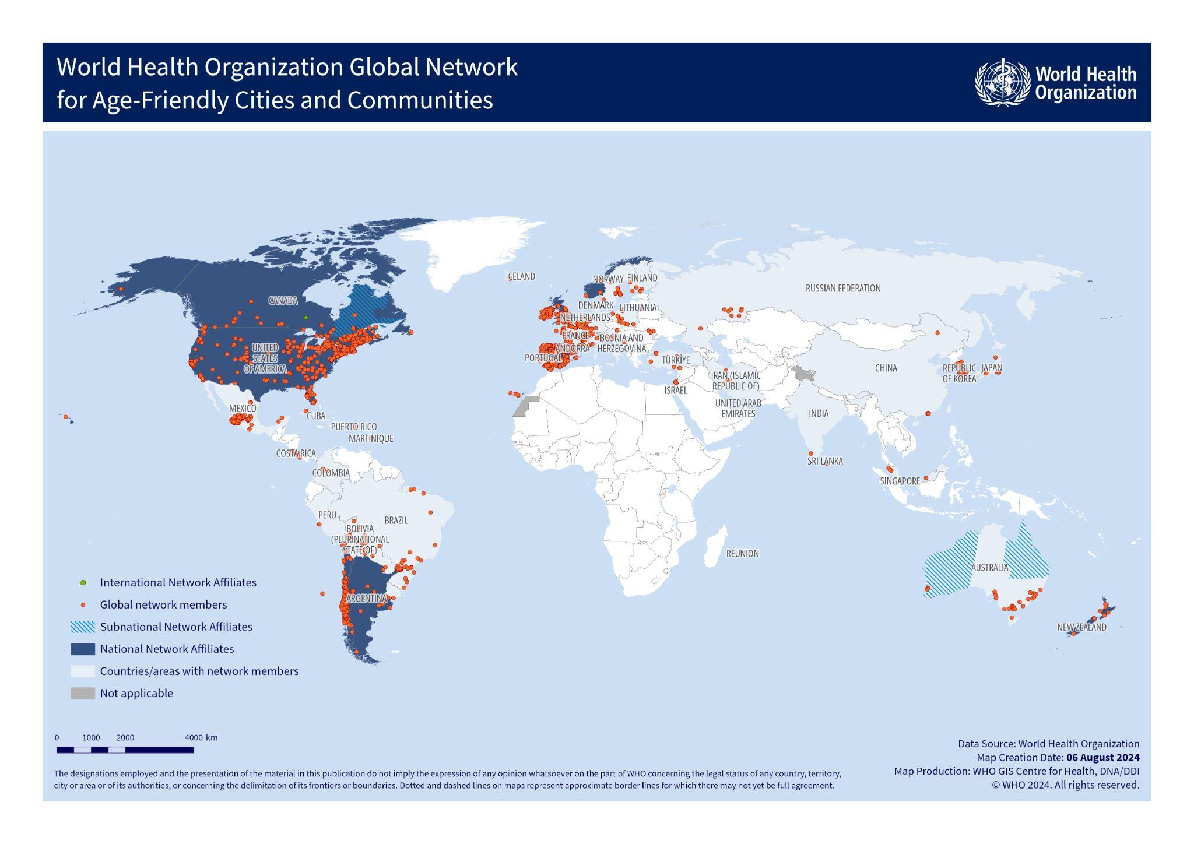
2030
Accessibility
Partner Profile
The WHO Global Network for Age-friendly Cities and Communities (GNAFCC) was established in 2010 to connect cities, communities and organizations worldwide with the common vision of making their community a great place to grow older.
GNAFCC currently counts over 1700 cities and communities in 53 countries in its membership, covering over 330 million people worldwide.
Website: agefriendlyworld.org
Email: gnafcc@who.int
Learn more about GNAFCC:

Slide 32
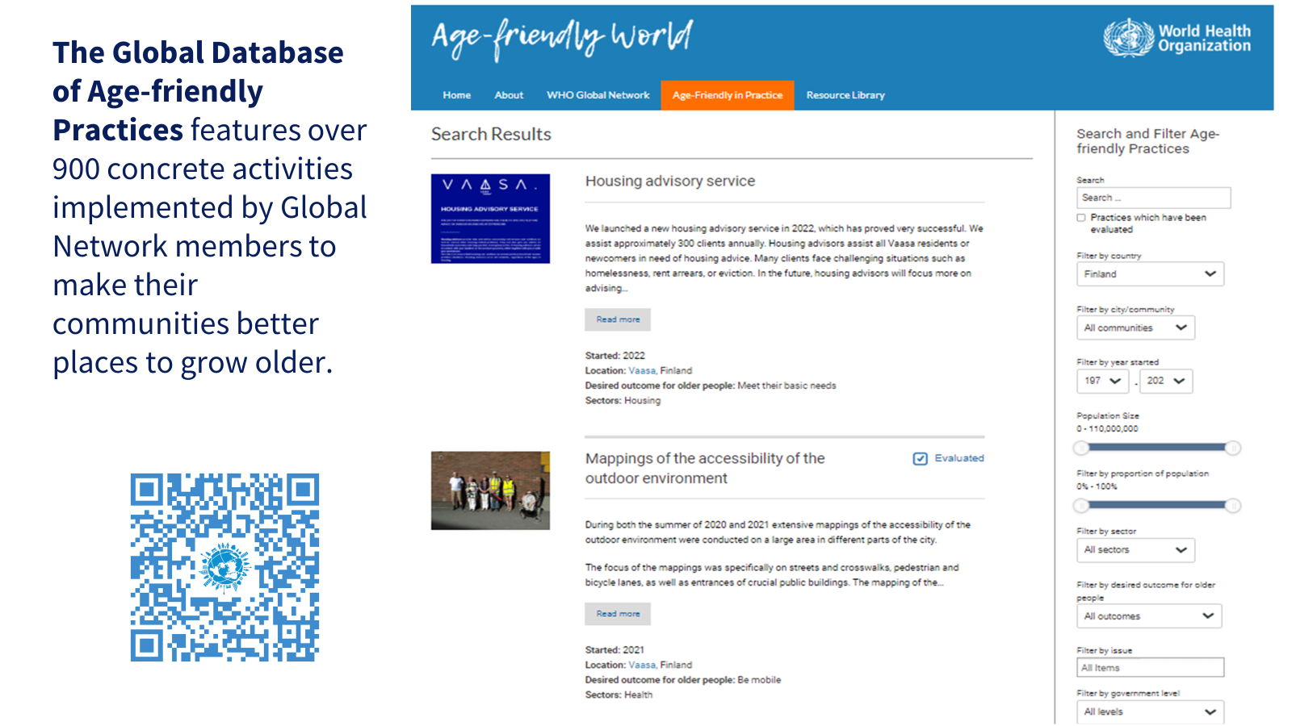
2030
Accessibility
Partner Profile
The WHO Global Network for Age-friendly Cities and Communities (GNAFCC) was established in 2010 to connect cities, communities and organizations worldwide with the common vision of making their community a great place to grow older.
GNAFCC currently counts over 1700 cities and communities in 53 countries in its membership, covering over 330 million people worldwide.
Website: agefriendlyworld.org
Email: gnafcc@who.int
Access:

Slide 33
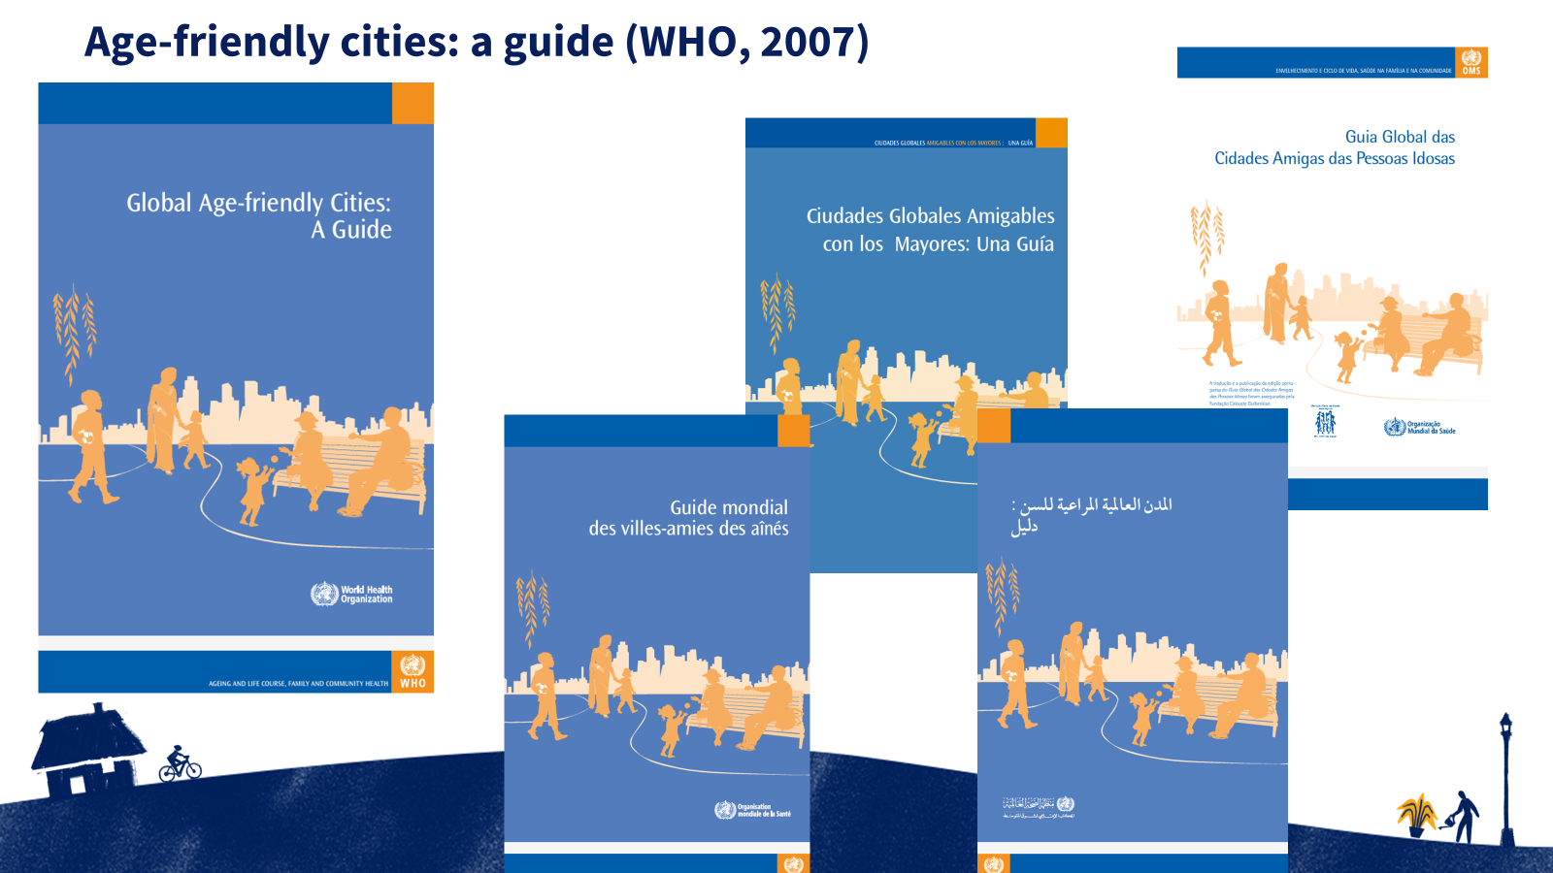
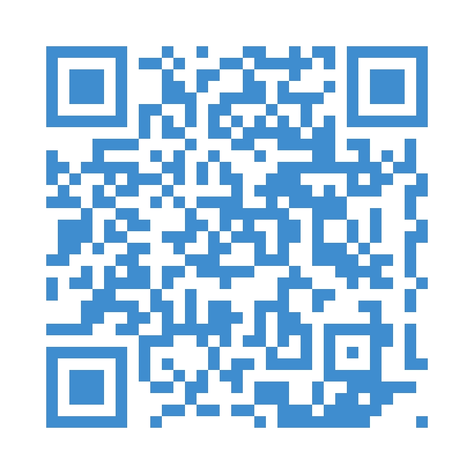
2030
Accessibility
Partner Profile
The WHO Global Network for Age-friendly Cities and Communities (GNAFCC) was established in 2010 to connect cities, communities and organizations worldwide with the common vision of making their community a great place to grow older.
GNAFCC currently counts over 1700 cities and communities in 53 countries in its membership, covering over 330 million people worldwide.
Website: agefriendlyworld.org
Email: gnafcc@who.int
Access:

Slide 34
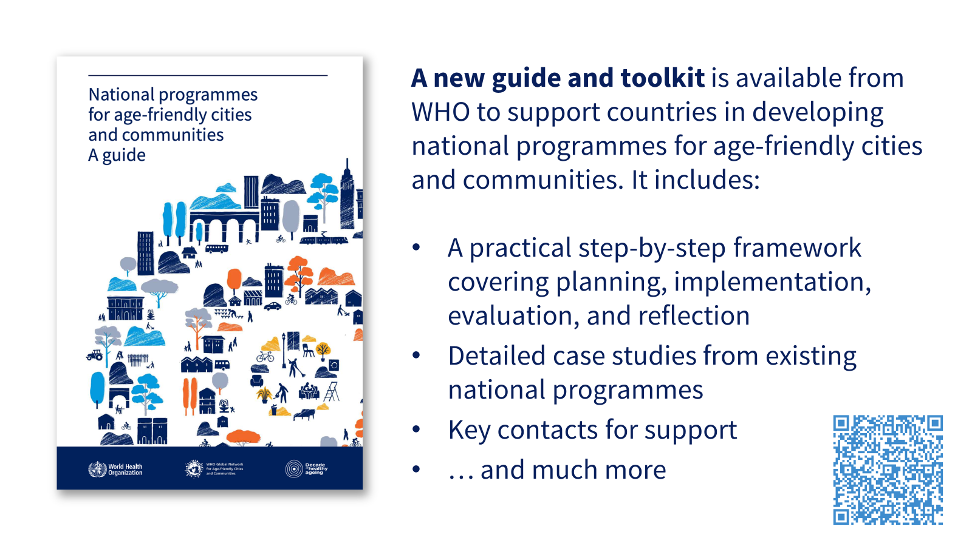
2030
Accessibility
Partner Profile
The WHO Global Network for Age-friendly Cities and Communities (GNAFCC) was established in 2010 to connect cities, communities and organizations worldwide with the common vision of making their community a great place to grow older.
GNAFCC currently counts over 1700 cities and communities in 53 countries in its membership, covering over 330 million people worldwide.
Website: agefriendlyworld.org
Email: gnafcc@who.int
Access:

Slide 35
2030
Accessibility
Partner Profile
The WHO Global Network for Age-friendly Cities and Communities (GNAFCC) was established in 2010 to connect cities, communities and organizations worldwide with the common vision of making their community a great place to grow older.
GNAFCC currently counts over 1700 cities and communities in 53 countries in its membership, covering over 330 million people worldwide.
Website: agefriendlyworld.org
Email: gnafcc@who.int

Slide 36
2030
Accessibility
Partner Profile
The WHO Global Network for Age-friendly Cities and Communities (GNAFCC) was established in 2010 to connect cities, communities and organizations worldwide with the common vision of making their community a great place to grow older.
GNAFCC currently counts over 1700 cities and communities in 53 countries in its membership, covering over 330 million people worldwide.
Website: agefriendlyworld.org
Email: gnafcc@who.int

Slide 37
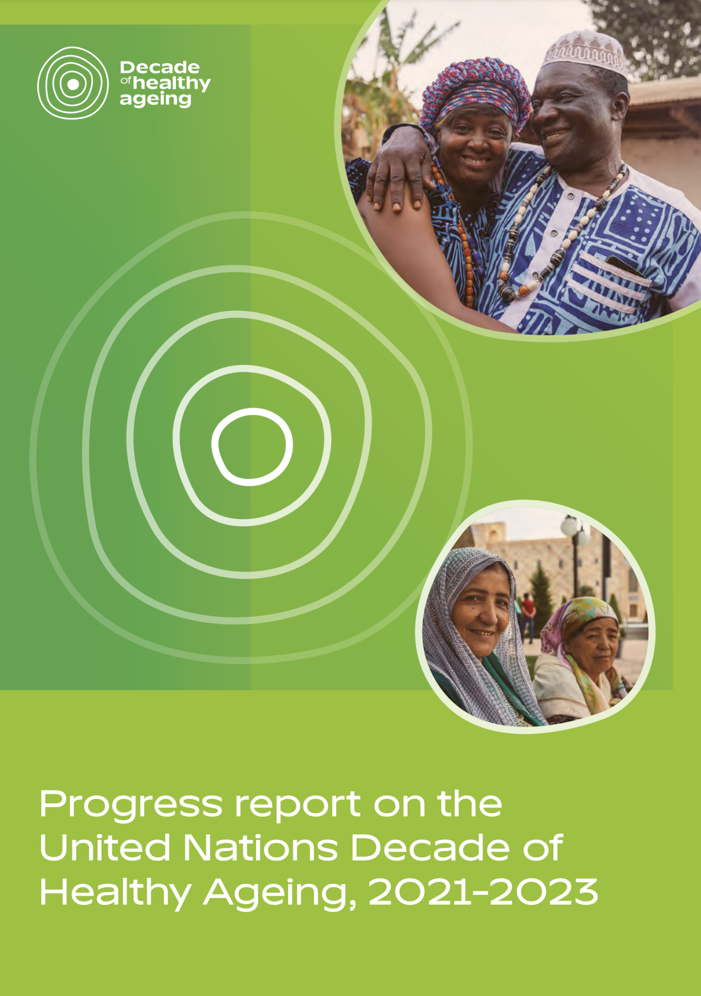
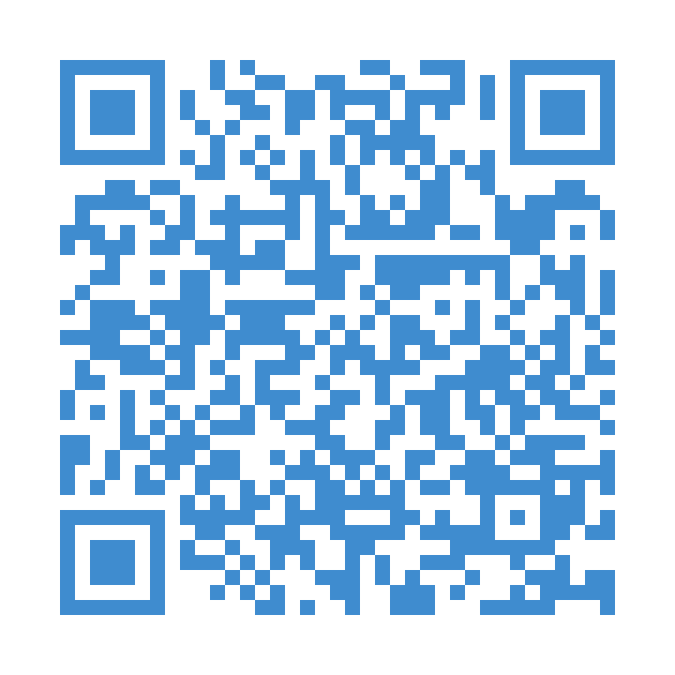
2030
Accessibility
Partner Profile
Progress report on the UN Decade of Healthy Ageing, 2021–2023
The activities of GNAFCC contribute to the implementation of the UN Decade of Healthy Ageing (2021–2030)’s action area on building age-friendly environments.
Explore what progress has been made in this area of work during the first 3 years of the UN Decade – including through 113 detailed case studies on age-friendly environments:
The WHO Global Network for Age-friendly Cities and Communities (GNAFCC) was established in 2010 to connect cities, communities and organizations worldwide with the common vision of making their community a great place to grow older.
GNAFCC currently counts over 1700 cities and communities in 53 countries in its membership, covering over 330 million people worldwide.
Website: agefriendlyworld.org
Email: gnafcc@who.int

Slide 38
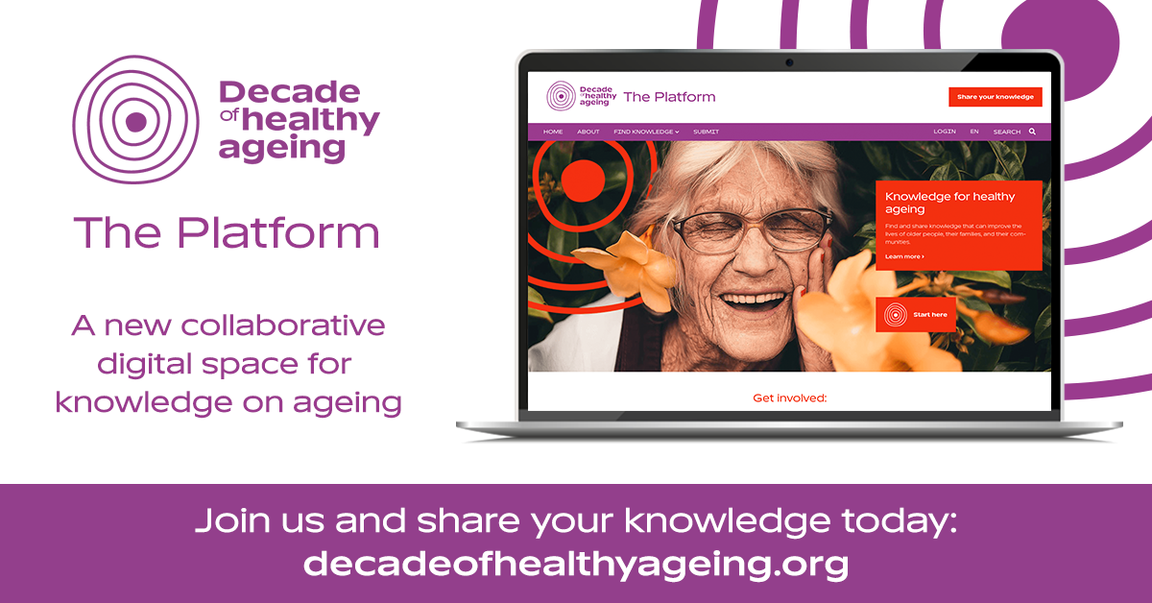
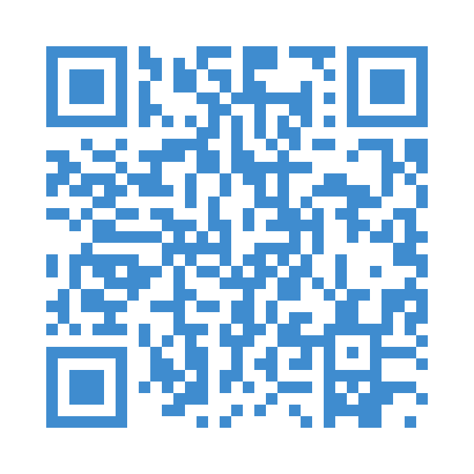
2030
Accessibility
UN Decade of Healthy Ageing knowledge Platform
Partner Profile
Access:
The WHO Global Network for Age-friendly Cities and Communities (GNAFCC) was established in 2010 to connect cities, communities and organizations worldwide with the common vision of making their community a great place to grow older.
GNAFCC currently counts over 1700 cities and communities in 53 countries in its membership, covering over 330 million people worldwide.
Website: agefriendlyworld.org
Email: gnafcc@who.int
The UN Decade of Healthy Ageing’s online knowledge Platform is a ‘one-stop-shop’ for resources and other forms of knowledge related to healthy ageing – submitted by stakeholders around the world.
Visit the Platform to explore knowledge on age-friendly environments and accessibility, too!

Slide 39
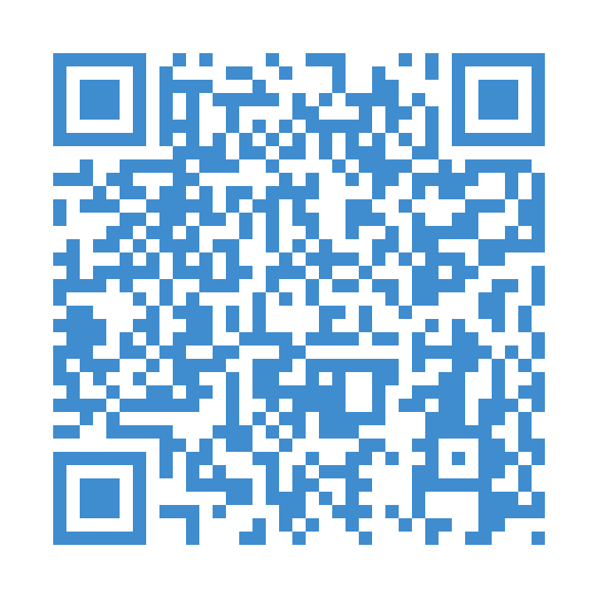
2030
Accessibility
Partner Profile
WHO Global report on health equity for persons with disabilities
Age-friendly cities and communities have a significant role to play in ensuring persons with disabilities are supported and recognised.
The WHO Global report on health equity for persons with disabilities analyses the factors that contribute to systemic health inequities for persons with disabilities and outlines policy and programmatic actions and recommendations to reduce these inequities.
The WHO Global Network for Age-friendly Cities and Communities (GNAFCC) was established in 2010 to connect cities, communities and organizations worldwide with the common vision of making their community a great place to grow older.
GNAFCC currently counts over 1700 cities and communities in 53 countries in its membership, covering over 330 million people worldwide.
Website: agefriendlyworld.org
Email: gnafcc@who.int

Slide 40
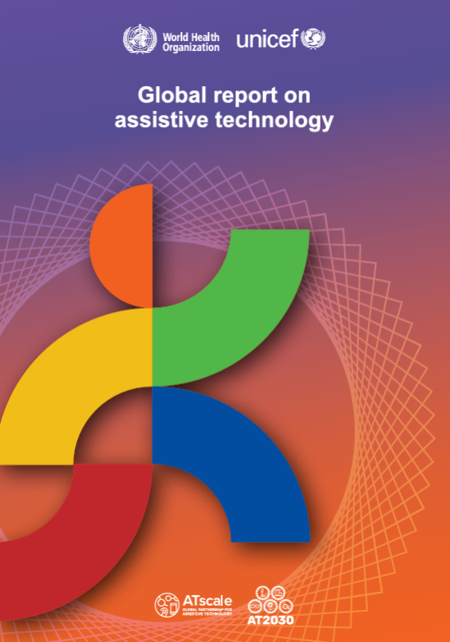
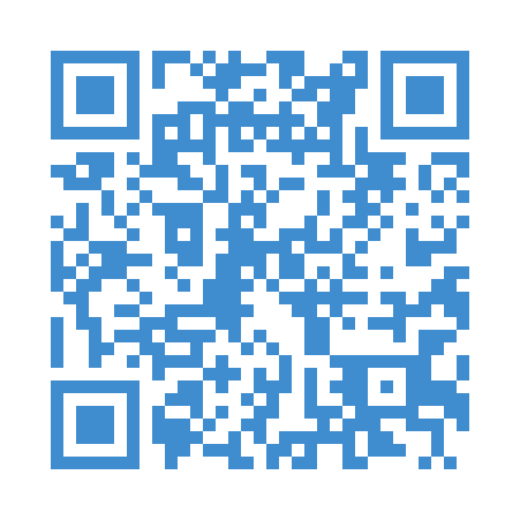
2030
Accessibility
Partner Profile
WHO Global report on assistive technology
There is a large, unmet need for assistive technology worldwide.
The WHO Global report on assistive technology presents a comprehensive dataset and analysis of current assistive technology access, drawing the attention of governments and civil society to the need for, and benefit of, assistive technology, including its return on investment.
The WHO Global Network for Age-friendly Cities and Communities (GNAFCC) was established in 2010 to connect cities, communities and organizations worldwide with the common vision of making their community a great place to grow older.
GNAFCC currently counts over 1700 cities and communities in 53 countries in its membership, covering over 330 million people worldwide.
Website: agefriendlyworld.org
Email: gnafcc@who.int
Access:

Slide 41
2030
Accessibility
Partner Profile
Global Disability Innovation Hub (GDI Hub) is an Academic Research and Practice Centre accelerating disability innovation for a more just world. Based at UCL (University College London) we are operational in 60 countries, with more than 70 partners. Since launching in 2016 we've reached more than 34 million people and are the World Health Organisations (WHO) first Global Collaborating Center on Assistive Technology.

Slide 42
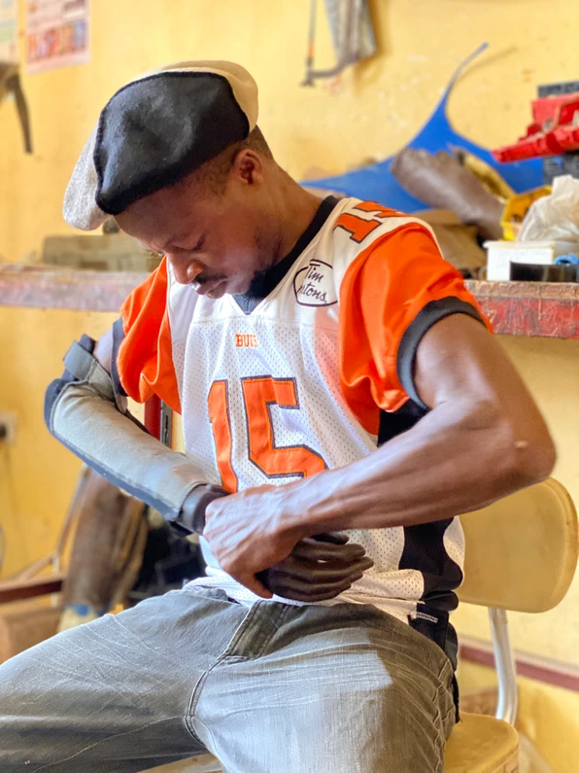
Delivering Inclusive Design in Cities
From Global to Local Actions

Slide 43
GDI Hub
Global Disability Innovation (GDI) Hub accelerates ideas into impact for a more just world - for disabled people, and all people.

Slide 44
About
Launched in 2016 as a legacy of the London 2012 Paralympic Games
Based on Queen Elizabeth Olympic Park, at UCL’s new East London campus.
Develop homegrown technologies alongside new knowledge and research.
Deliver accelerators and market shaping initiatives.
Build ecosystems with a focus on low-and middle-income countries.

Slide 45
AT2030
AT2030 tests ‘what works’ to improve access to life-changing Assistive Technology (AT) for all. We've reached 34 million people in 61 countries, driving a lifetime of potential.

Slide 46
AT2030 V3 priority countries
ASIA
Indonesia
India (Regional Hub)
South Asia
AFRICA
Kenya
Rwanda (Regional Hub)
Ethiopia
Tanzania
Malawi
Sierra Leone
Ghana
Liberia
Nigeria
South Africa
Zimbabwe

Slide 47
AT2030 V3 Outputs
8 procurement pilots/frameworks at the country, regional and global level​
22 innovation ecosystem development interventions​
30 case studies produced​
30 country-level strategies for disability inclusion and AT access​
38 innovative ATs supported​
50 partnerships supported to increase AT capacity​
75 strategic tools developed to increase AT capacity​
80 peer-reviewed journal articles published​
120 influencing papers, answering critical research questions​
220,000 downloads/views of publications/papers​
100% (£31 million) in match funding (in cash or in-kind) through partnerships

Slide 48
AT2030 V3 Outputs
30 more AT innovations on track to scale
15 more innovative service delivery models on track to scale
60 more AT Ventures supported for sustainable growth
45 more countries or organisations implementing AT2030 funded ideas

Slide 49
AT2030 Structure
Cluster 1: Include
leadership & engagement
Amplifying stories and knowledge driving inclusion through partnerships, networks and DPOs. With advocacy and engagement across key sporting and cultural moments, we’ll empower for change in collaboration with AT users and the disability innovation community.

Slide 50
From Global to Local Action

Slide 51
From Global to Local Action
April 2020
6 City Case Studies
1
Comparison Report
1 Global Action Report
March 2024

Slide 52
From Global to Local Action
104
persons with disabilities living in 6 cities
92
stakeholders from Government and Built Environment
People
Practice
Policy

Slide 53
From Global to Local Action
Methodology

Slide 54
From Global to Local Action
Top Priorities across cities
Housing
Education
Healthcare
Where to Start?
City Planning and Governance | Integrate accessibility in city masterplans. Engage persons with disabilities in governance.
Essential Infrastructure and Services | Make schools accessible with inclusive resources and trained staff. Equip hospitals to support people with disabilities.
Transport Systems and Mobility | Equip transit with ramps, lifts, and accessible information.

Slide 55
From Global to Local Action
Neighbourhoods (Including Informal Settlements) | Ensure access to community services and support community-led design.
Housing | Build accessible homes with wider doorways, step-free entrances, and ensure affordable options.
Public and Green Spaces | Design parks and public spaces with accessible paths, seating, and restrooms.
Streets | Implement curb cuts, tactile paving, and audible signals for safe crossing.
Public and Private Buildings | Encourage inclusive practices in businesses and public buildings.
Workplaces | Create fully accessible workspaces with adjustable features and clear signage.
Policies (Government and Institutional) | Develop inclusive policies and involve people with disabilities in decision-making.

Slide 56
View our new reports!

Slide 57
Frontier Tech Hub X GDIHub

Slide 58
Brought to you by
PERSONS WITH DISABILITIES AND OLDER PERSONS CONSTITUENCY GROUP

