Slide 1
A Global – Local Innovation Approach for Appropriate Technology in LMIC: A case study in Nepal
10th May, 2024 | 2nd NEPOCON Conference
Kathmandu, Nepal

Slide 2
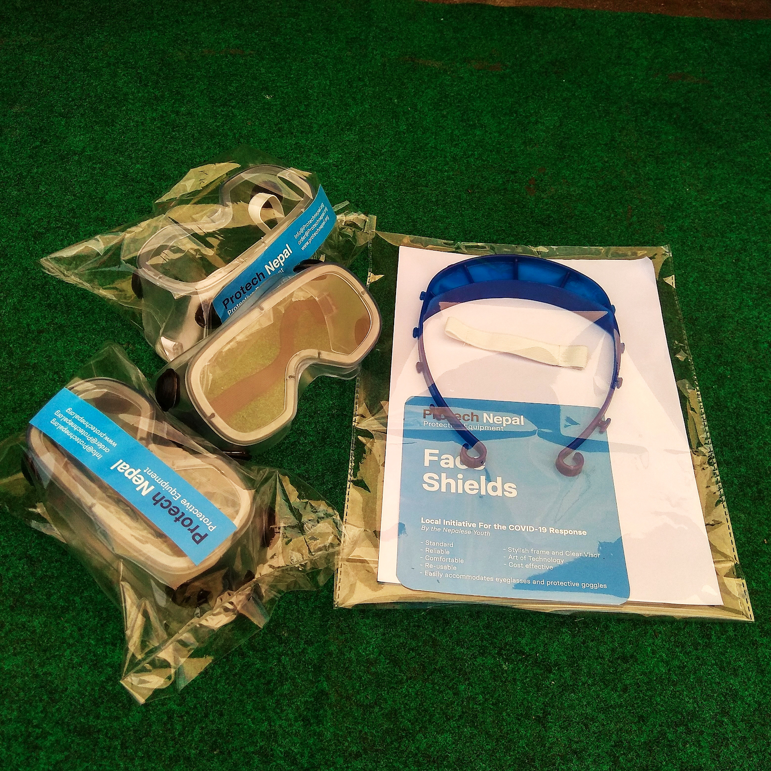
Zener/COVIDaction: Rising from an earthquake to fight the pandemic in Nepal

Slide 3
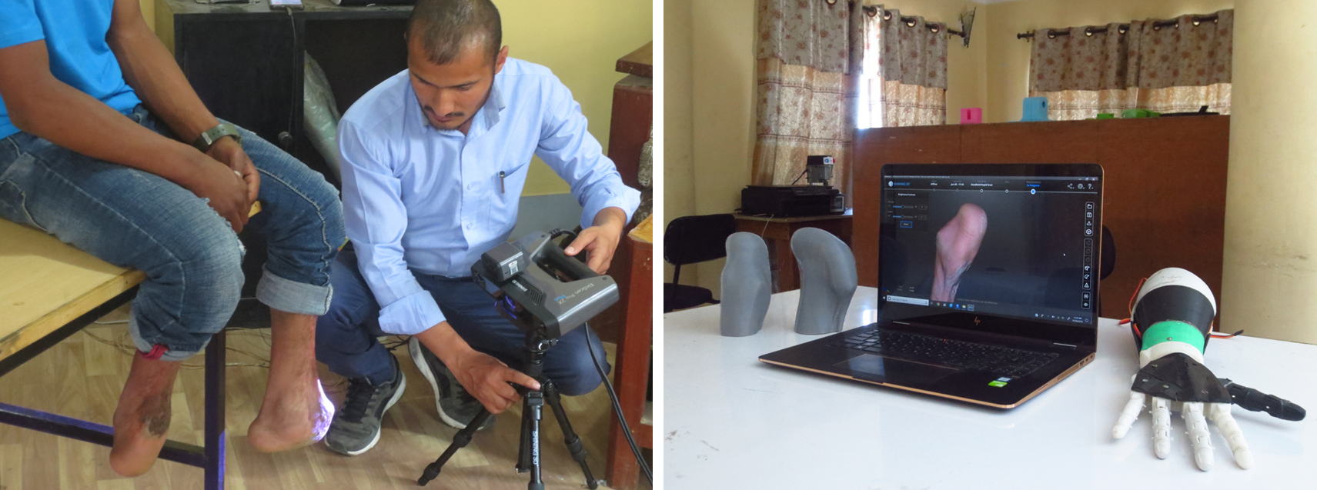
We did what we could – with engineering limits.

Slide 4
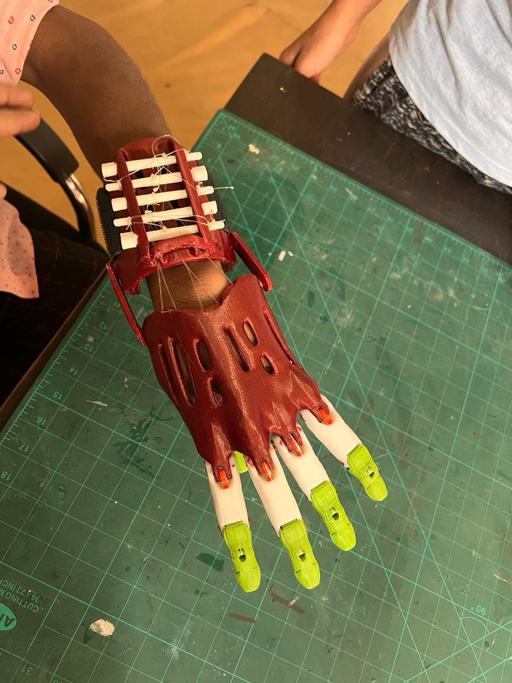
Potential AT users turning to Engineering and 3D printing firms for support.
People see hope in 3D printing technology due to advancement in technology itself and rise in DIY movements.
Rise in popularity due to ease of finding ready to print designs in an internet.
X Engineers-led institutions have limited know how of AT product development.
X User's comfort and product's appropriateness to meet their needs is often ignored/missed out.

Slide 5
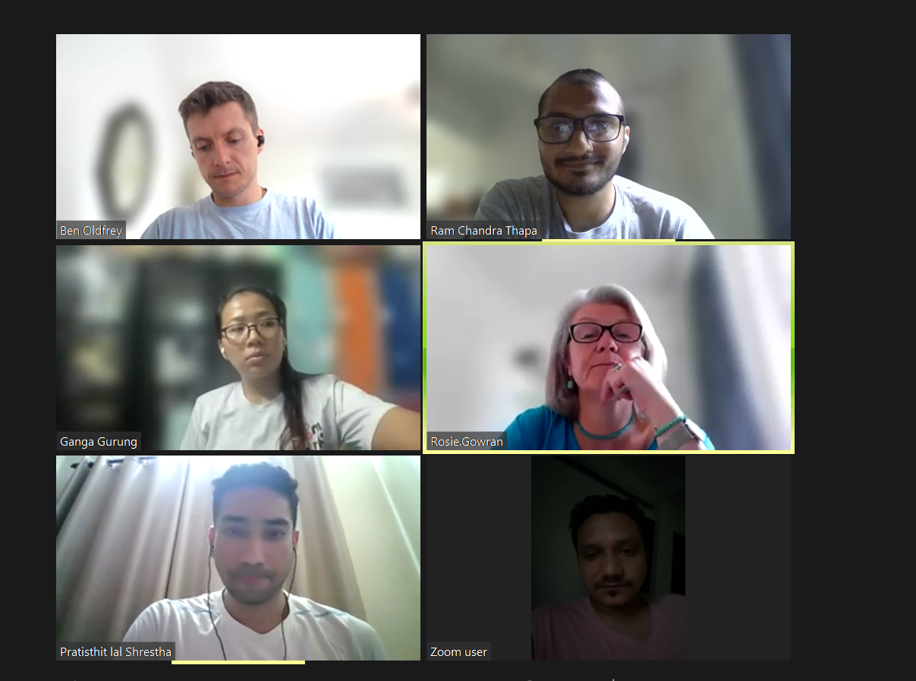
Inclusive foundation of Enabling Friday Community:

Slide 6
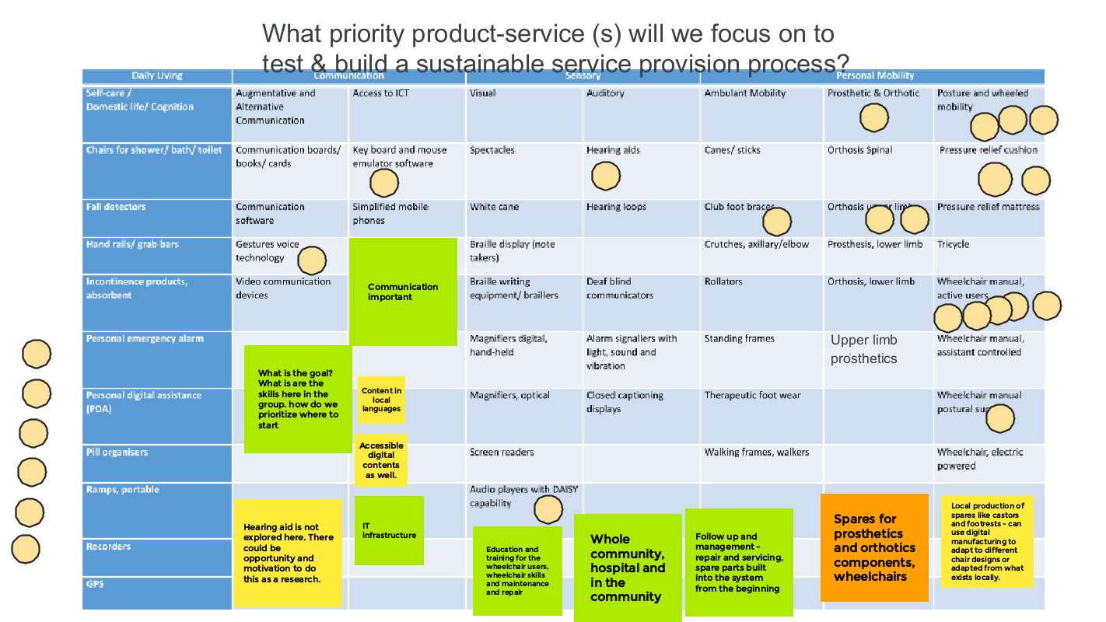
Directing workstreams

Slide 7
Mission
"Our mission is to collectively build sustainable assistive technology (AT) provision in Nepal by supporting infrastructure development through advocacy, evidence-based practice, service system standards and innovation, working together to meet the needs of persons with disabilities now and in the future."

Slide 8
Consortium

Slide 9
DR BEN OLDFREY ASSISTANT PROFESSOR, UCL GLOBAL DISABILITY INNOVATION HUB UKAID AT2030 PROGRAMME

Slide 10
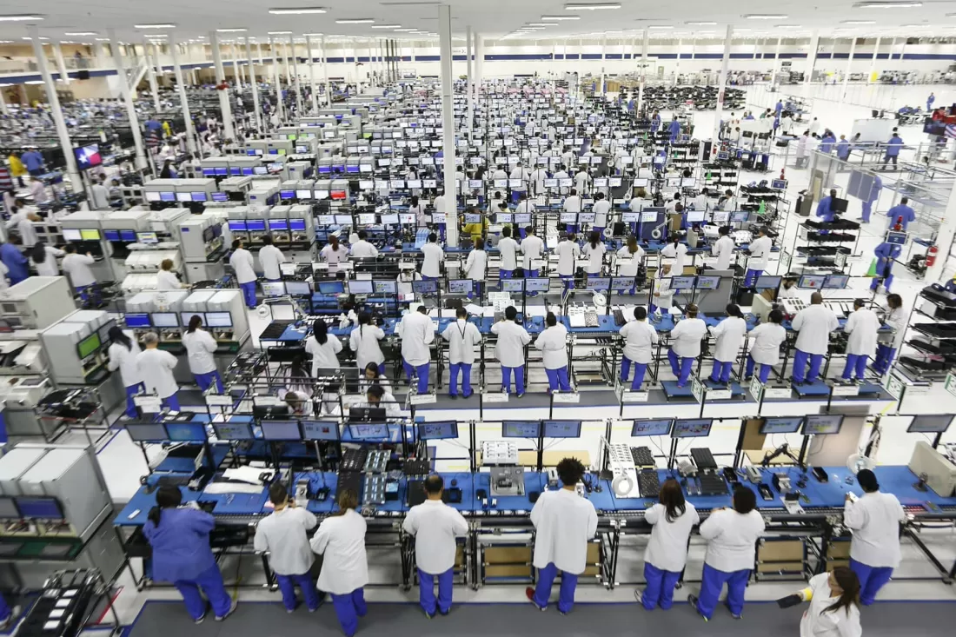
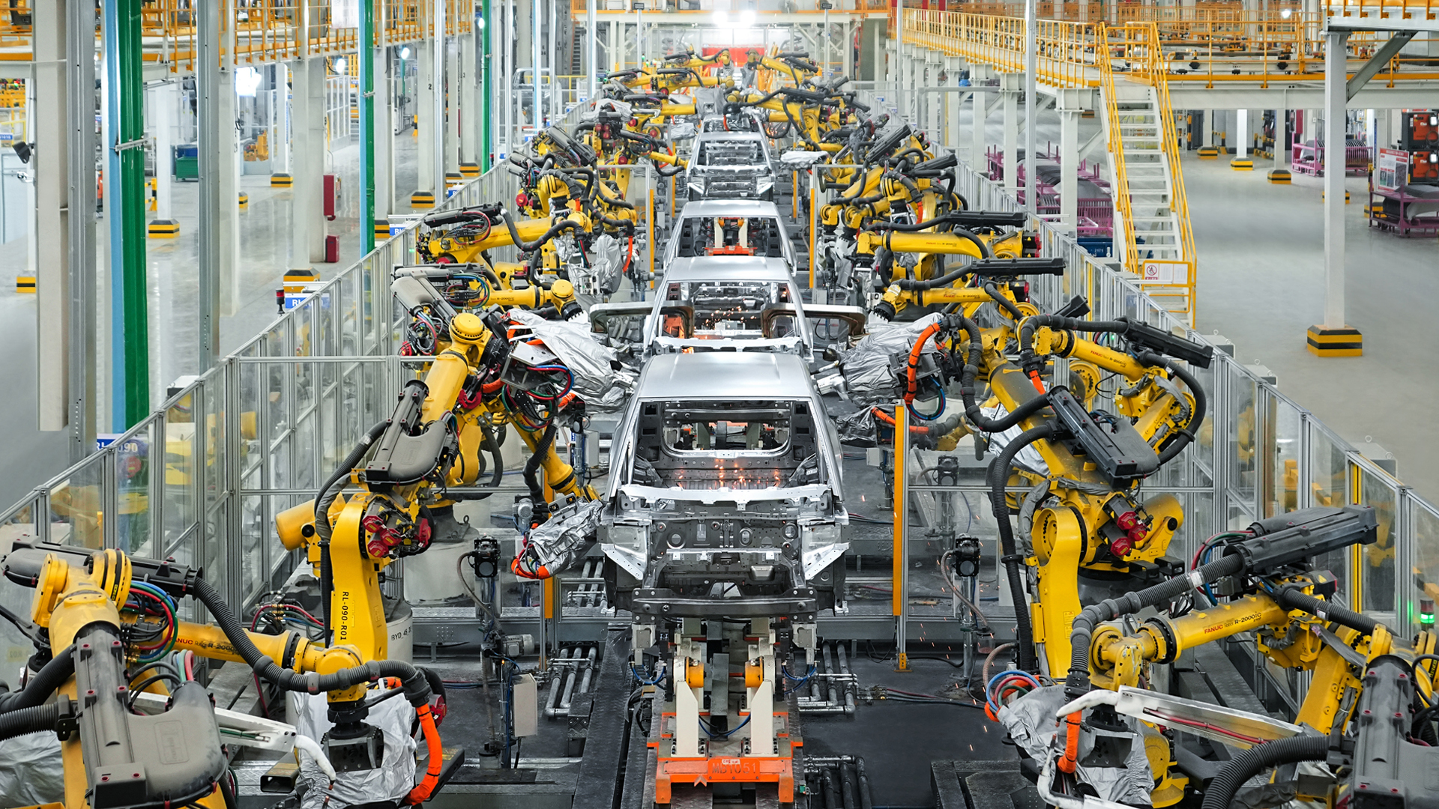
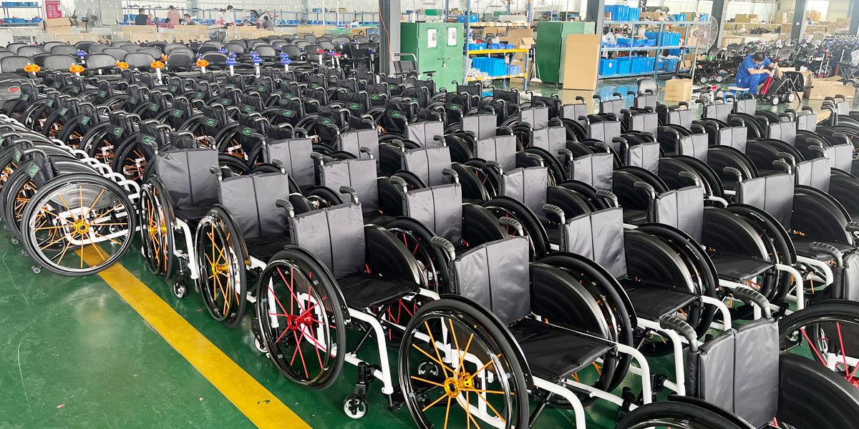
https://www.techspot.com/news/84608-foxconn-profit-dropped-q4-2019-iphone-12-mass.html
https://www.byd.com/eu/news-list/BYD_to_Build_A_New_Energy_Passenger_Vehicle_Factory_in_Hungary_for_Localised_Production_in_Europe.html
https://www.jbhmedical.com/what-we-should-check-when-purchase-a-manual-wheelchair.html

Slide 11
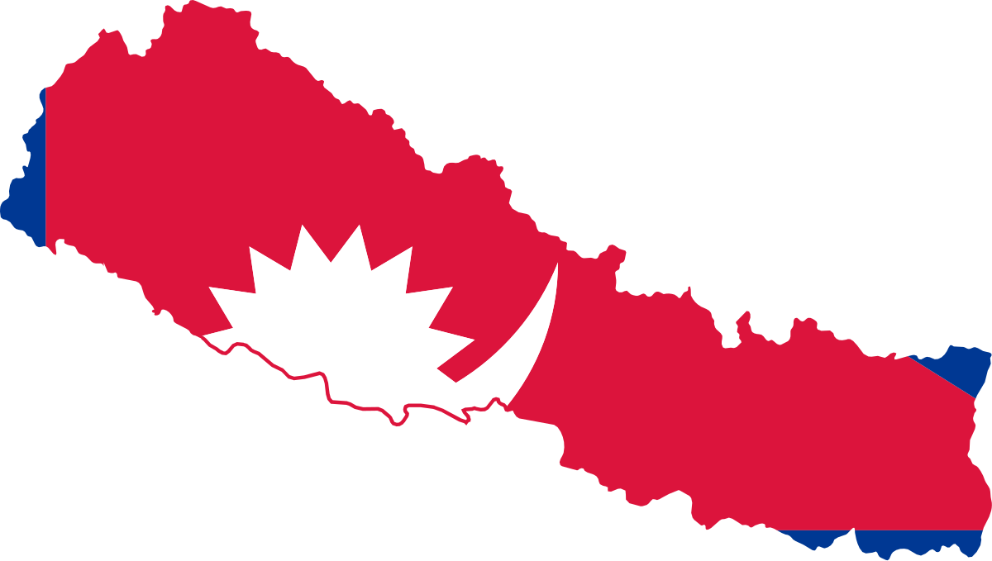
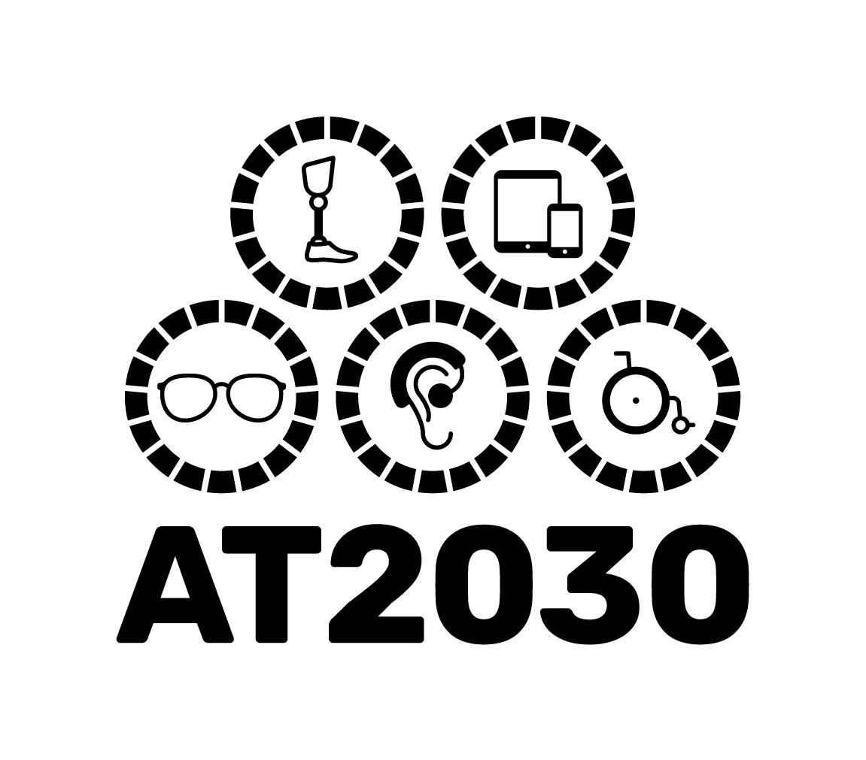
Need for multiple production and innovation models

Slide 12
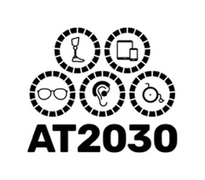
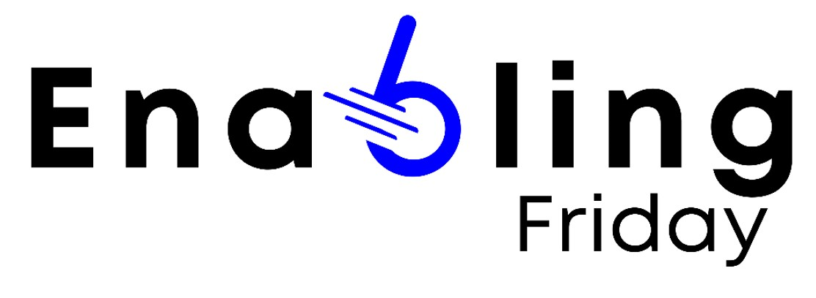
AT2030 Local Systems Strengthening: Nepal
Consortium
Workshops
Situational Analysis of Manual Wheelchair Provision
Wheelchair Spare Parts Pilot
Local Bespoke Product Development
TBC
TBC
UNICEF
Digital Manufacture of Children’s Prosthetics
Prosthetic Liner Production with Operation Namaste
Incoming for 2024

Slide 13
AT2030 Local Systems Strengthening: Nepal
Consortium
Workshops
Wheelchair Spare Parts Pilot
Local Bespoke Product Development
Situational Analysis of Manual Wheelchair Provision
Local Bespoke Product Development
TBC
TBC
UNICEF
Digital Manufacture of Children’s Prosthetics
Prosthetic Liner Production with Operation Namaste
Incoming for 2024

Slide 14
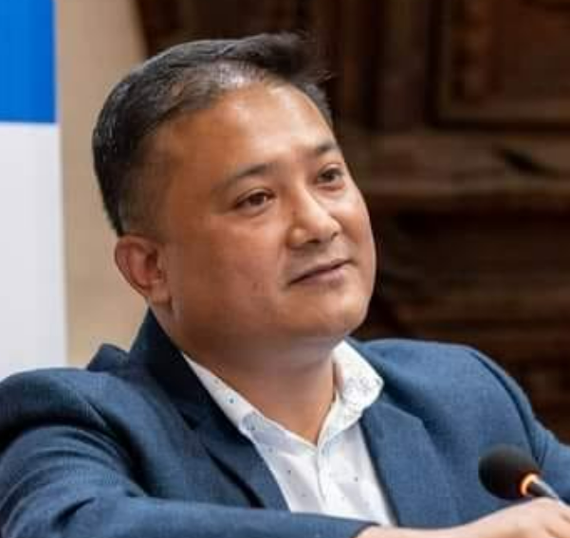
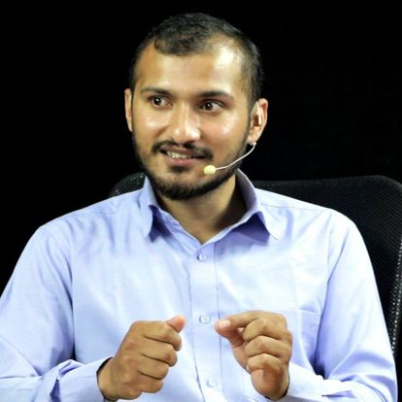
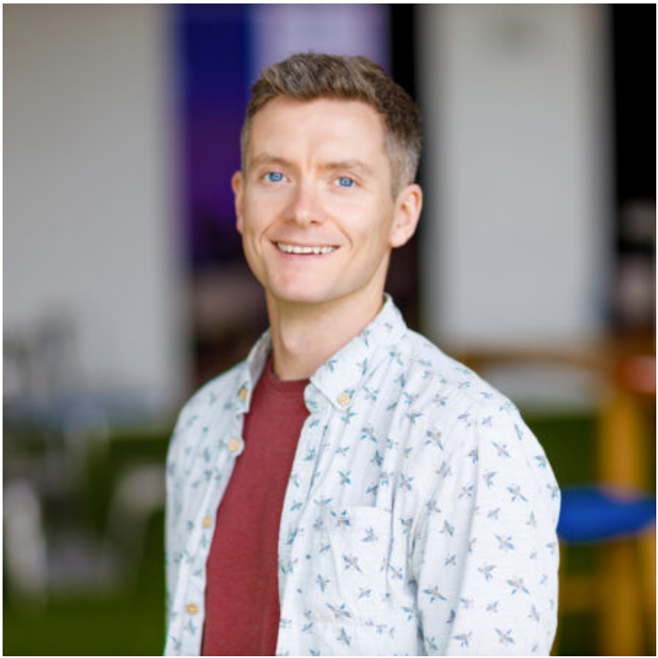
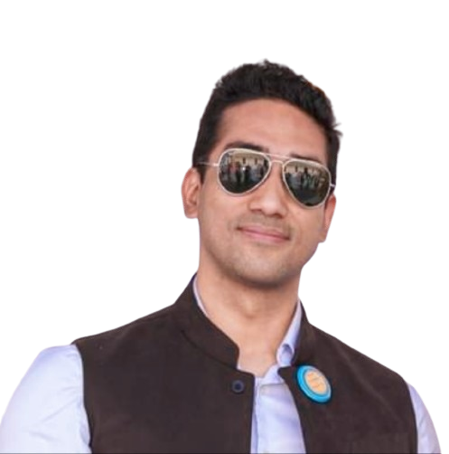
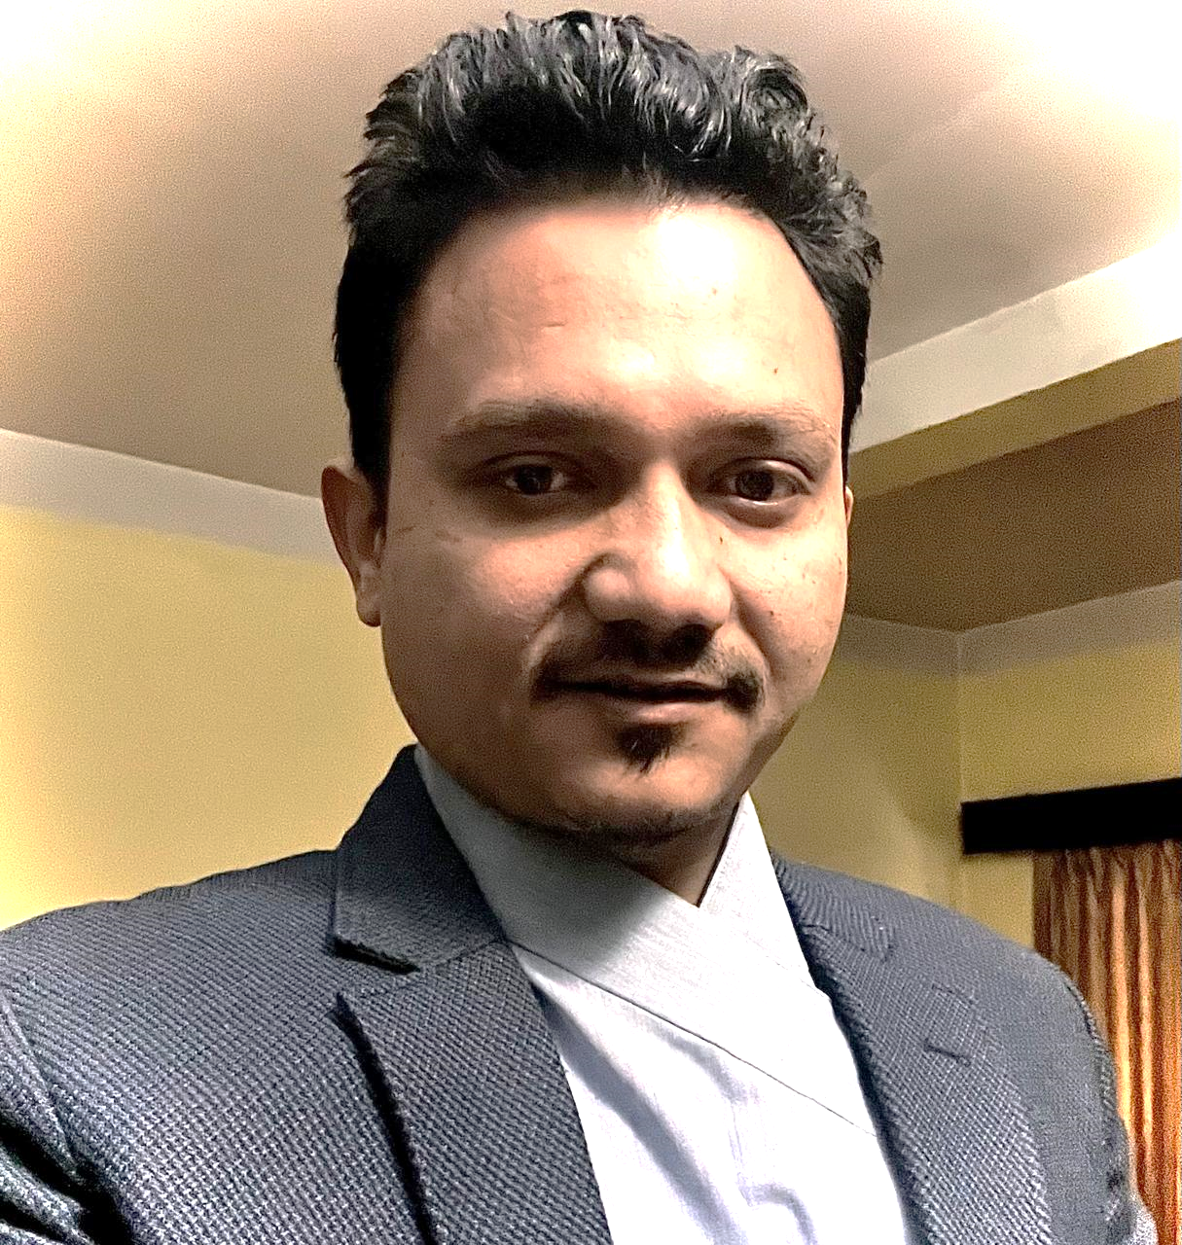
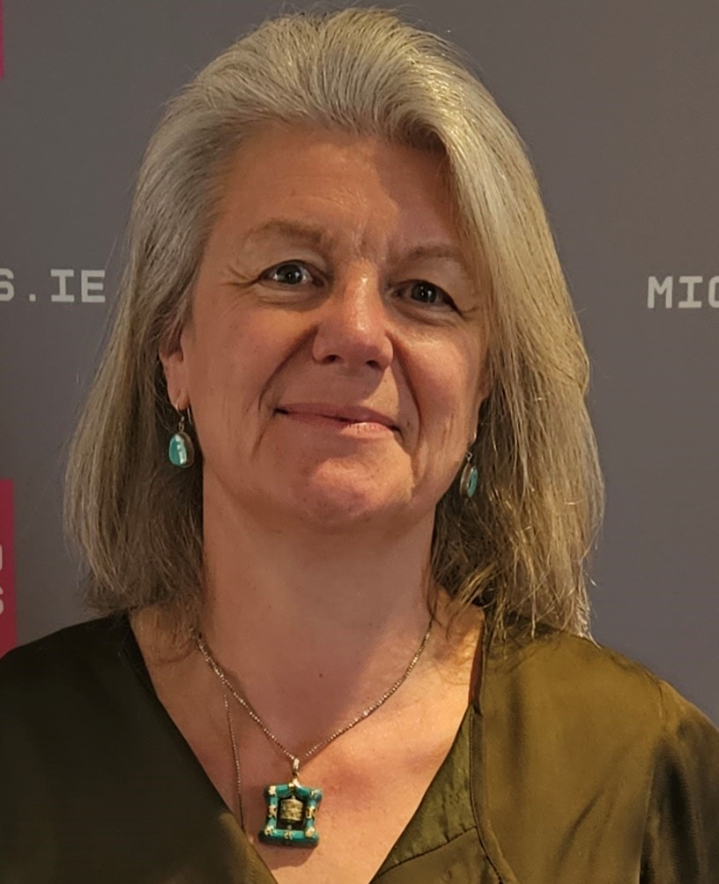
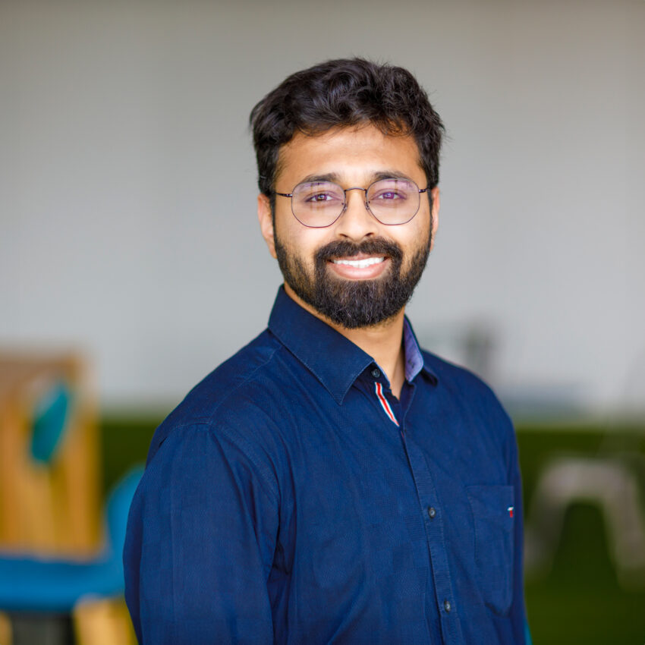
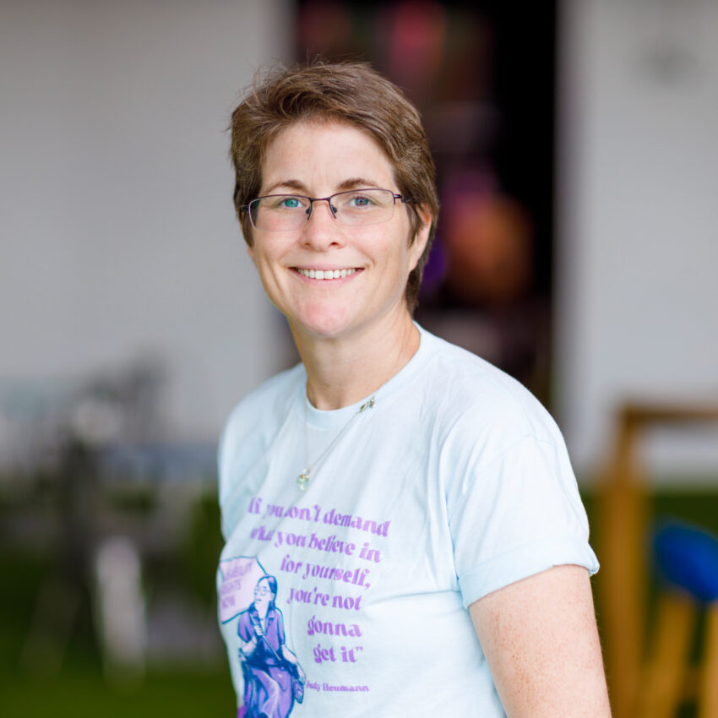
EFC Product Innovation Team 1
Ram Chandra Thapa
Innovator/Co-founder,
Zener Technologies
Dr Ben Oldfrey
Assistant Professor,
GDI Hub, UCL
Ashish Thapa
Research Assistant,
Design Lab, Kathmandu University
Amit Ratna Bajracharya
Certified Prosthetist
Managing Director
Limb Care Nepal
Ganga Gurung
Occupational Therapist
Co-founder, Bloom Park
Bikash Paudel
Engineer/Co-founder,
Zener Technologies
Pratisthit Lal Shrestha
Assistant Professor,
Principal Investigator, Design Lab Kathmandu University
Dr Rosie Gowran ​
Associate Professor​
Occupational Therapy, ​
University of Limerick
Dr Tigmanshu Bhatnagar
Researcher/Lecturer
GDI Hub, UCL
Prof Cathy Holloway
Director/Professor,
GDI Hub, UCL

Slide 15
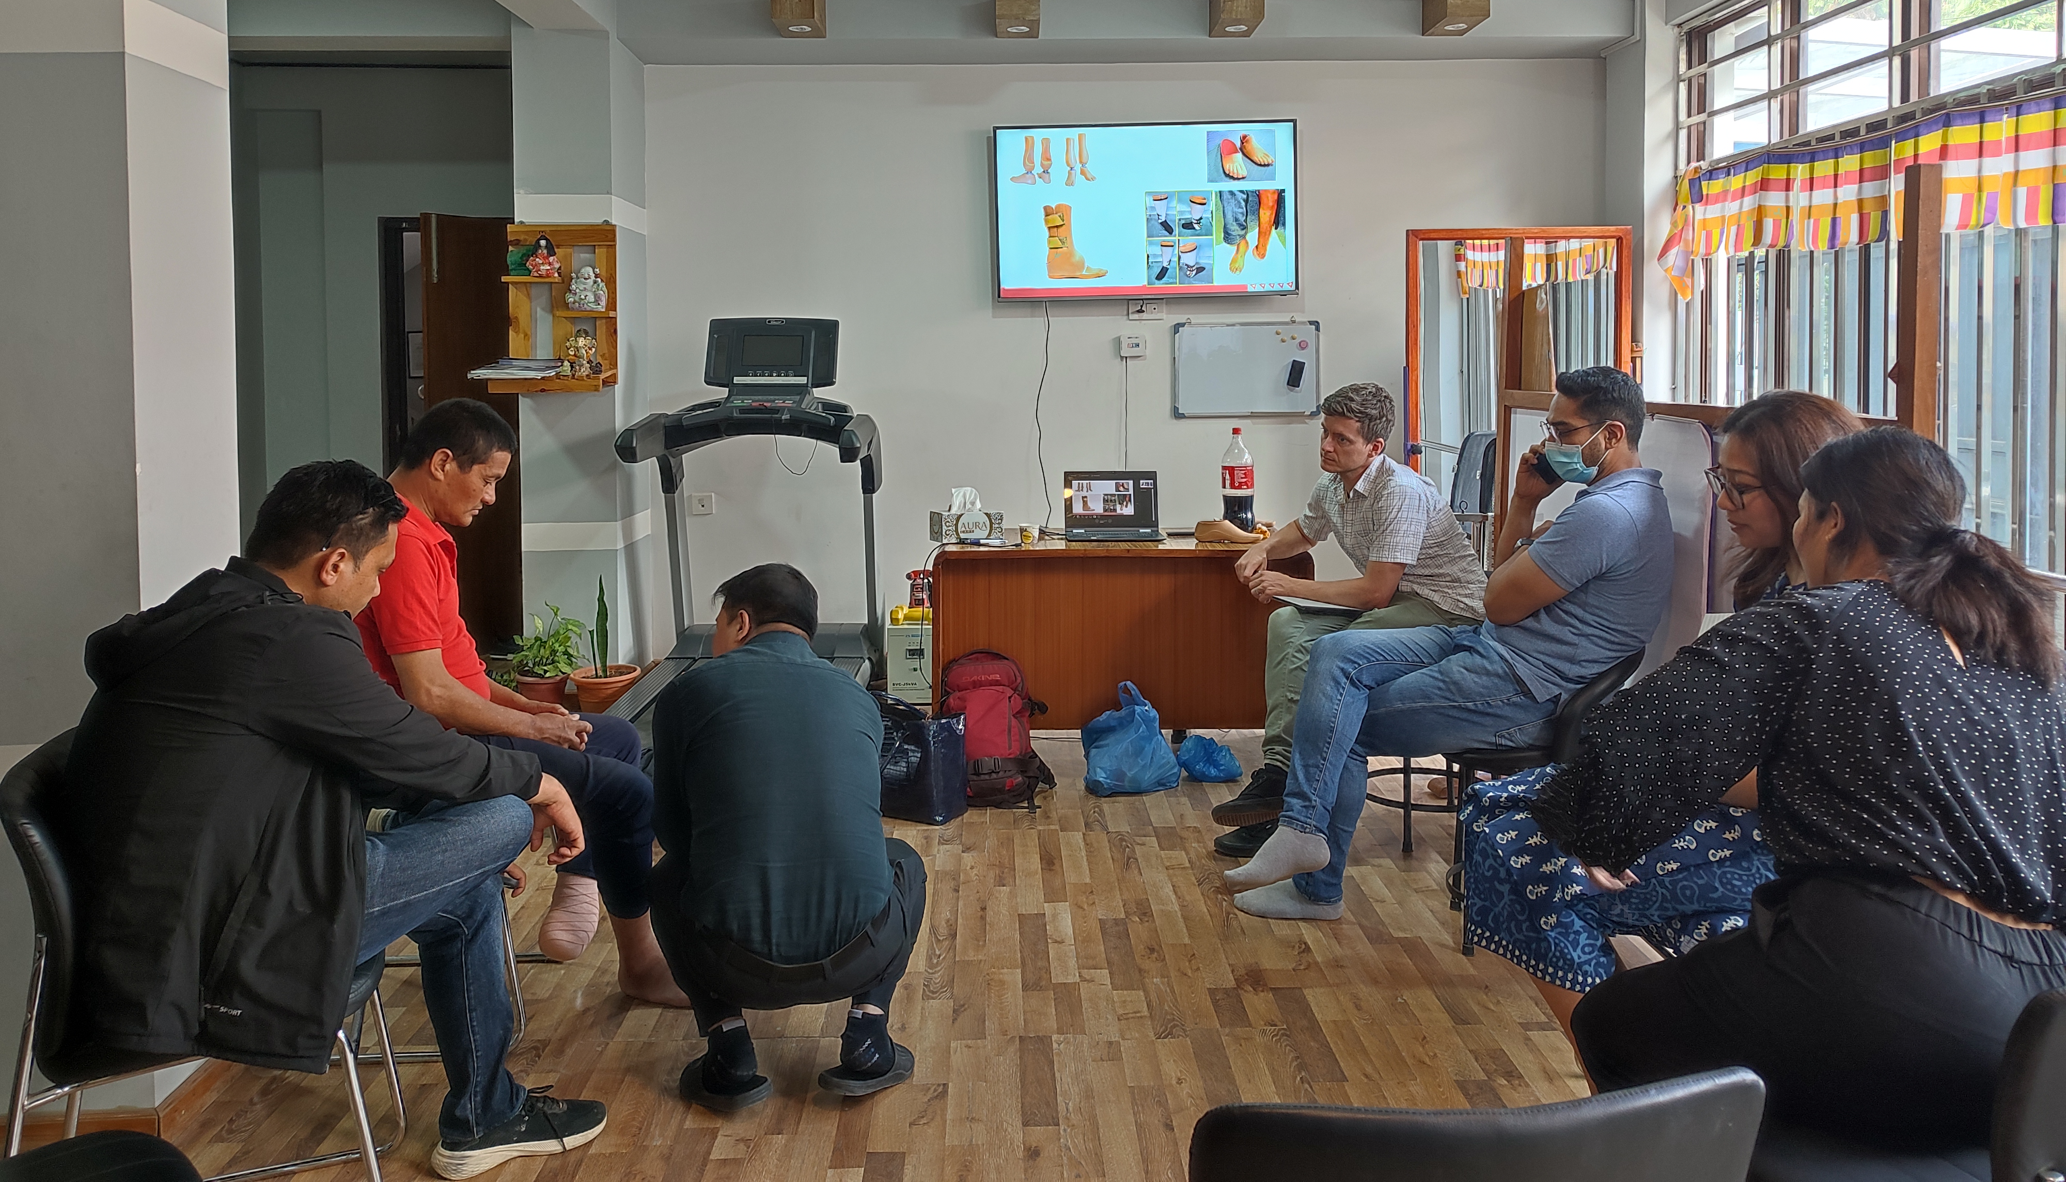
Researcher/ Engineer
Occupational Therapist
AT User
Researcher/ Engineer
Production Engineer
Certified Prosthetist
Certified Prosthetist

Slide 16
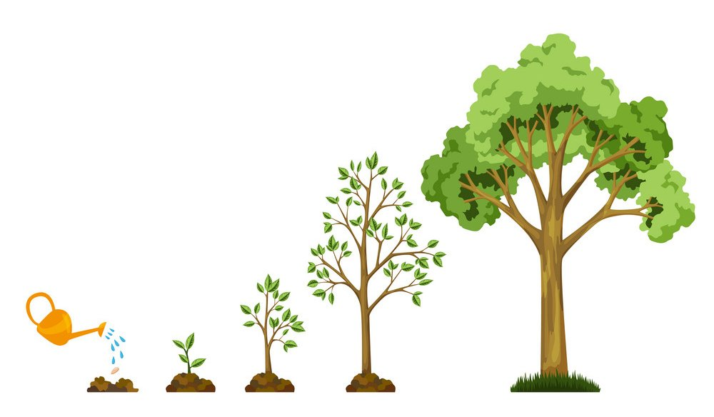
AT2030 Local Systems Strengthening: Nepal
Consortium
Workshops
Situational Analysis of Manual Wheelchair Provision
Wheelchair Spare Parts Pilot
Local Bespoke Product Development
Watch this Space
Watch this Space
UNICEF
Digital Manufacture of Children’s Prosthetics
Prosthetic Liner Production with Operation Namaste
Incoming for 2024

Slide 17
ASHISH THAPA RESEARCH ASSISTANT DESIGN LAB, KATHMANDU UNIVERSITY

Slide 18
Academia-industry collaboration
Academia KU/UCL/UL
Industry Zener
Clinics Limb Care Nepal Bloompark
Laying out alignment with standards such as COPM for outcome measurement
Platform for collaboration
People
Translating Users requirement to engineering specifications
Proper rehabilitation as per national/international clinical standards
Support in design and production
Ensuring sustainable repair and maintenance

Slide 19
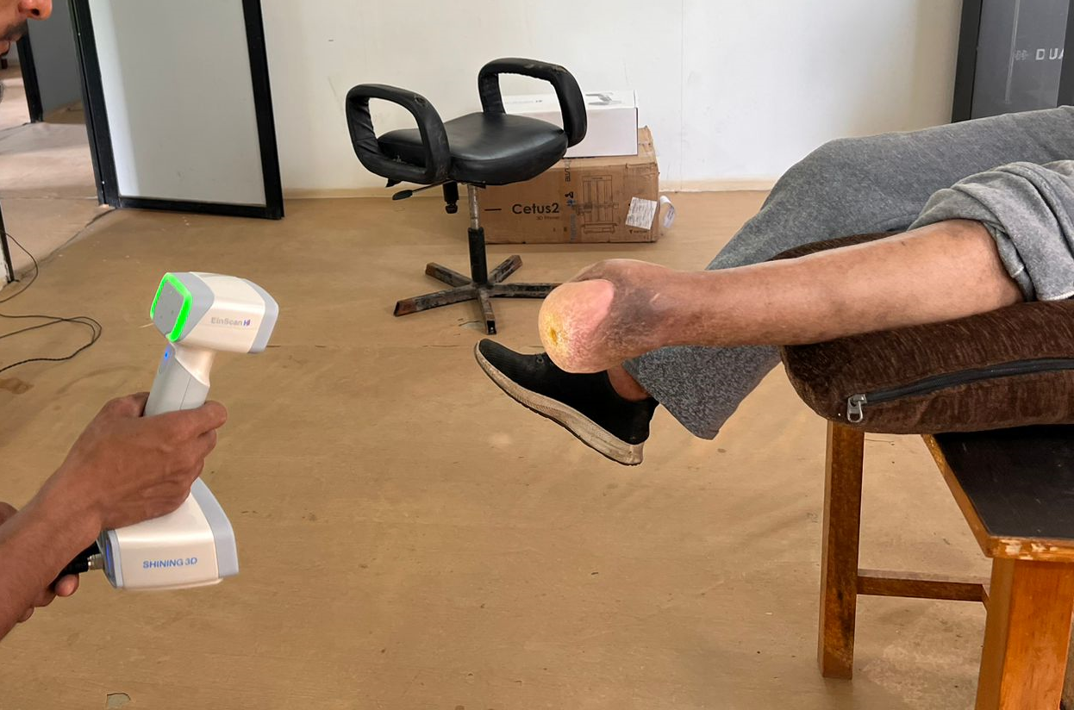
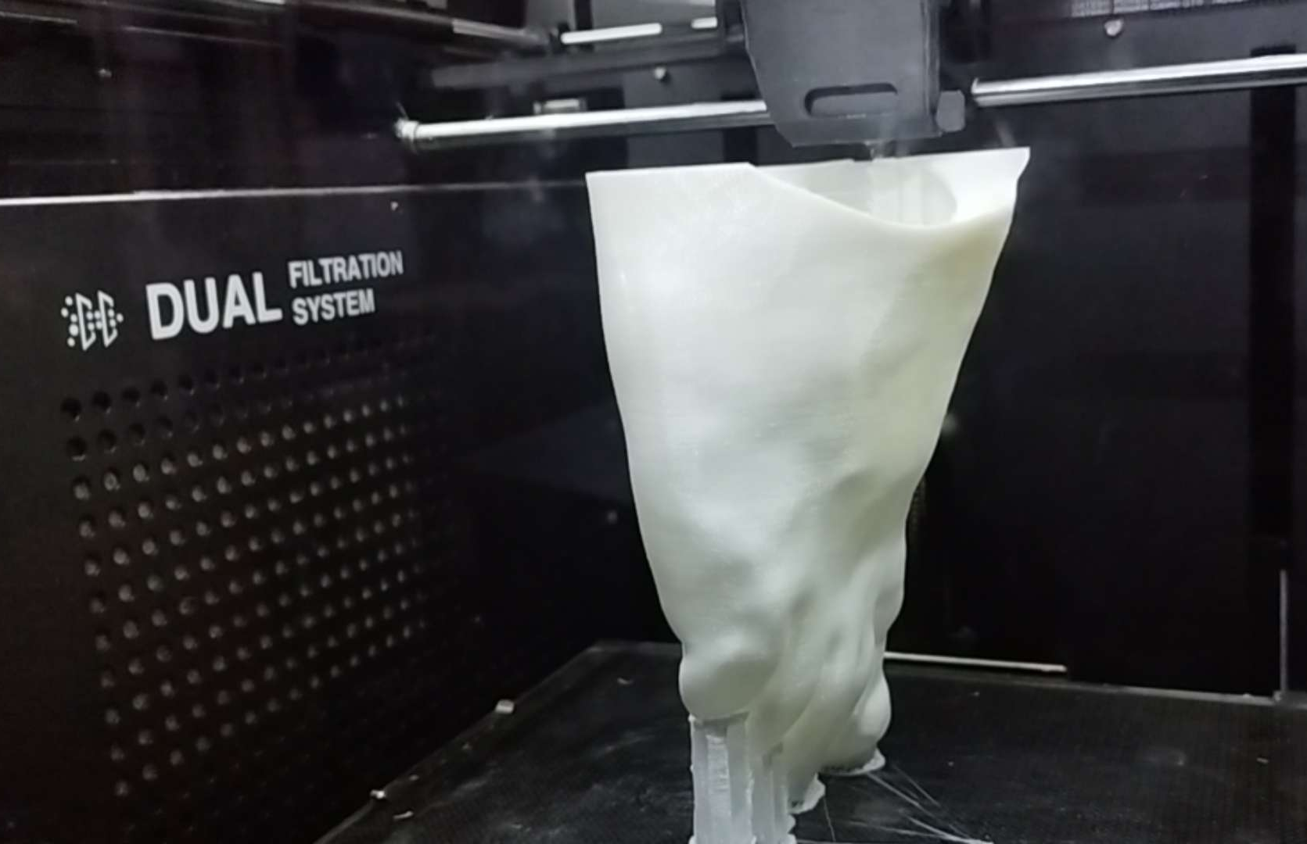
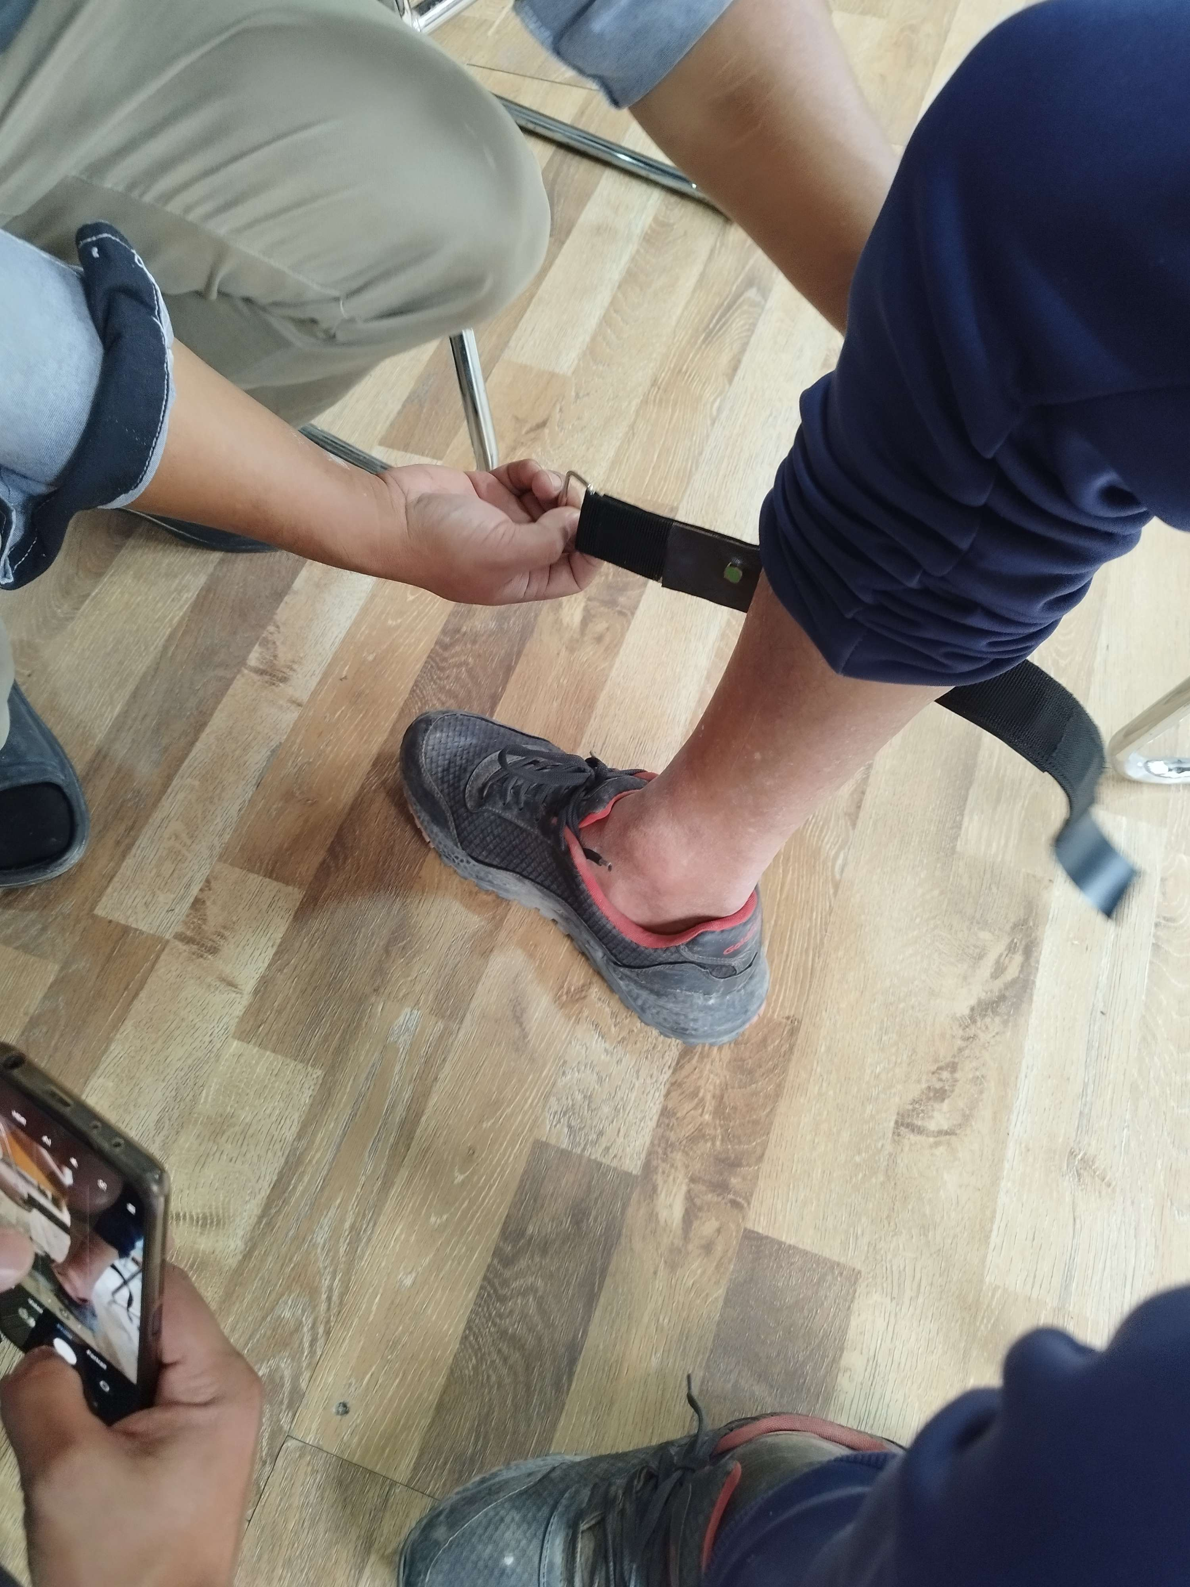
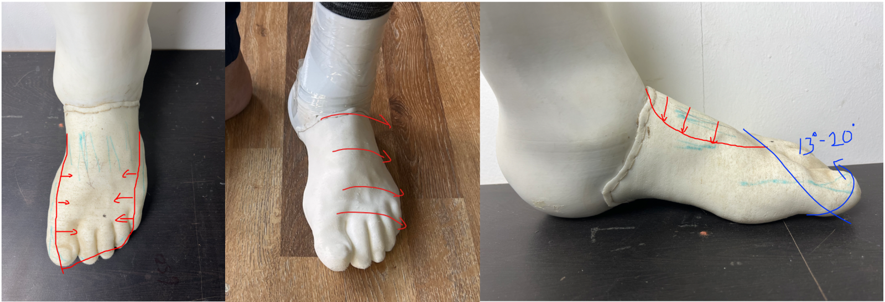
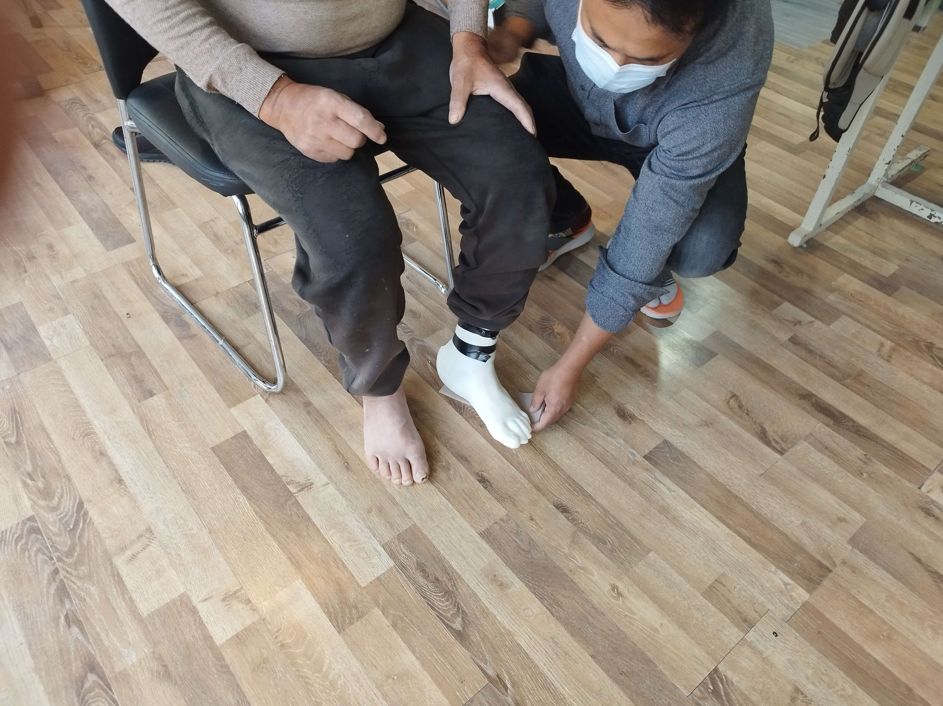
Co-design with User
3D Scan/ Measure
Design/ Modification
3D Printing
Fitting/ Testing
Clinical Assessment

Slide 20
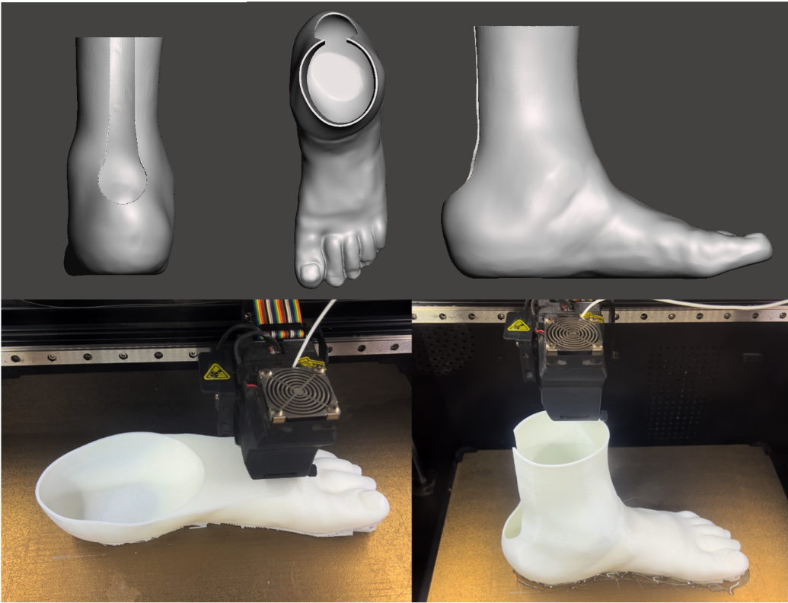
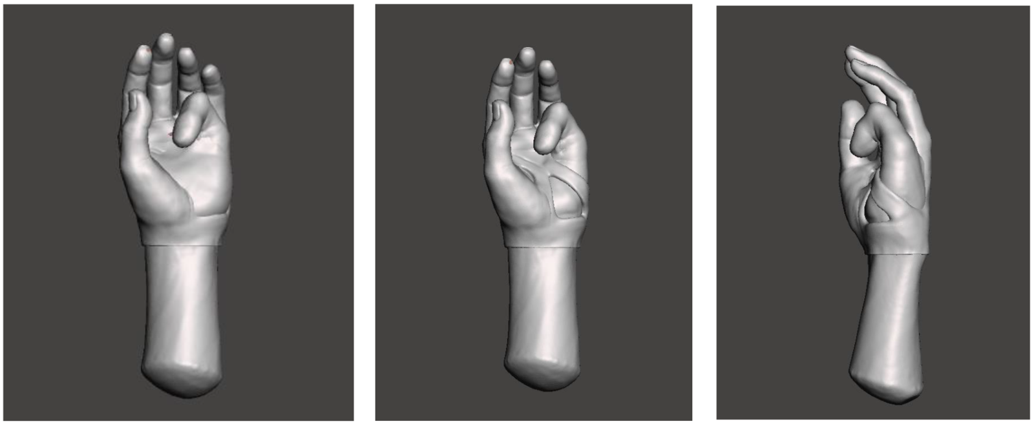
Fabrication process
Scanning
Digital modeling
3D printing
Testing
Iterations

Slide 21
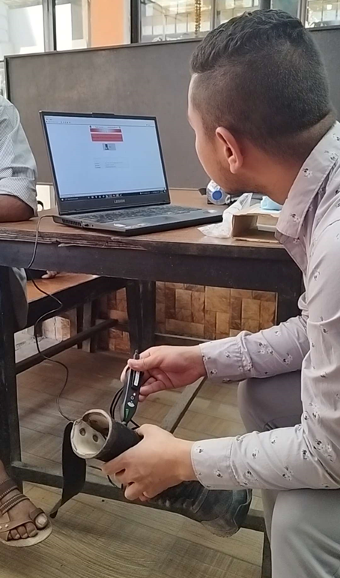
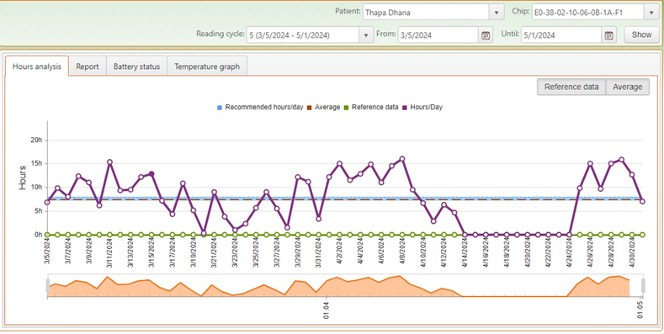
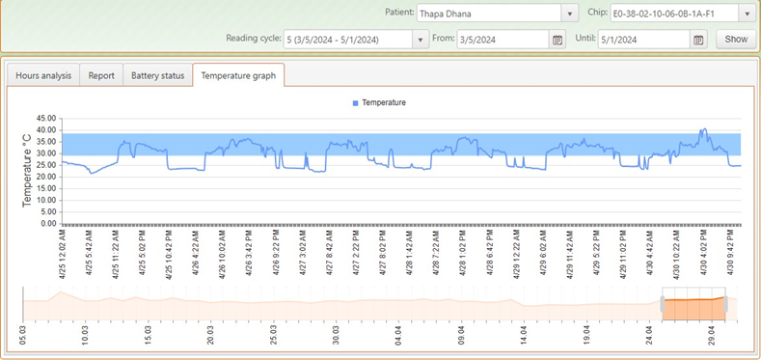
Orthotimer Data Capture and Logging

Slide 22
GANGA GURUNG OCCUPATIONAL THERAPIST COFOUNDER, BLOOM PARK

Slide 23
OCCUPATIONAL THERAPY – A key partner in Bespoke Assistive Product Development

Slide 24
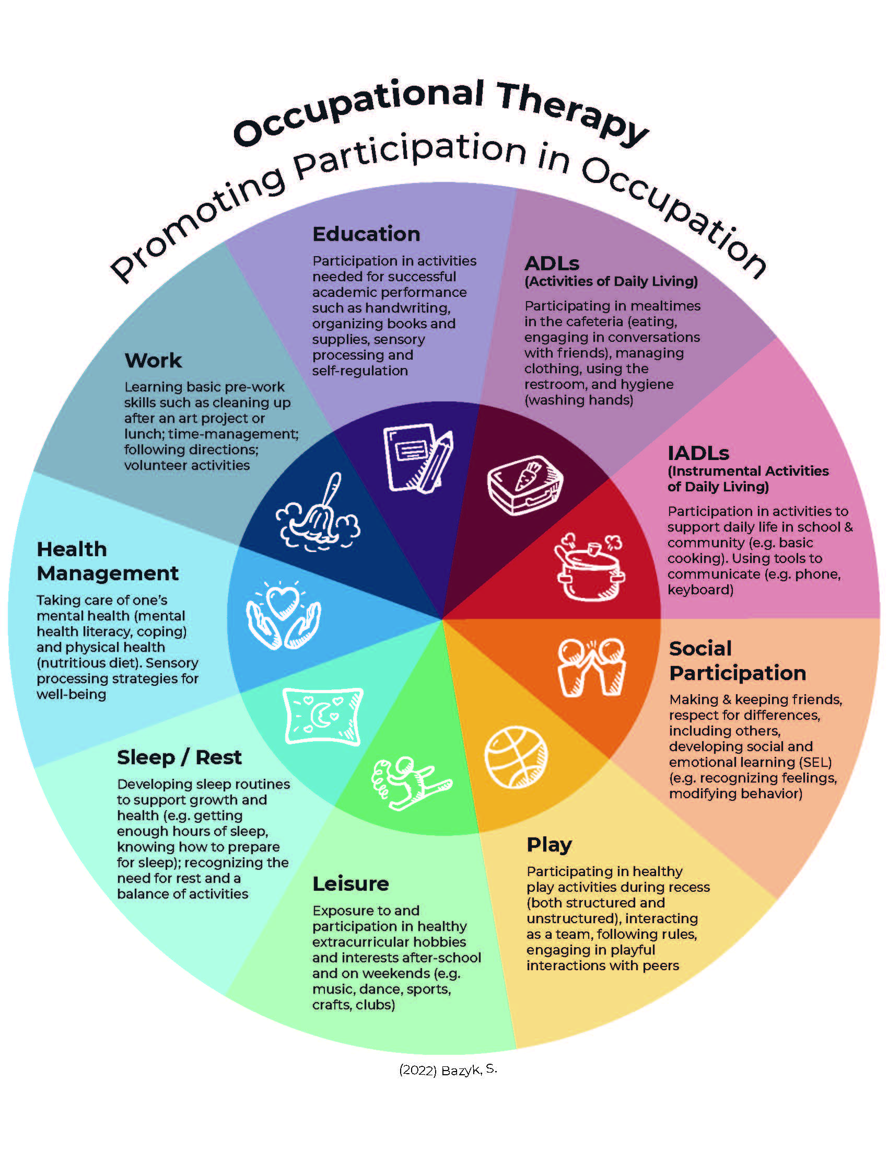
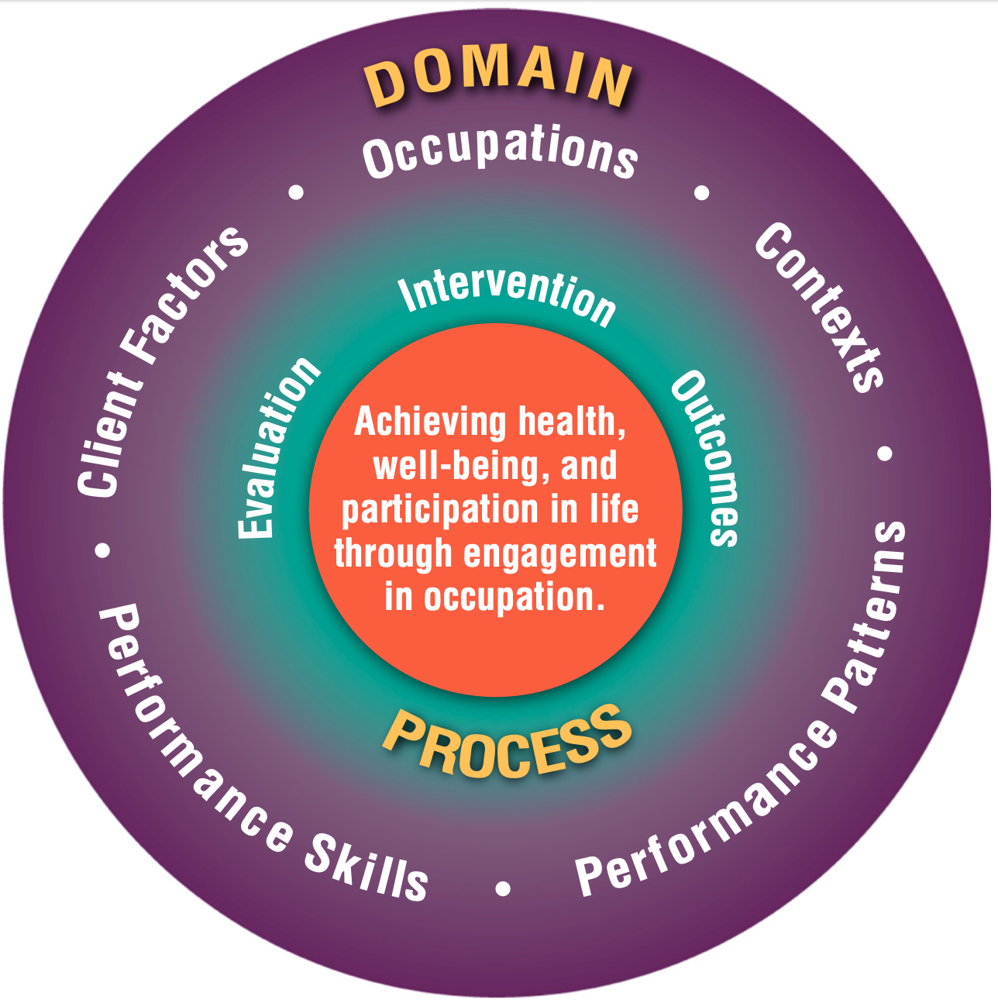
OCCUPATIONAL THERAPY LENS
Occupational therapy brings in a unique perspective to the team and interdisciplinary collaboration, with the person at the centre of bespoke product development and co-design.
Occupational Therapists take into account a person’s intrinsic and extrinsic narrative, considering physical, psychological, social, environmental and spiritual elements.
Christiansen & Baum, 1997; Christiansen et al., 2005; Law et al., 2005
Bazyk, S. (2022).
Occupational Therapy:
Promoting Participation
in Occupation.
Notes:
This holistic interdisciplinary approach truly situates the person as part of the team, central to co-design.

Slide 25
The Occupational Therapy Process
1. Evaluate:
Seek to understand a person's narrative, their story, the impact of amputation on daily life and the person's ability to do what they want and need to do or perform.
2. Prioritise Goals:
Build rapport, interview, understand the nature of amputation from the persons perspective
Identifying what is important and how well daily living activities are performed (Occupational Performance)
Recording importance, performances and level of satisfaction using the Canadian Model of Occupational Performance Measure(COPM) before and after bespoke prosthetic product use.
3. Collaborating with the interdisciplinary team:
Informing person-centred design, considering performance areas, patterns of doing and context of living and working, educational & counselling needs, need for adaptation: environment, exercises, energy conservation techniques, psychosocial adjustment.
4. Review, Reflect and Renew throughout:
Regular follow ups, gives a real picture of acceptability and sustainable use of the prosthesis, person's improved health and participation in life.

Slide 26
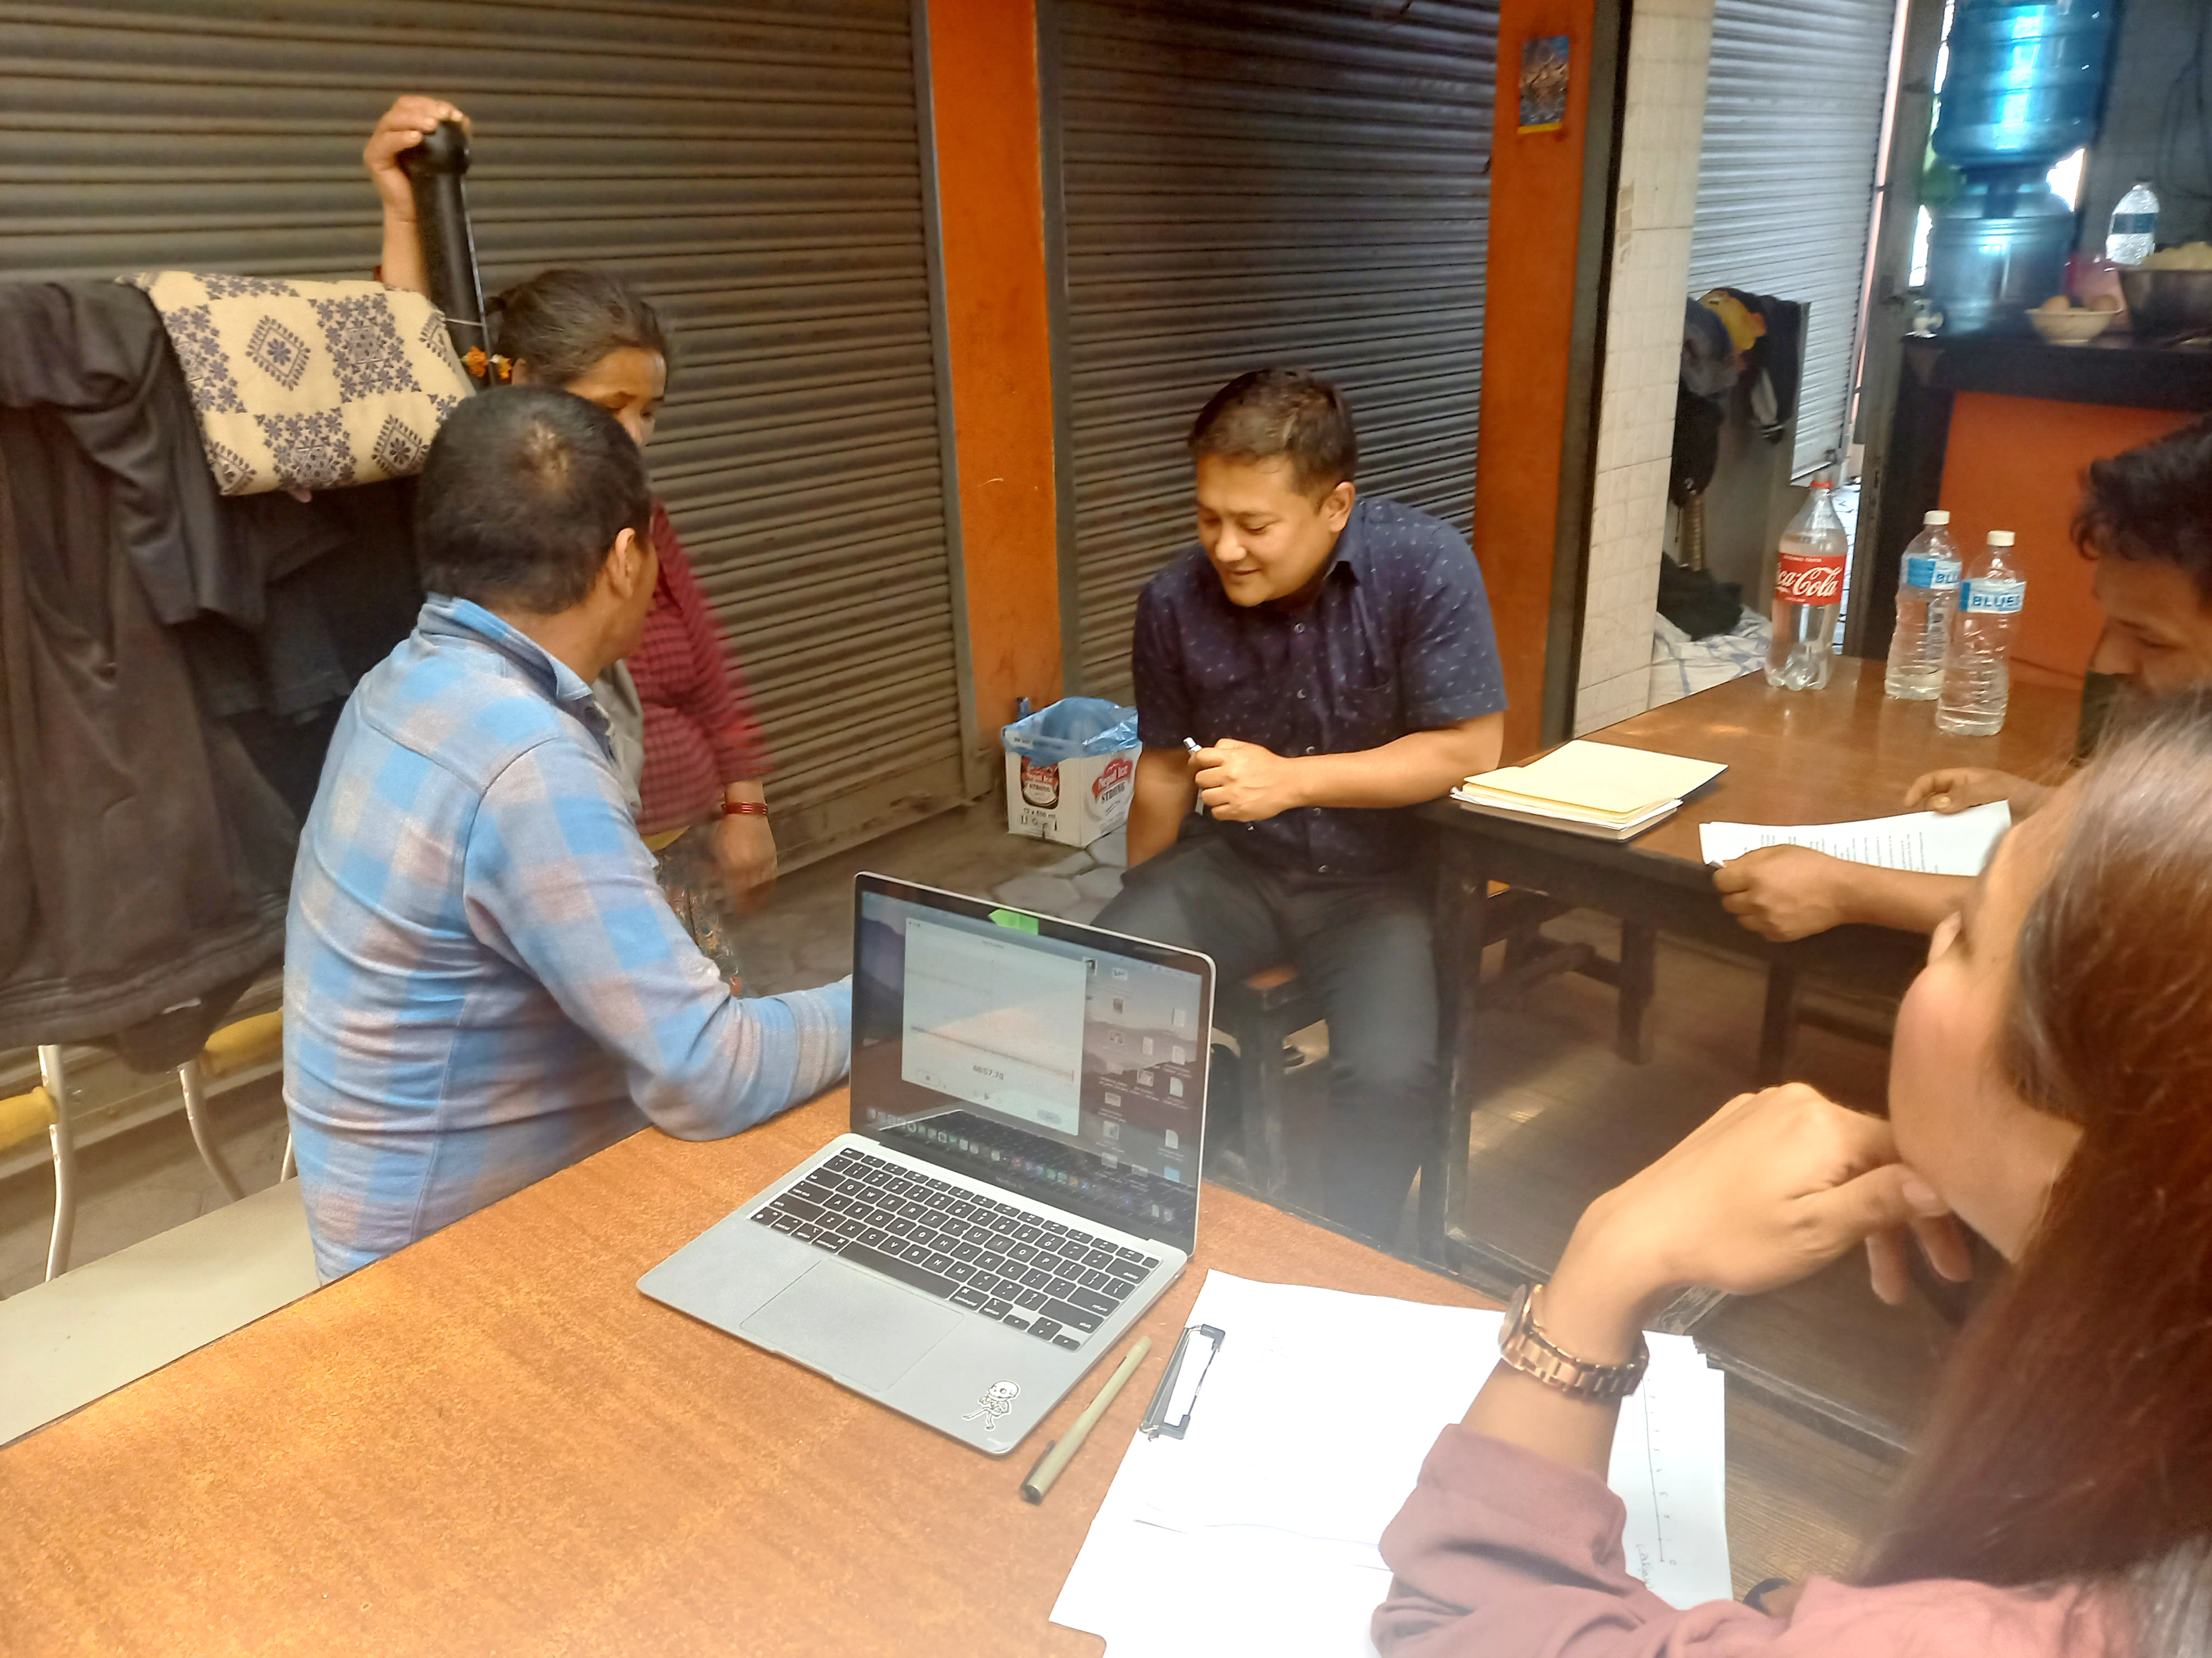
Participant 1 – Profile
Person: 54 years old man, primary occupation: Tea Shop / Driver
Diabetes for 20 years: greater toe injury led to lisfranc amputation
Mobilising with Axillary Crutches: never used prothesis following amputation.
Amputation impacted: work/driving, personal ADLs, walking long distances, play with grandchildren, meeting friends, amongst other activity limitations from a meaningful life.
During the design process: it was important that the functional prosthesis contribute to personal priorities and improved QOL, enabling purposeful and meaningful daily living activities.
Ongoing considerations: Diabetes, stump / wound care, prevention and health promotion addressed with constant follow-ups.

Slide 27
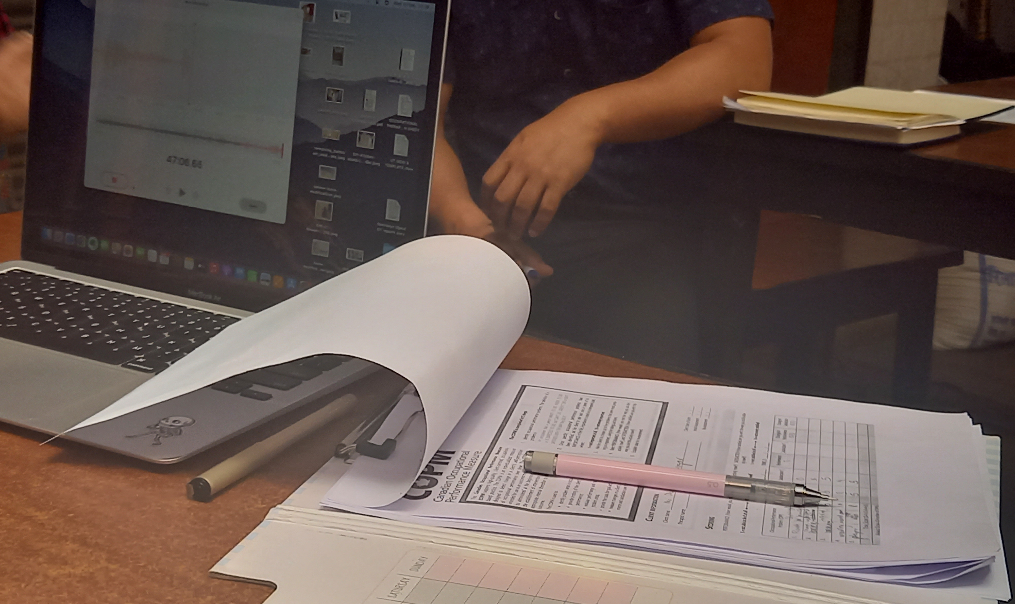
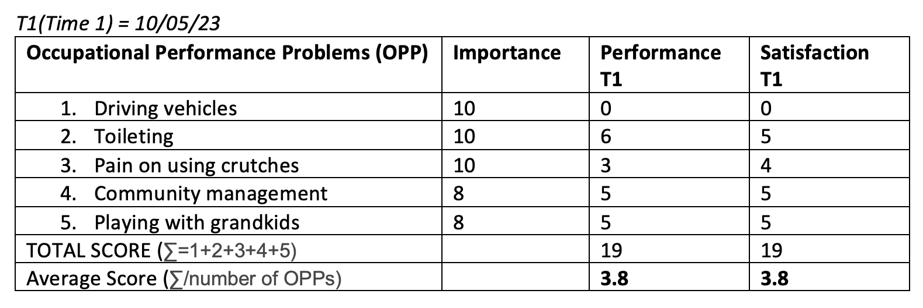
Participant 1 – Before
Notes:
He wants to be able to provide for his family by resuming driving, play with his grandchildren, send them to school, perform self-care independently, cook, visit around the community.

Slide 28
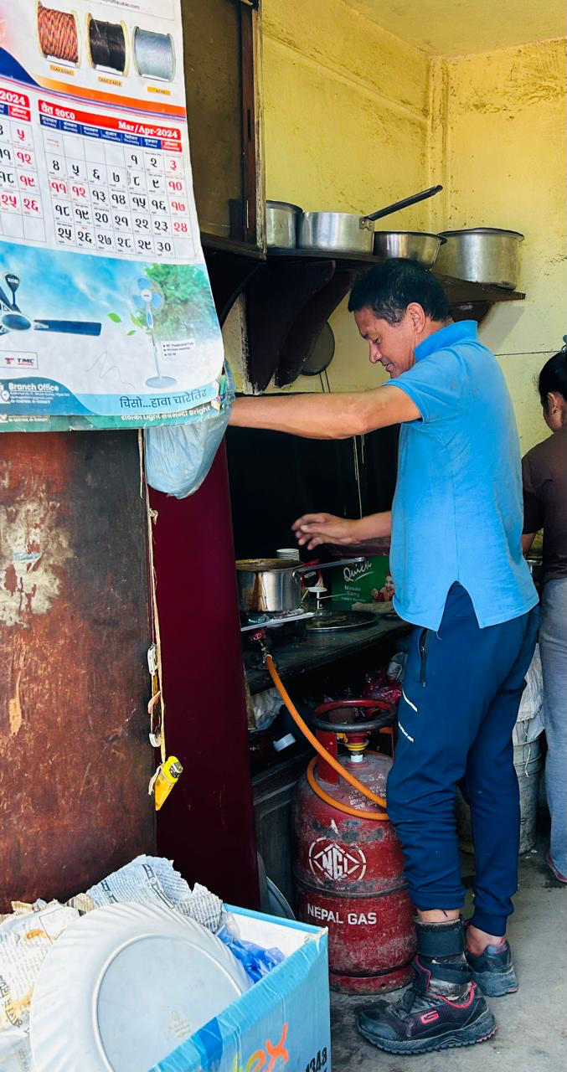
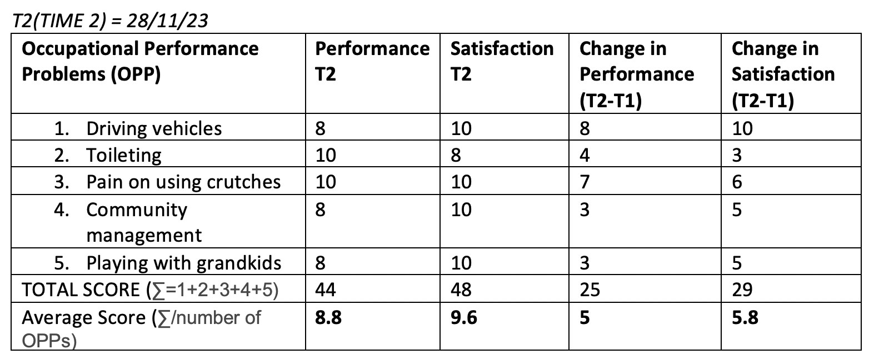
Participant 1 – with Bespoke product

Slide 29
Participant 2- Profile
Person: a motivated 26 years old man, enjoys socialising and driving heavy vehicles
Injury: Machine injury on left hand resulted in a partial hand amputation
Amputation impact: Hindered his driving license process, personal
ADLs and IADLs requiring bimanual hand use, social discrimination,
unable to do his current tailoring work dexterously
During the design process: Collaboration with the team for the
possibility of a functional hand, prioritising the participants' needs and wants
Ongoing considerations: Adaptive devices, desensitization of skin, improve self-esteem, education and counselling

Slide 30
Participant 2- Before

Slide 31
AMIT RATNA BAJRACHARYA CERTIFIED PROSTHETIST LIMB CARE NEPAL

Slide 32
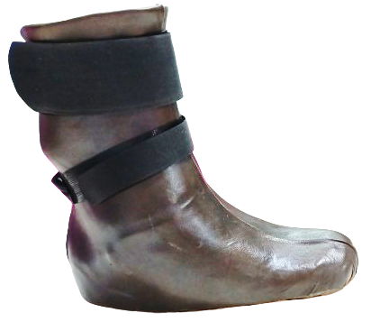
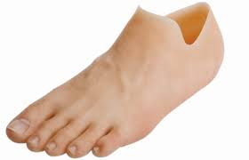
Although various prosthetic options exist for this level of amputation, our mission is to develop a digital intervention in capacity of local resources to the patient's unique functional needs that can tailored precisely in clinics of Nepal
Burger, Helena & Erzar, D & Maver, Tomaz & Olensek, A & Cikajlo, Imre & Matjačić, Zlatko. (2009).
Notes:
What we need here is sustainability, so the nation need to become more accustomed to local technology following technological advancements in the world.
I have seen that there are lots of indigenous innovations of products were made in Nepal. Our technicians who are best in their experience and skill are giving best solution even though they do not have academic qualification. But as it falls to subset of resources to create appropriate technologies which is also the demand of National standard of Assistive Technology of Nepal. But there is a Huge gap of Technical research in prosthetics and orthotics

Slide 33
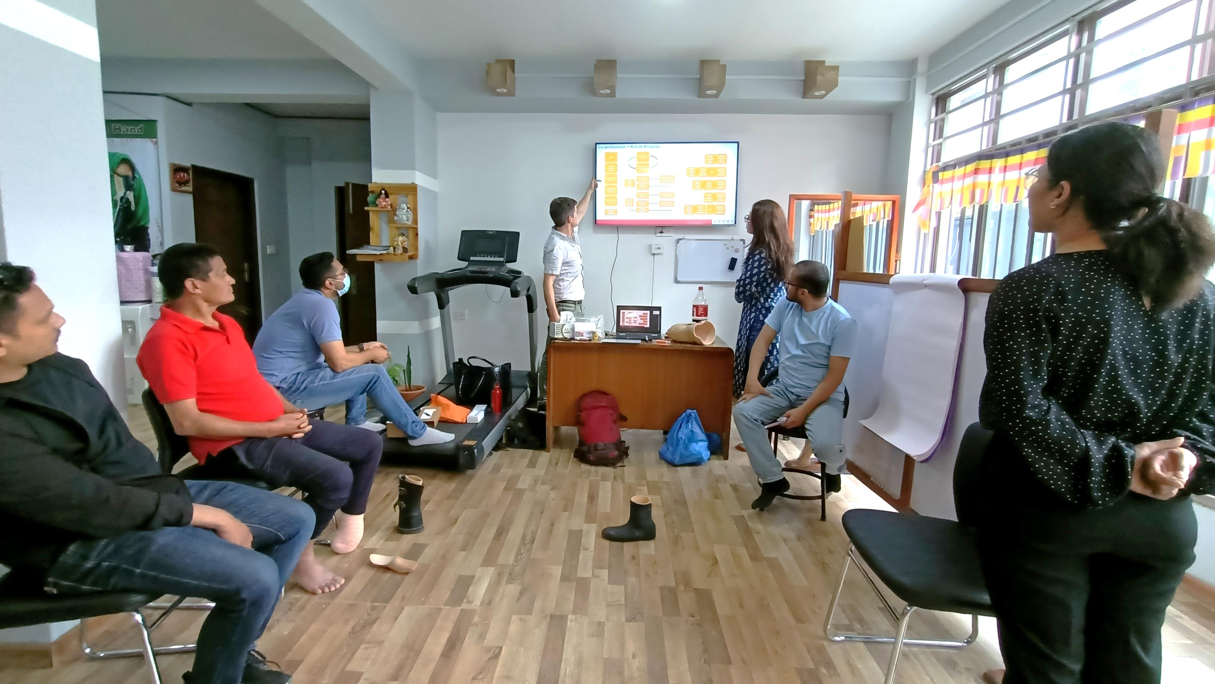
METHODS
Notes:
The plan and design focused on the patient needs. The first team session of designing involves client as the team member respecting right to choice approach.

Slide 34
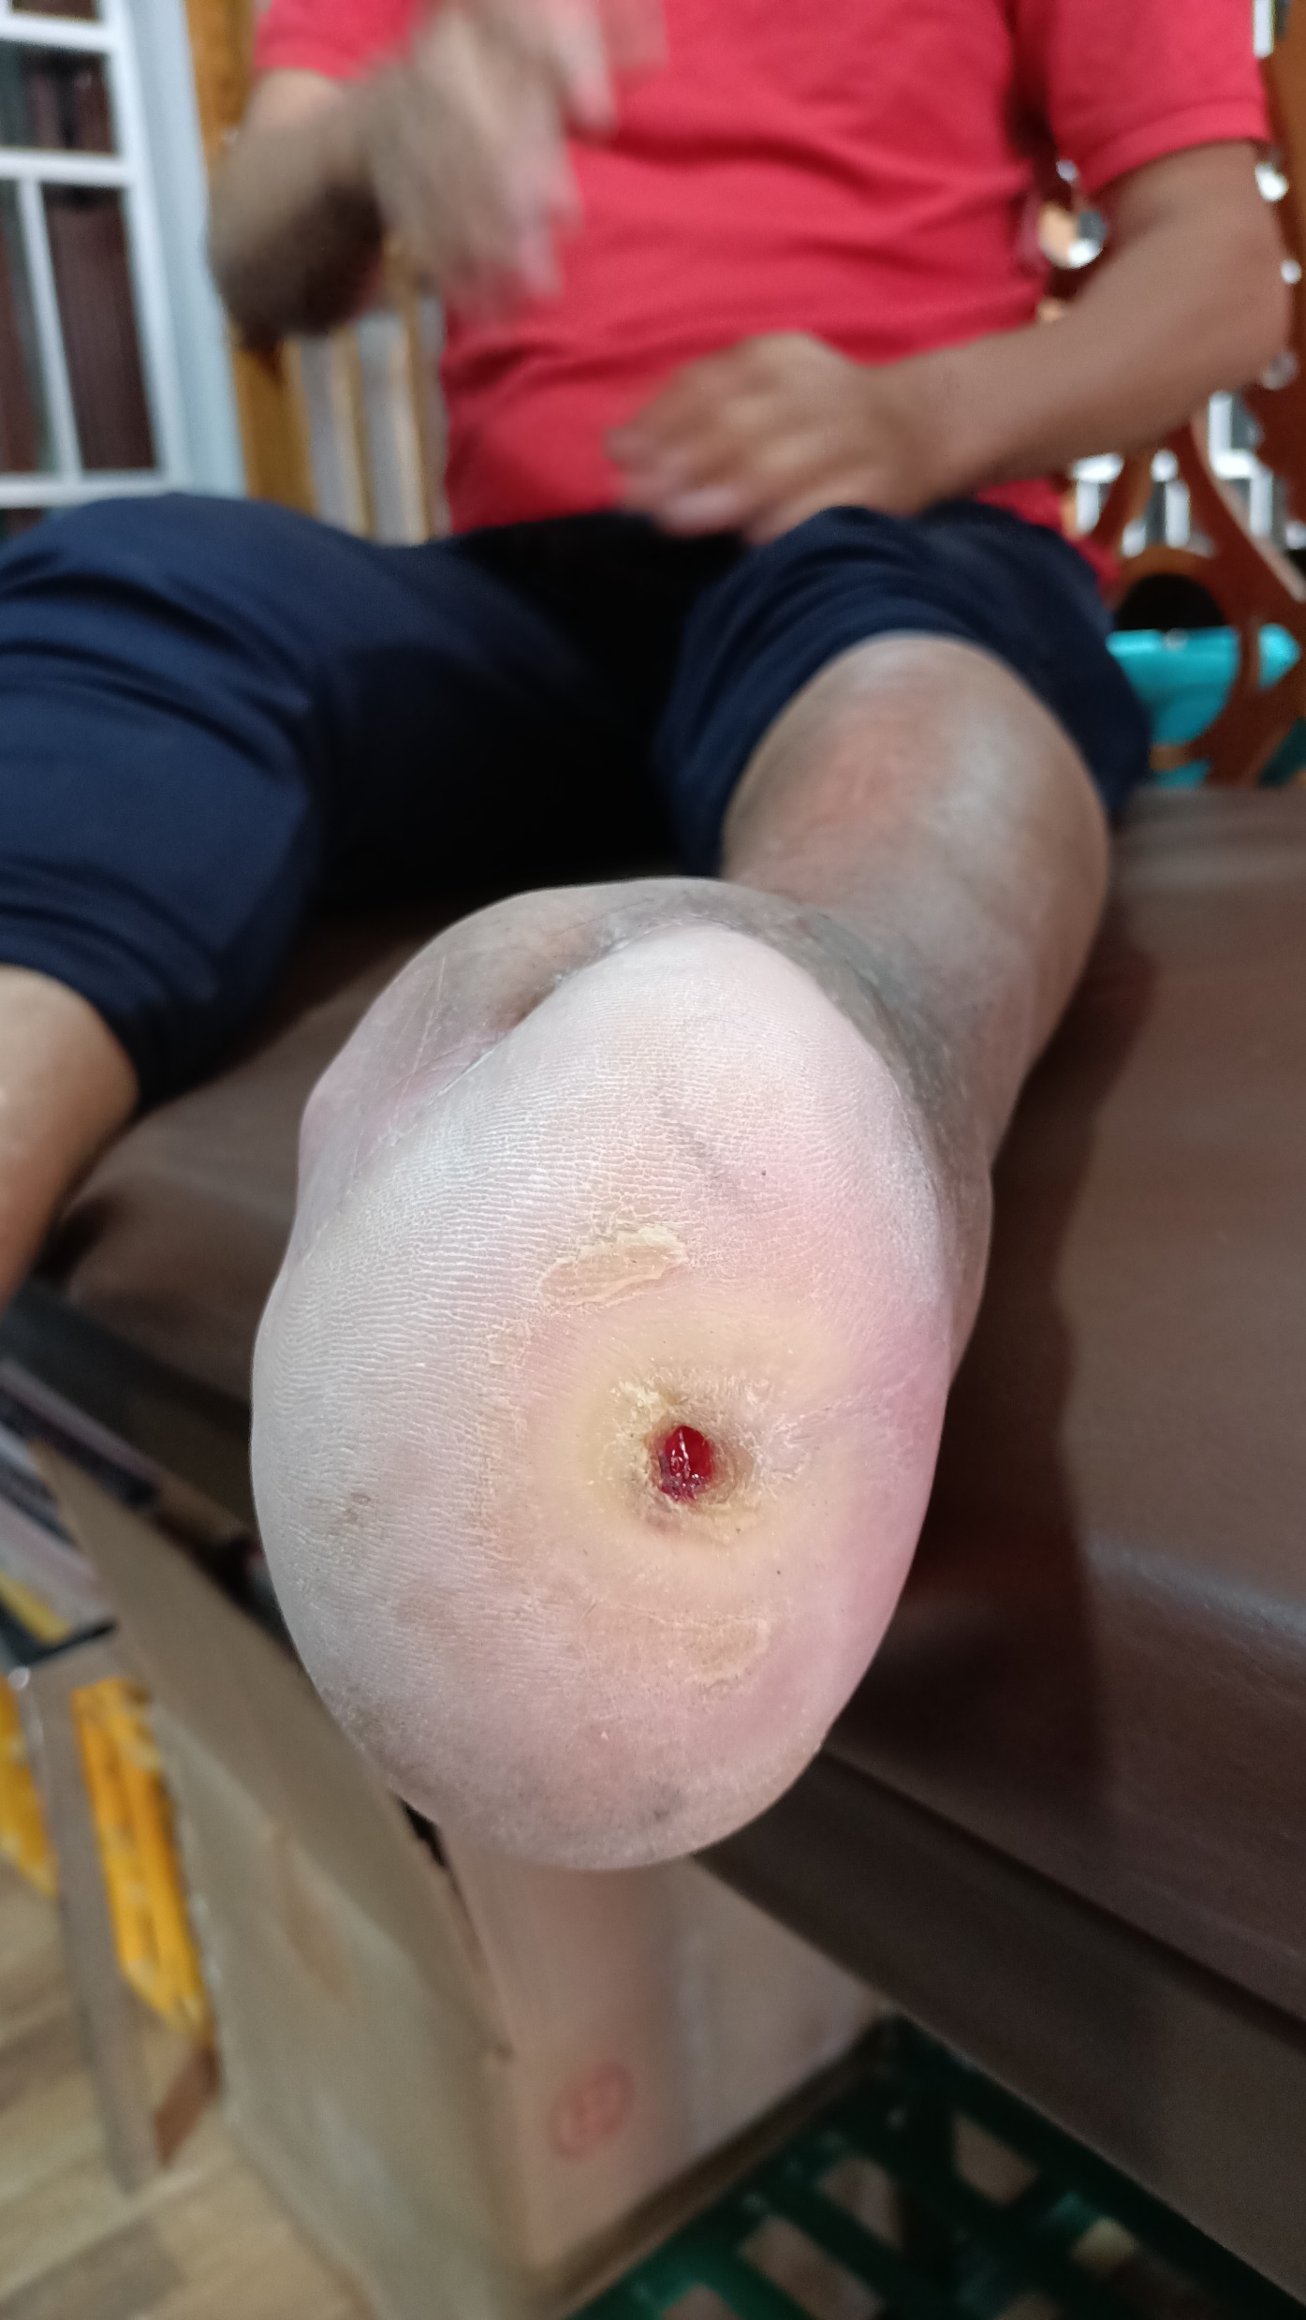
Lower Limb Case
52 years Male
Height 5.6 Weight 76.5
Occupation : Tea shop
Partial foot Amputation due to neuropathic foot ulcer
The open wound presented, protecting with bandages and was using axillary crutch for non weight bearing ambulation
Decreased ankle range of motion - dorsiflexion and plantar flexion limited to 90 degree. The good strength in knee extensor and flexors. The residual limb had equinovarus deformity with a limping/Antalgic gait pattern. The incision line was good and healed properly.

Slide 35
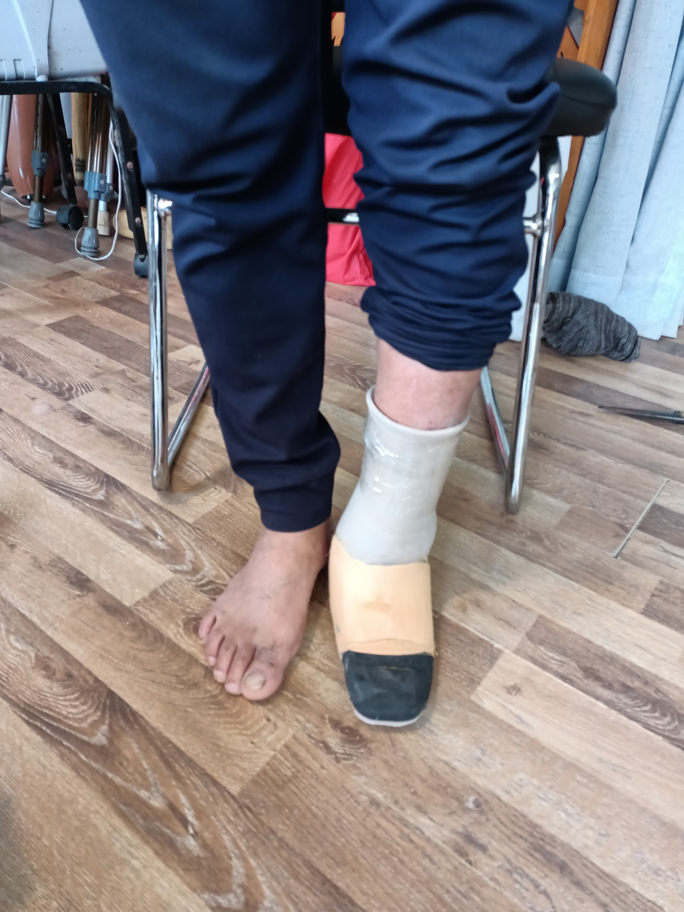
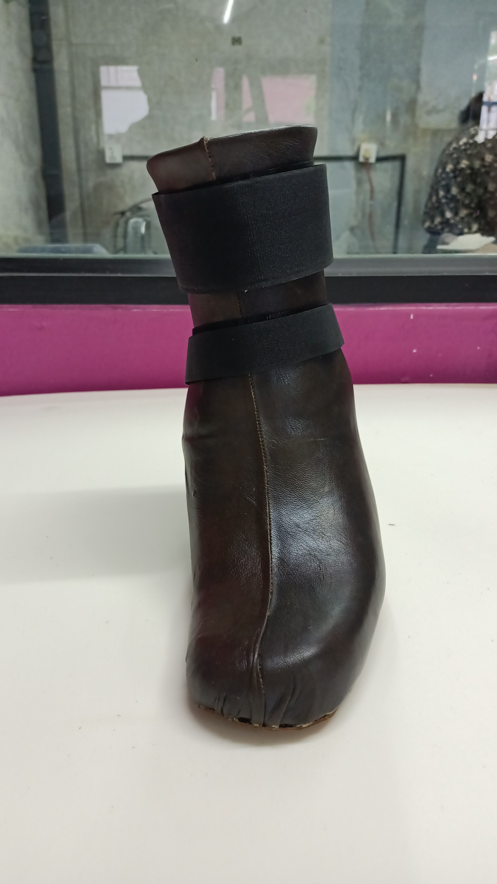
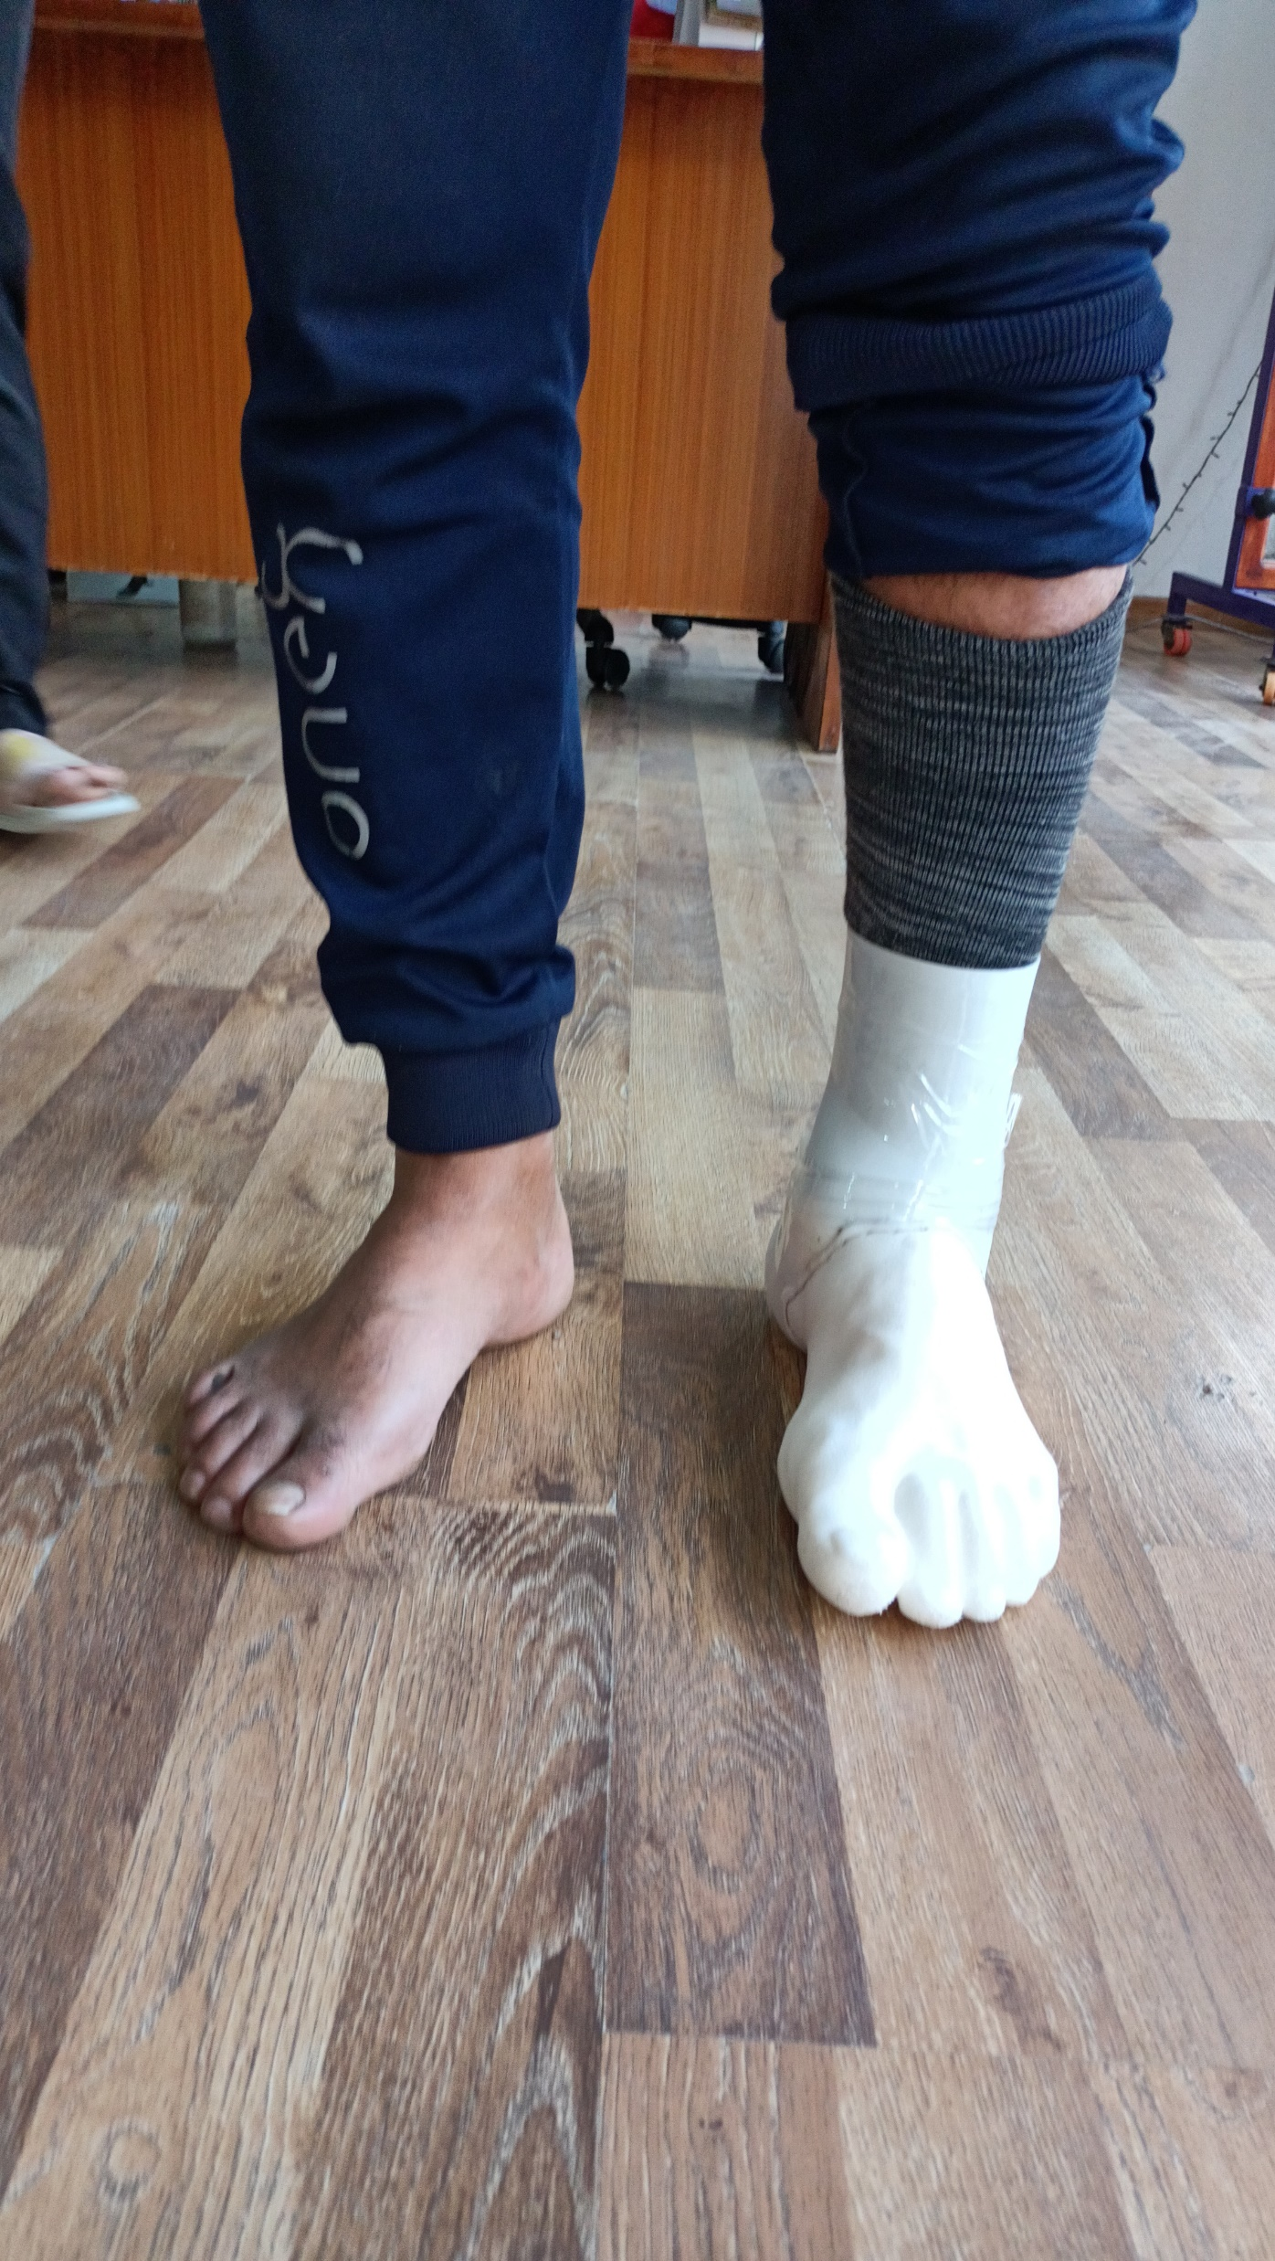

Slide 36
Administered 2 times
The three important activities | Day 1 | Day 84
Cooking | 1.4 10-20 % patient can do but impaired 80-99% | 6.75 50-60% patient can do but impaired 40-59%
Driving
Fetch grand children from School
Use of Toilet
Minimal detectable changes for average score (90%CI) = 2 points | Difference | 5.35

Slide 37
Administered PLUS M – 3 Times

Slide 38
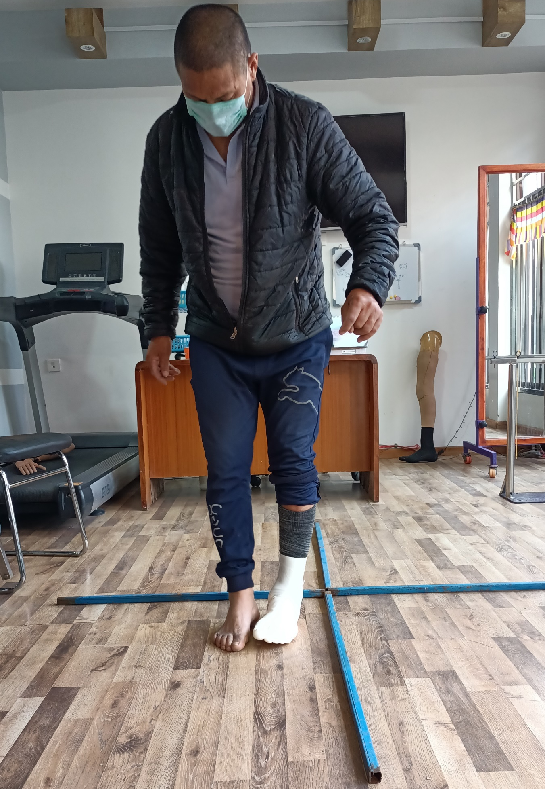
Four Square Step Test

Slide 39
2MWT Vs Socket Comfort Scores
Notes:
The 2MWT in 3d printed prosthesis was not performed because socket comfort score informed was 7, he felt slightly discomfort but tolerable while donning the 3d printed prosthesis. In conventional prosthesis socket comfort score was 9, he felt very mild discomfort in the first day and after a month the socket was the most comfortable and pain free.

Slide 42
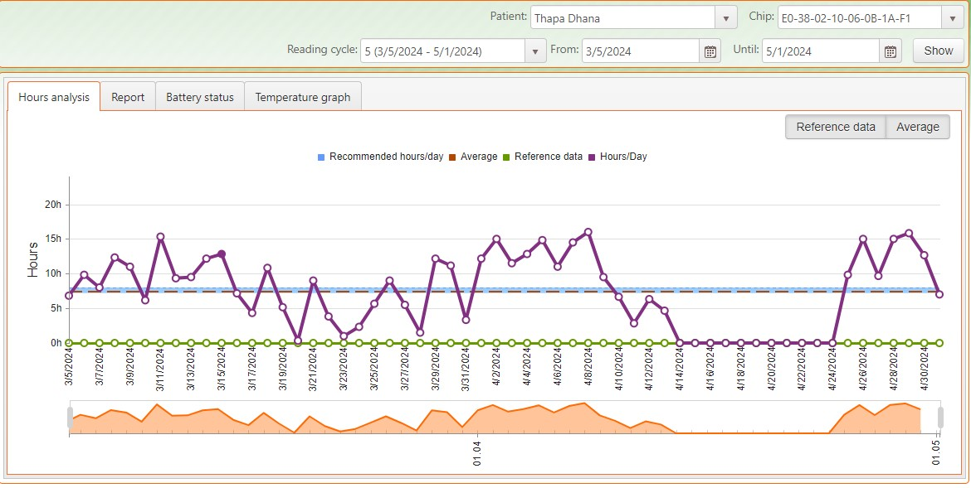

Slide 43
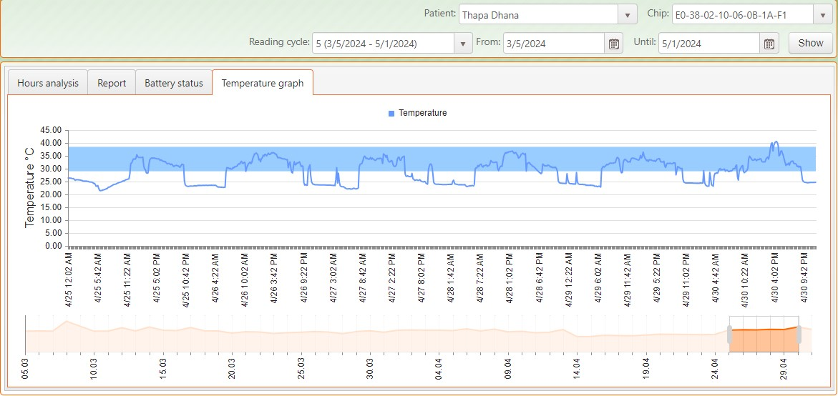

Slide 44
Discussion
Our thoughts in making technology appropriate rather than just fulfilling the need by importing it from the outside. So, I would like to say again, it is not just about the production of the device; we perceive it as an opportunity to establish a model for creating a domestic resource finding system within the nation.

Slide 45
THANK YOU!

